Slide 1
Crash Report
(HSMV90010S)
Rev 11.3.21

Slide 2
Directory
Signing In
First Time Users
Default Search
Day / Night Mode
Changing the Password
Connectivity
Running Tags / DLs
Starting A Crash
Managing the View
Filling Out the Form
FLHSMV Online Manual
NCIC Importing
Driver’s Exchange
Importing Roadway Information
Finding FL State Statutes
Diagram
Hit & Run
Narrative
Submitting the Form
Updating the Form

Slide 3
Signing In

Slide 4
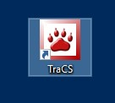
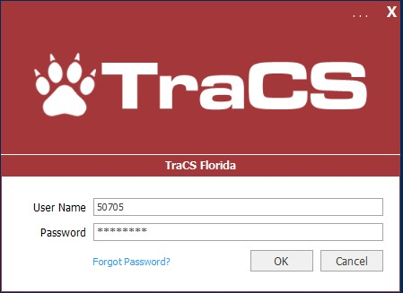
Launching TraCS And Signing In
Launch TraCS
Sign in with your user ID and password
If you don’t know your ID & password ask your system administrator
Some agencies use the same log in information as the Windows log in ID & password (Active Directory)
Some agencies use department email addresses for log in information
As of baseline version 20, the User Name will no longer show and you will be required to type it in everytime.

Slide 5
First Time Users

Slide 6
Initial Setup
Set your default search
Pick day/night time mode
Change your password (those not using active directory w/ TraCS)

Slide 7
Default Search

Slide 8
Favorite Searches - Officers
Officers should pick their User ID in the General search tab
Officers should pick Open and Rejected under Status in the General Search tab

Slide 9
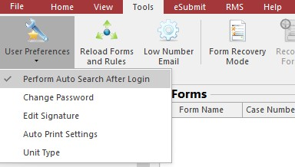
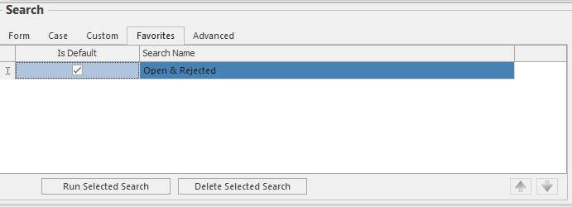
Favorite Searches - Officers
Press the Save button under the Favorites label
Name your favorite default search and check Is Default
Under Tools/User Preferences, Check Perform Auto Search After Login
Now upon logging in, officers will automatically see all open and rejected forms, or rather, they will see all work that they’ve yet to validate which requires their attention

Slide 10
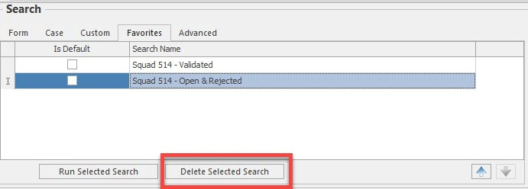
Favorite Searches - Supervisors
Supervisors may have multiple searches
They should pick their squad members from user ID field
They should have a search for Validated reports for status
They should also have a search for Open and Rejected for their squad to make sure officers are validating reports in a timely manner
If members of a squad change, supervisors must delete the favorite search and recreate a new one

Slide 11
Pick Day/Night Time Mode

Slide 12
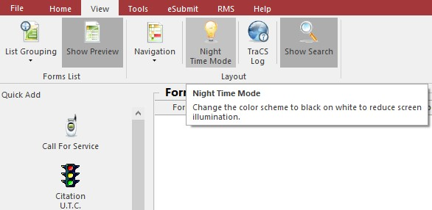
Day/Night Time Mode
To toggle between day/night time mode, go to the View tab and press the Night Time Mode button.

Slide 13
Change Password

Slide 14
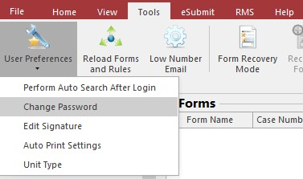
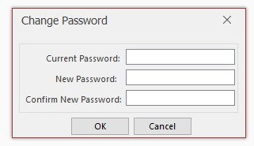
Change Password
Go to Tools/User Preferences/Change Password

Slide 15
Connectivity
If you see the green wifi bars this means you are able to complete reports and sync them up to the station.

Slide 16
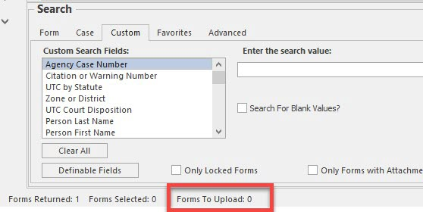
Connectivity
After closing a form, you’ll notice at the bottom TraCS will say ‘Forms to Upload: 1’
As long as your wifi bar remains green, you will notice within 30 seconds it will change to ‘0’ which means it made it to the station.

Slide 17
No Connectivity
If you see the red wifi bar this means TraCS cannot connect to the internet or to the server.
First, check that your aircard and your VPN is all connected properly
If your internet and VPN both appear to be working and you still see red, contact your IT

Slide 18
Run Tags/DLs In NCIC/FCIC

Slide 19
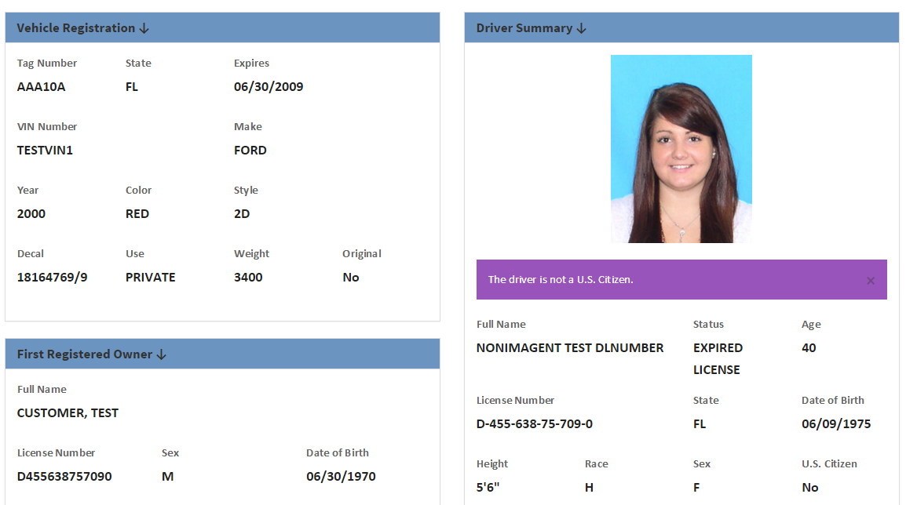
Run Florida DL’s & Tags In FCIC
Before you open a form, run your DLs and Tags in your FCIC
OFFICER SAFETY…Make sure the person and car does not have a possible hot file hit!
This will allow you to import data into a clipboard for use on the TraCS forms
If you use the TraCS NCIC tool (ELVIS) you can import cars and people from across the US and Canada…and you can get license photos too!

Slide 20
Starting A Crash

Slide 21
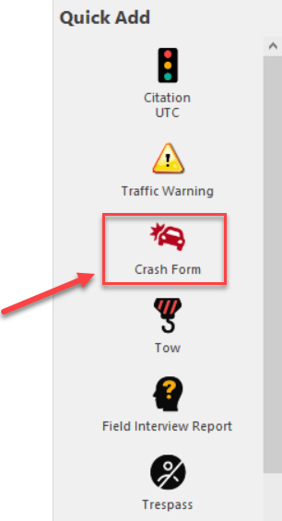
Launch A Crash Form
Click on the Crash button on the left navigation panel

Slide 22
Starting A Case
Upon opening a form, this box will come up. Click CREATE.
You do not have to use it, but if you want to, you are welcome to enter some details to help you remember the case you are working

Slide 23
Managing The View

Slide 24
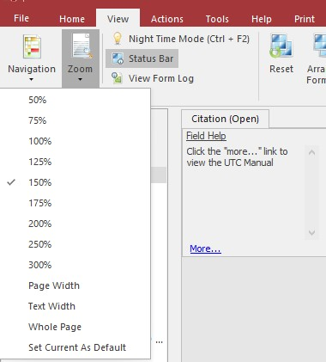
Zooming The Form In
Under the View tab there is a Zoom button
Page Width will stretch out as far as possible
Once you select the zoom you wish to use. Click on view, zoom and then scroll to the bottom and select “Set Current As Default”. This will use the same zoom for the next form that is opened. Please note: you must set the zoom separate for each form.

Slide 25
Night-Time Mode
Under the view tab there is another opportunity to turn on night-time mode

Slide 26
Navigation Panel
Under the View tab/Navigation, you can show/hide the entire left panel

Slide 27
Filling Out The Form

Slide 28
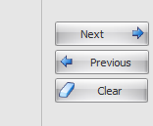
Navigating Through The Form
There are 5 ways to move from field to field:
Enter button
Tab button
Next button in the databar
Click on a field using your touchpad/mouse
Click in the Navigation Panel to jump around the form

Slide 29
How To Enter Data
The databar is where you type in data
Help tips are provided

Slide 30
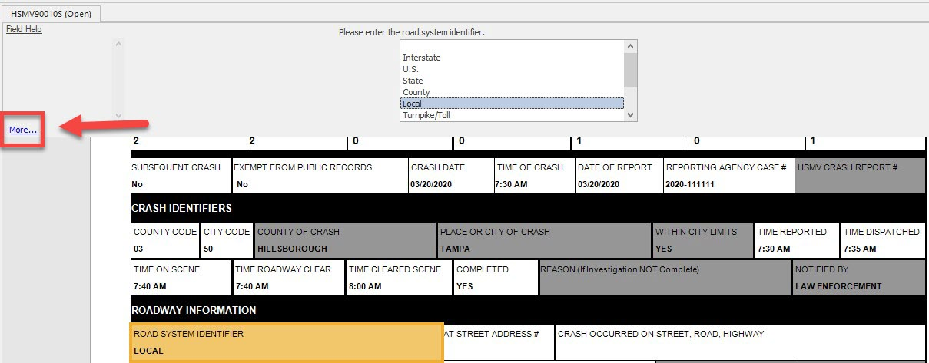
FLHSMV’s Online Crash Manual
The “more…” link on nearly every field will take you to the related page in the state’s crash manual online

Slide 31
The First Time Only
The first time you complete a Crash, you will be required to enter some basic information, such as:
The city where the crash was written
The county where the crash as written
Information related to your identification as a reporting officer
The second time you write a Crash and beyond, this information will default based on the initial entry

Slide 32
NCIC Importing
You should be running every tag and license BEFORE opening a form in TraCS (officer safety!)
The last 10 DLs and Vehicles ran should automatically show up on a pick list when you get tab to the First Name and Vehicle Year fields.
You can start typing your desired selection to highlight who you want

Slide 33
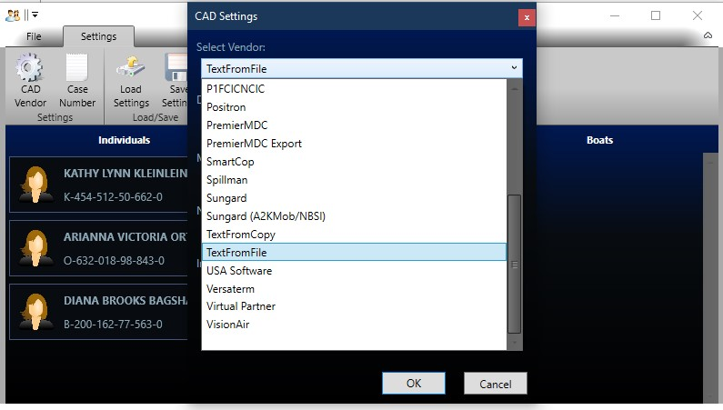
NCIC Importing - Settings
You must run cars and persons before opening the form
If the queries you ran are not showing up automatically, then press the NCIC import button on the home tab and make sure your vendor is selected from the drop-down list
If there is still nobody to select, or if your vendor is not on the list, then you must contact your IT helpdesk and they can contact TraCS for additional support
The shortcut to import manually is Control +J, Alt + A, and Enter
Control + J: Launches editor
Alt + A: Selects All
Enter: Commits the Import button

Slide 34
NCIC Importing
This is what it looks like when there are queries to import

Slide 35
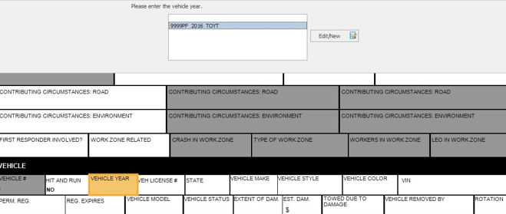
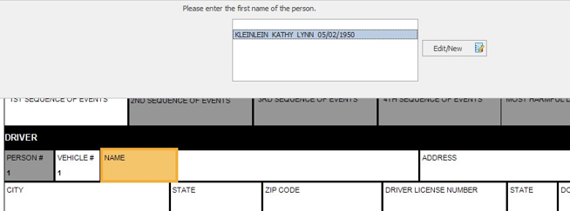
NCIC Importing
On the First Name and Vehicle Year fields you can import the NCIC data

Slide 36
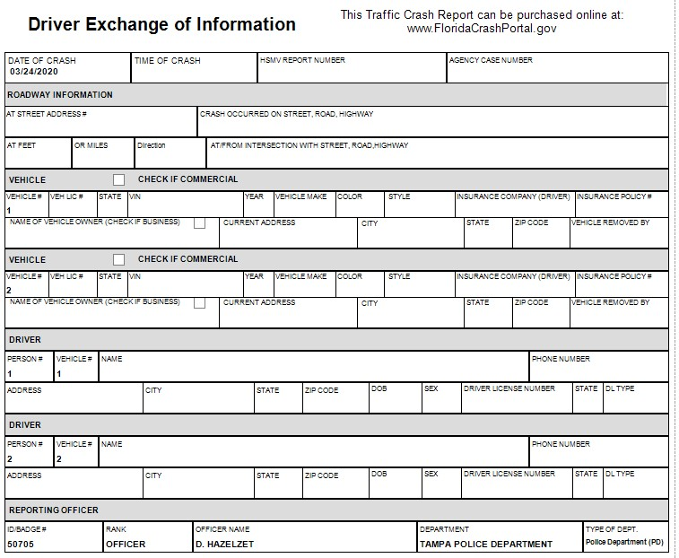
Driver Exchange
Start off all crash reports as a Driver Exchange to collect the bare minimum information so you can quickly clear the scene.
Email or print the driver’s exchange.
Then go back and change to a Short or Long Form.
When changing to a short or long form the grayed-out boxes will un-shade for the information needed for that particular form.

Slide 37
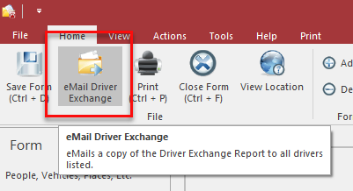
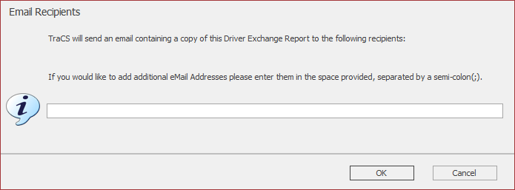
Emailing Driver Exchange
If email addresses are entered in person sections, when you validate the crash report the driver exchange will automatically be emailed.
You can also add additional email addresses for the report to be sent to for persons not listed on the report (ex: “it’s my mom’s car”) by pressing the email driver exchange button.
Officers will be BCC’d

Slide 38
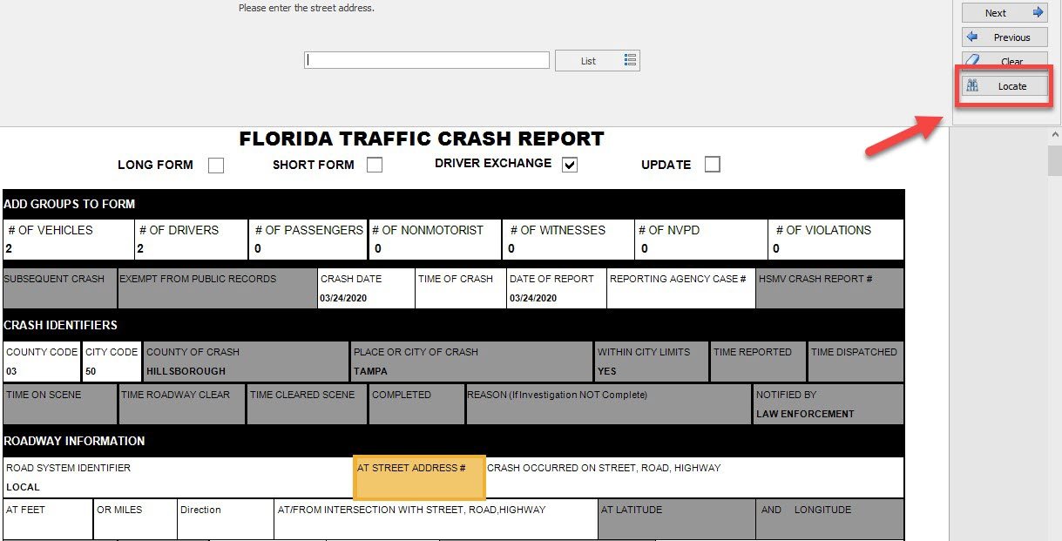
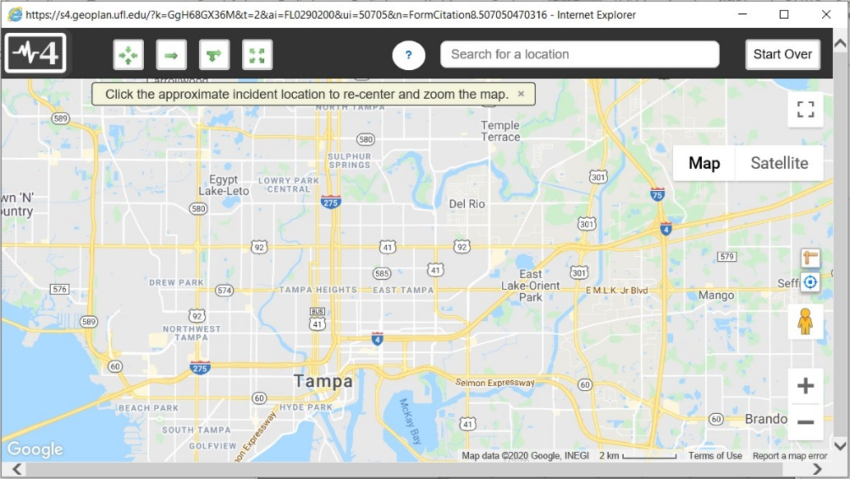
Importing Roadway Information
On “At Street Address# or Crash Occurred On Street, Road, Highway you will see a LOCATE button appear below the Next, Previous, Clear button.
Click on Locate and this will launch a map

Slide 39
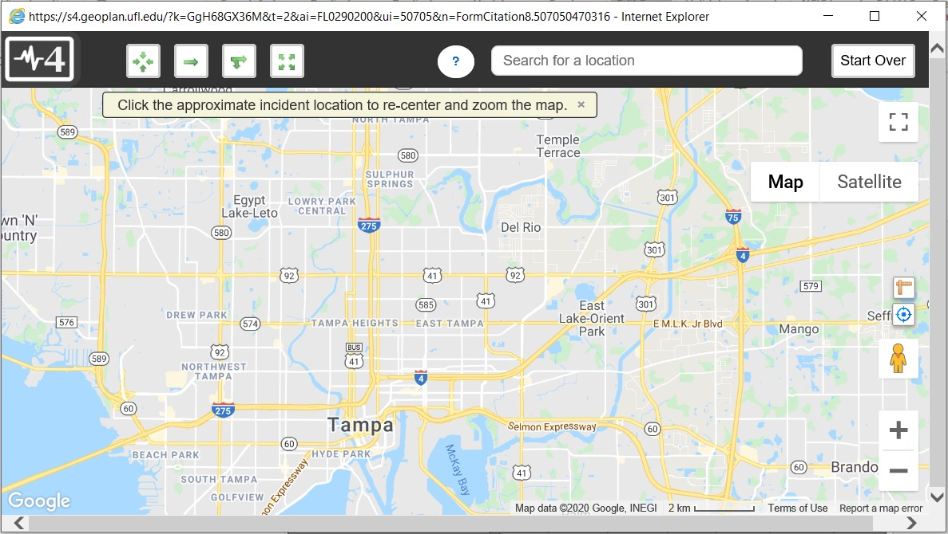
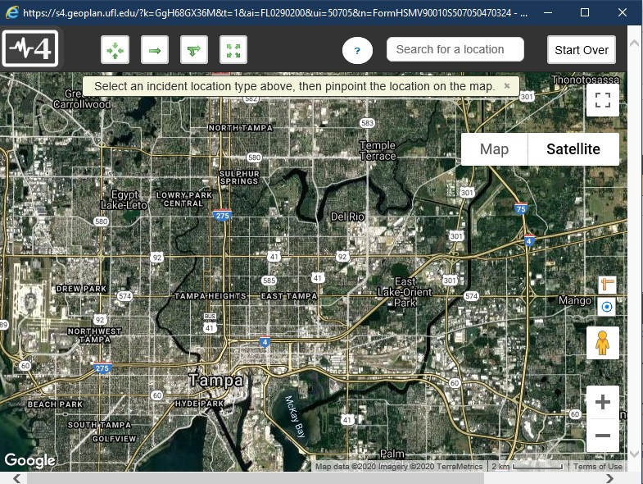
Importing Roadway Information
Pan around to find the location
Use the address search to find the location by address or name of a business or landmark (123 Main St, Busch Gardens, etc)
You can use map or satellite view

Slide 40
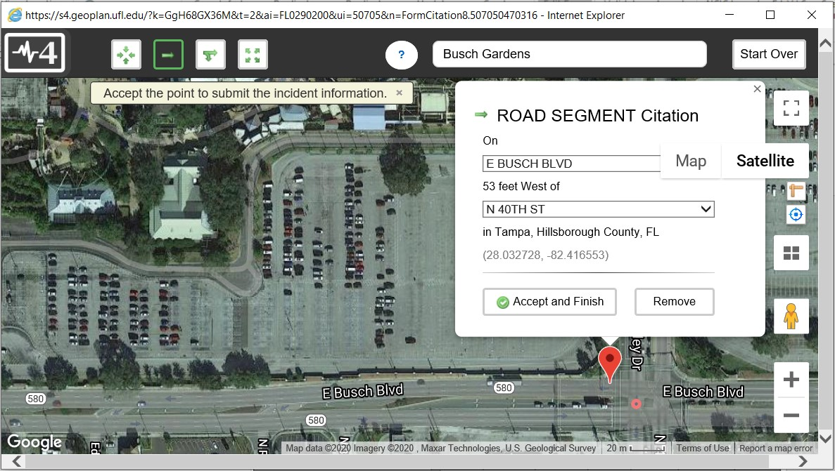
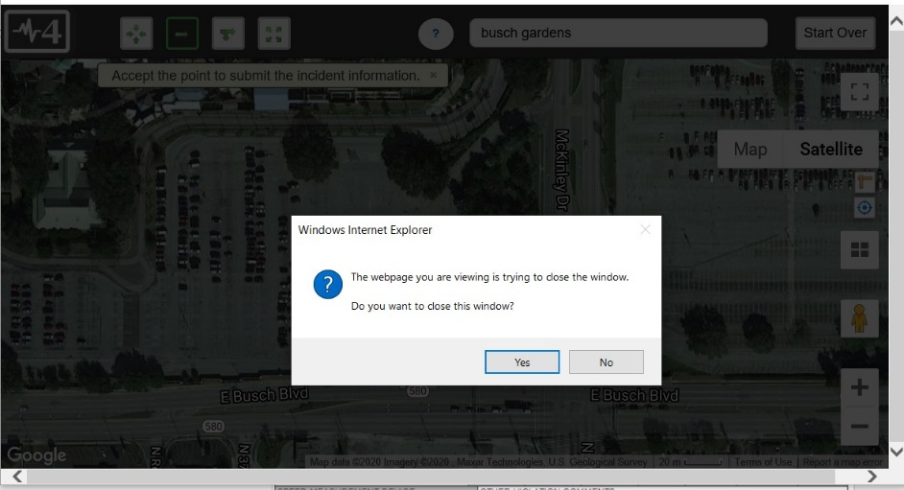
Importing Roadway Information
Select the type of location (intersection, road segment, ramp, or off roadway)
Click on the map to select a location
Click on Accept and Finish and Yes to return to the form

Slide 41
Importing Roadway Information
The information will feed back onto the form; including the latitude and longitude

Slide 42
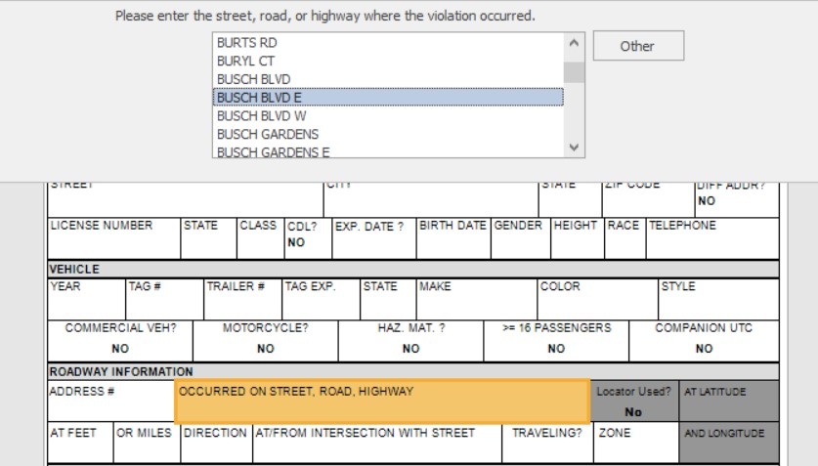
Manually Entering Roadway Information
If you cannot use the location tool for some reason, the street and intersecting street fields contain list of streets in your county
You can press Other to free type roadway information; however, you should avoid this when possible

Slide 43
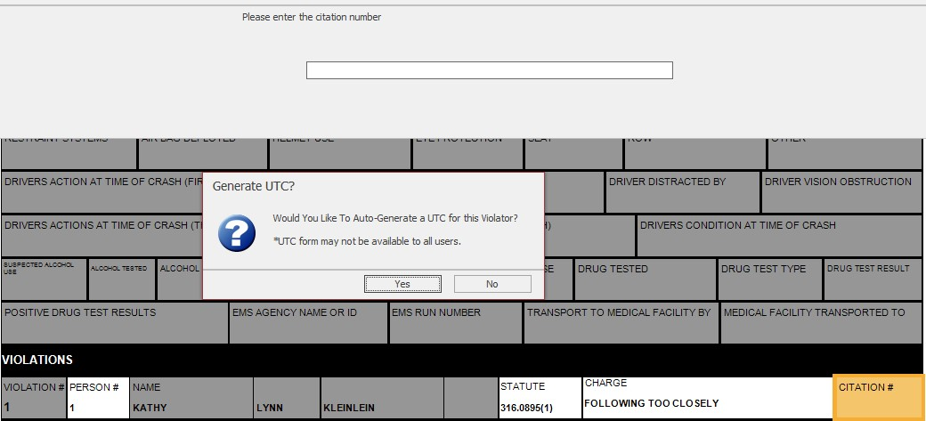
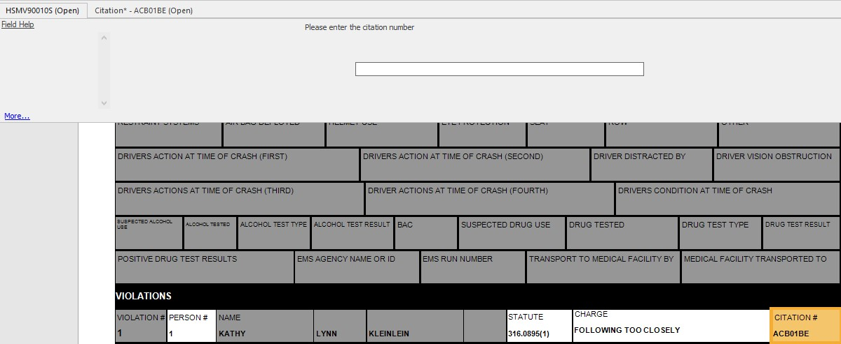
Driver Exchange – Add UTC
Upon entering a violator on a driver exchange, the system will ask if you want to generate a UTC
If you say yes, the entire UTC will be created, and the ticket number will be placed on the crash form
Note: This feature only works after you’ve completed your first Citation in TraCS; until then you will not receive this prompt

Slide 44
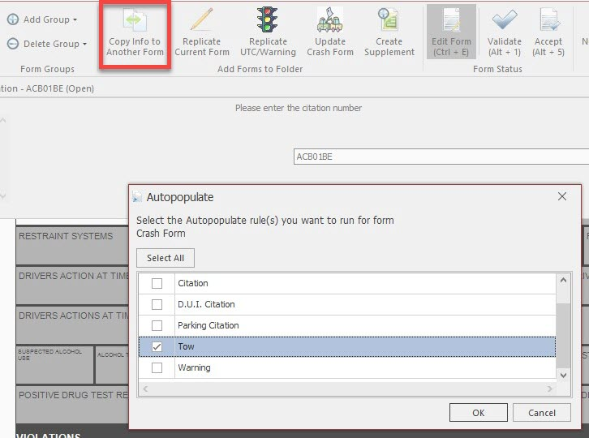
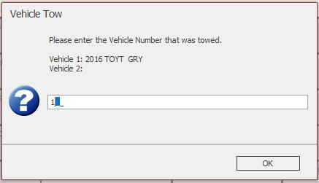
Driver Exchange – Add Tow Sheet
To add a tow sheet, press the Copy to Another Form button and pick Tow
If more than one vehicle exists, you will be asked which vehicle requires a tow sheet
Note: You’ll notice you can generate several other forms from a crash as well by pushing this button

Slide 45
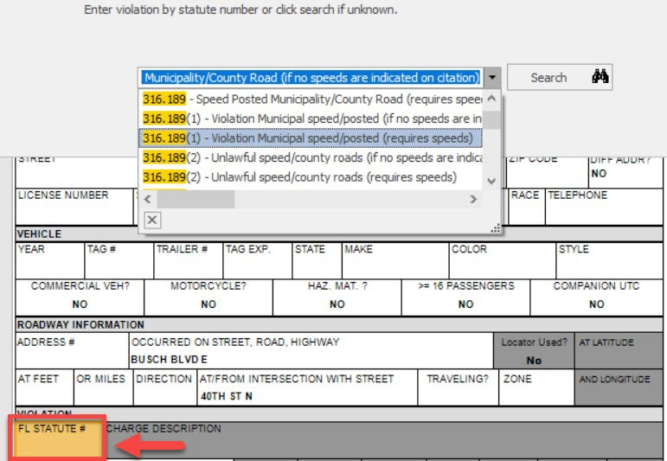
Finding Florida State Statutes
If you need to search Appendix C through TraCS, press the Search button
State statutes can be located by partial number or key word
Check favorites to save favorites to the top of the list

Slide 46
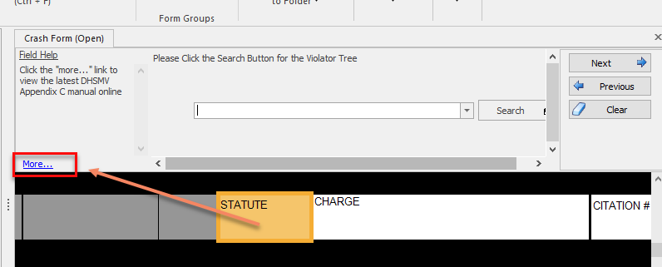
Finding Florida State Statutes
Under the Help tab you can press the Appendix C button to launch the FLHSMV website which hosts a PDF version
You can save this PDF locally
You can use Control + F to “find” key words or statute numbers
You can also launch this manual from the FSS field by pressing the more link

Slide 47
Diagram

Slide 48
Diagram Tools
There are many options for electronic diagramming
TraCS built in diagram tool (free)
Easy Street Draw
Crash Zone/Quick Scene
Visio
Import a scanned image that you hand draw

Slide 49
TraCS Diagram Tool
Open and launch the TraCS diagram tool.

Slide 50
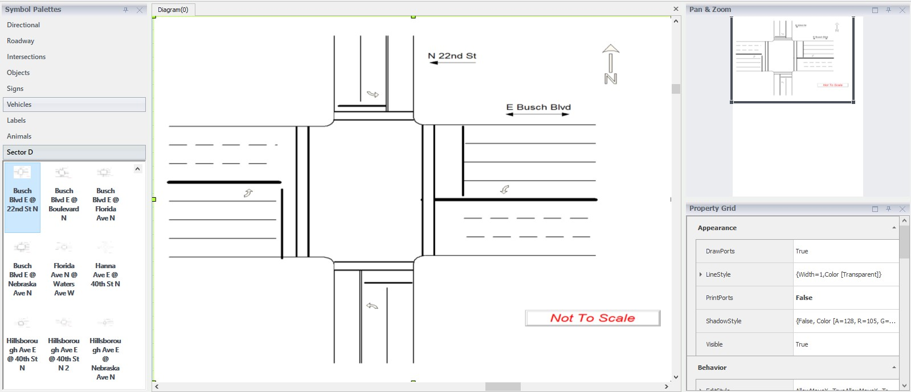
TraCS Diagram Tool
Go to File/Save As before adding cars and people if you want to reuse templates
Templates can be designed and shared if you send them to your IT staff

Slide 51
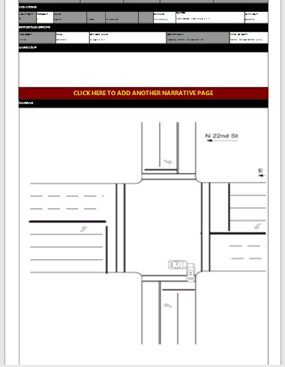
TraCS Diagram Tool
Verify your image and close the TraCS Diagram Tool by clicking on the “X” in the top right. The image will shrink down to fit and will import onto the crash report.

Slide 52
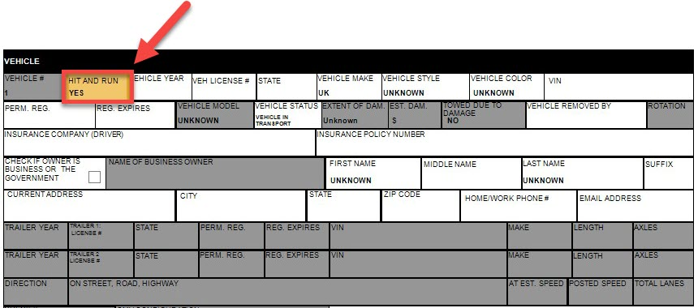
Hit & Run’s
When filling out a Hit & Run, select Hit & Run = YES in the vehicle group and move on
In the driver group, associated the person number with the vehicle number and move on
Do not attempt to fill out any other fields unless the vehicle and/or driver is confirmed. Unconfirmed information goes in the narrative.
In addition to putting unconfirmed information in the narrative, there is a special Hit & Run group that your agency can use for internal purposes only.

Slide 53
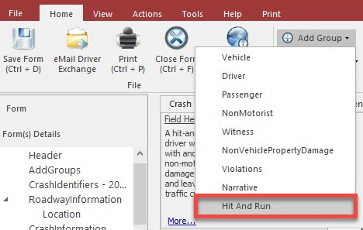
Hit & Run’s
Any additional Hit & Run information can be stored by pressing the Select a Group to Add button and selecting Hit & Run
This information does not go to the state and is for internal use only.

Slide 54
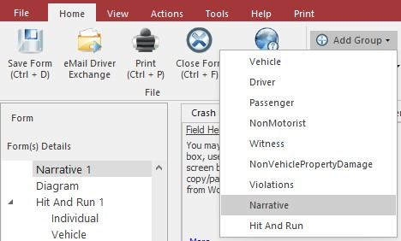
Narrative
If you run out of room on the narrative, press the red button to add another narrative or under Home tab click Add Group and then Narrative
The second narrative box will print on a separate page
It is recommended that on updates to crashes you always add a new narrative

Slide 55
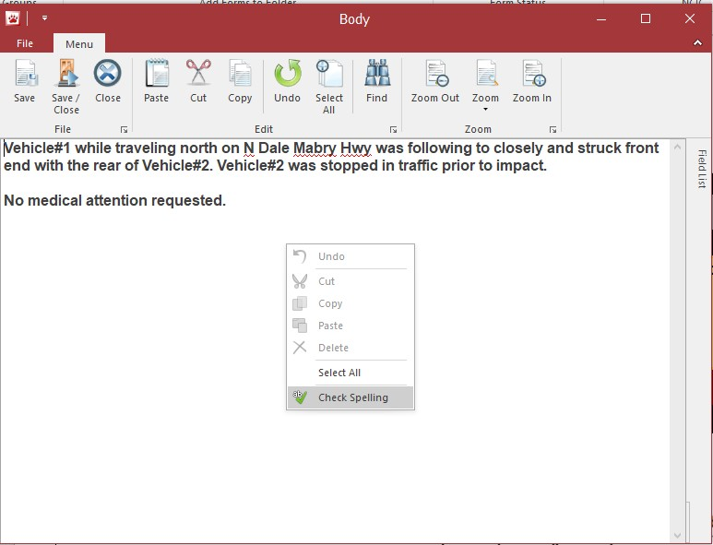
Narrative
You can right click for spell check and for other options

Slide 56
Narrative
When typing a narrative, you can change the font size for your desired view. To change the font size click on “Edit” next to the text field. Click on the “menu” tab located at the top of the body. Click on “zoom” and then click on the desired zoom percentage. Once this has been set, it will remain the default for future crash narratives.

Slide 57
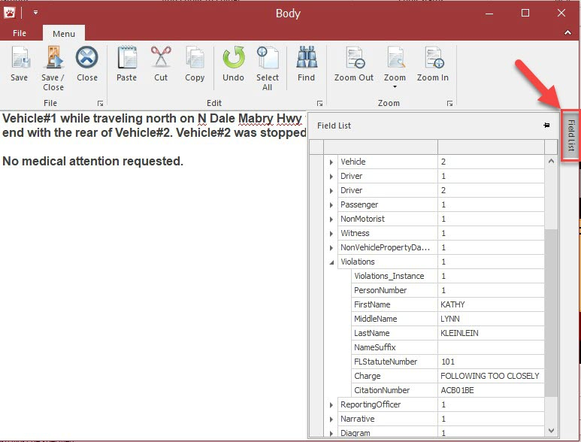
Narrative
You can use the Field List on the right to view information on the crash form while in the narrative
You can double click any value to insert it on the narrative

Slide 58
Electronic Submission To DHSMV

Slide 59
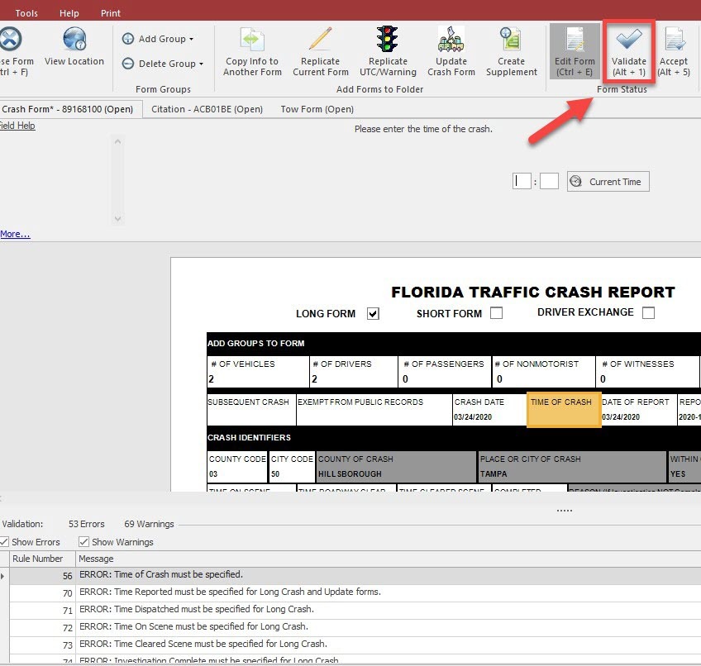
Validation
Once a user has completed filling out a form, the validate button will check the form data against the DHSMV edit rules to help ensure acceptance of the form once it is submitted
Errors and warnings are displayed in the bottom pane
You may double click the item to jump to the field on the form that requires correcting
Warnings DO NOT prevent validation
You can uncheck the Warnings box so you only see Errors

Slide 60
Accept The Crash Form
After officers Validate the crash form, supervisors will Accept the crash form.

Slide 61
Automated Submission To DHSMV
Once a crash is “Accepted”, it will be “Submitted” to DHSMV automatically
Below is how all of this looks in the Forms Manager

Slide 62
Edit Forms After Closing
If you shut down a form and reopen it, you must click on the Edit Form button
An officer or supervisor can edit a form by pressing the Edit Form when it is in any of the following statuses
Open
Rejected
Validated
Accepted
However, once a form is a submitted status, you must complete an “update” to make changes

Slide 63
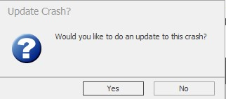
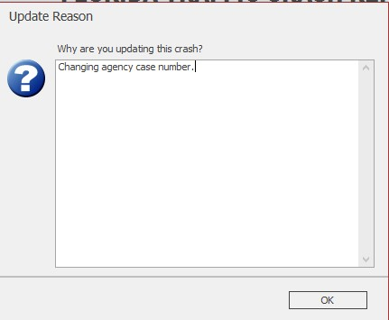
Updating Crash Forms
To Update a crash form, open the original form, go to the Actions tab, and pick Update Crash Form.
The shortcut is Alt + F1

Slide 64
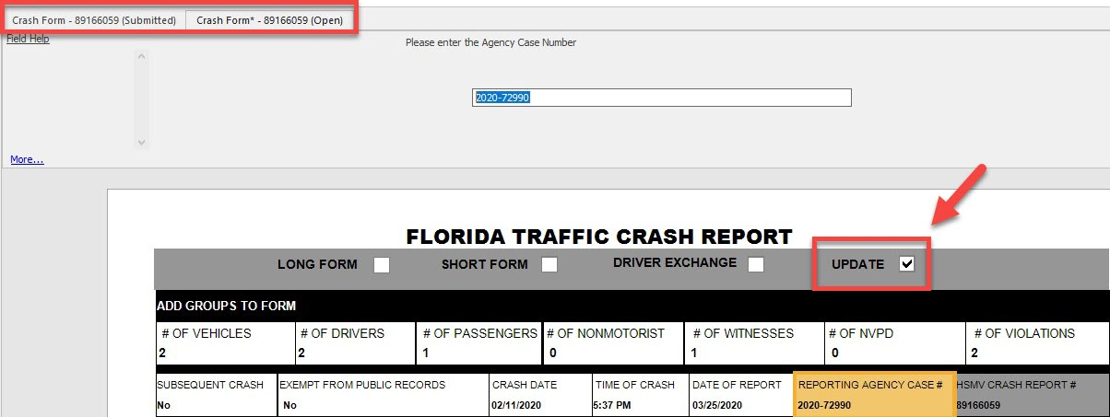
Updating Crash Forms
“Update” will automatically be chosen for you
Make whatever changes are necessary
You can tab back and forth between the original form and the new form

Slide 65
Updating Crash Forms
Remember to Validate the form when you are done so it can be Accepted by a Supervisor and then sent to FLHSMV electronically!
All updates become LONG forms.
If there is no diagram you can draw a text box in the field and write Diagram Not Applicable.

Slide 66
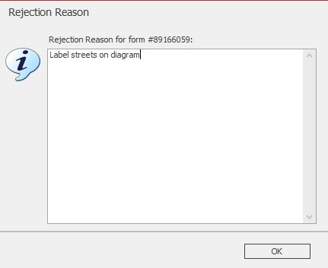
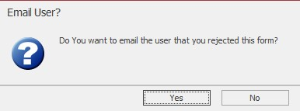
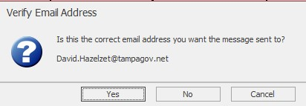
Rejecting Crash Forms
Under the Actions tab, supervisors can press the Reject button
It will prompt for a user email if one is not on file, and will email the user to let them know a form was rejected

Slide 67
Printing & Emailing

Slide 68
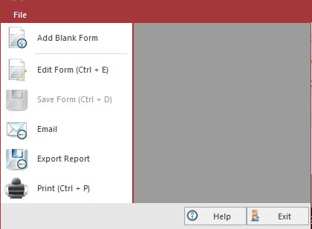
Printing
Printing can be accomplished manually and/or automatically by clicking print or upon the status change of a form, to either a local or network printer.

Slide 69
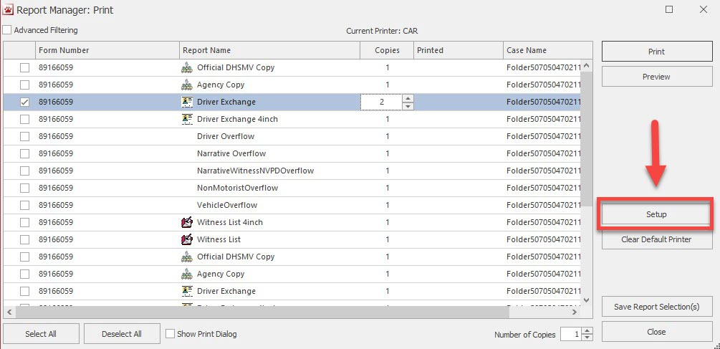
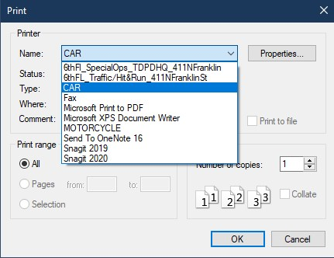
Printing Locally
We recommend your Windows default printer be set up to the printer you will use most often before signing into TraCS
We recommend that you DO NOT change the printer through the Setup menu in TraCS
However, if you must…
Choose “Set Up” to set up your local printer. Any installed printers will be detected and made available on the printer list.

Slide 70
Zebra Printers
If you use the Zebra printers, you must have your IT person visit this link to learn about configuration
http://www.tracsflorida.org/wiki/index.php?title=Zebra_RW_420_Printer_Configuration

Slide 71
Export Reports
If users would like to export a crash report as a PDF, tiff, or other format, use the Export option.

Slide 72
Email Reports
If you have an Outlook profile on your local machine, email should be automated
Otherwise, please use the Export function to email reports with other email providers

Slide 73
Auto-Print Features For Drivers Exchange
Under the Print tab, the auto-print button will allow you to set automatic prompts for printing for driver exchange forms
The first time only, you’ll be prompted on your printer type (4-inch or full page)

Slide 74
Searching For Forms In The Forms Manager

Slide 75
Searching For Forms
Under the Form tab you can search by agency case number.
Use the % or the * symbol to search for partial case number or a key word in a narrative (example: 22-1234 could be searched by %1234 or by *1234)

Slide 76
Additional Tips

Slide 77
What Does Each Status?
Open – User is still working on the form
Rejected - Supervisor rejected form for correction
Validated – User is done working on the form and the form is ready to be “accepted”
Accepted – Supervisor has approved, and the form is ready to go to the State
Submitted – Has been submitted electronically to the State
Submitted reports are “locked” to prevent further editing.

Slide 78
Moving Forms Through The Process
Under no exceptions, the following buttons must be pushed
Officers MUST press the validate button when they are done
Supervisors MUST press the Accept button when they are done
The server MUST be set up properly to automatically submit accepted forms to the state
If a crash is in accepted status for more than 24 hours, there is an issue with the server and IT MUST tell TraCS they require assistance

Slide 79
TraCS training videos are available on YouTube.
https://www.youtube.com/channel/UCjwvWomJybrJ31P7fJp4JIQ/videos

