Slide 1
Master Index User Guide
04-19-23

Slide 2
Navigate To:
Searching Master Index
Searching by Individual
Searching Wildcards- * (asterisk)
Searching Wildcards- _ (underscore)
Wild Card Searches- ,(comma)
Searching Wildcards- ~ (tilde)
Searching by Vehicle
Searching by Location
Searching Property
Searching Phonebook
Searching by Personnel
Adding Flags- Individuals
Removing Flags- Individuals
Adding Flags- Locations
Removing Flags- Locations
How Flags Appear in Search Results
Modifying Flags
Refining Searches by Date
Selecting and Viewing

Slide 3
Master Index
A Master Index is a database that is used across an agency to maintain consistent, accurate and current demographic and essential data on the incidents managed within its jurisdiction. TraCS maintains Master Indexes on the common information found on all forms. The following Master Indexes can be searched in TraCS:
Individual
Vehicle
Location
Property
Phonebook
Personnel

Slide 4
Searching Master Index

Slide 5
Searching Master Index

Slide 6
Searching by Individual

Slide 7
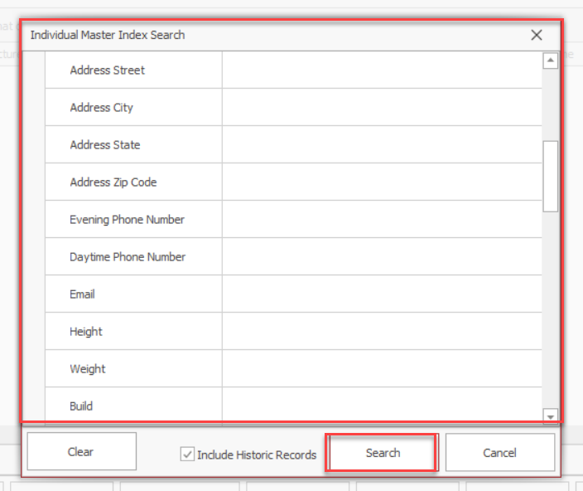
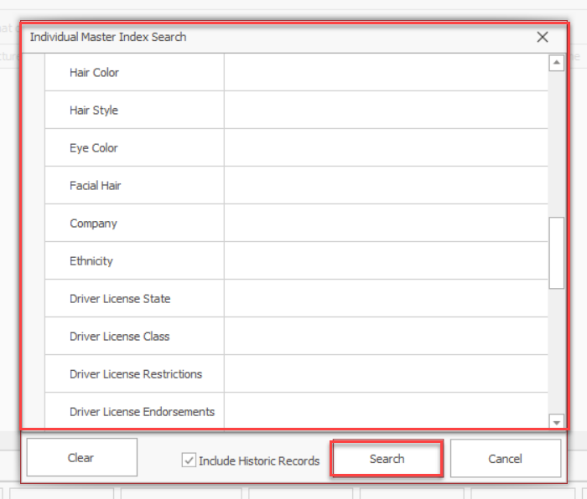
Searching by Individual

Slide 8
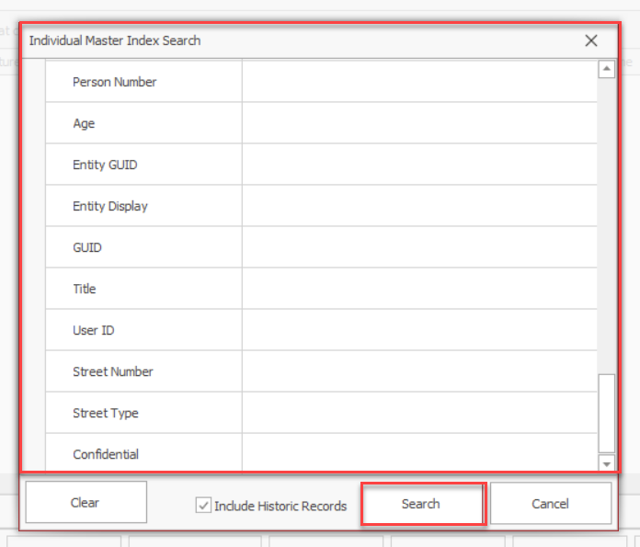
Additional Search Options by Individual

Slide 9
Searching by Individual

Slide 10
Searching by Individual

Slide 11
Searching by Individual

Slide 12
Searching by Individual

Slide 13
Searching by Individual

Slide 14
Searching by Individual

Slide 15
Individual Search Criteria

Slide 16
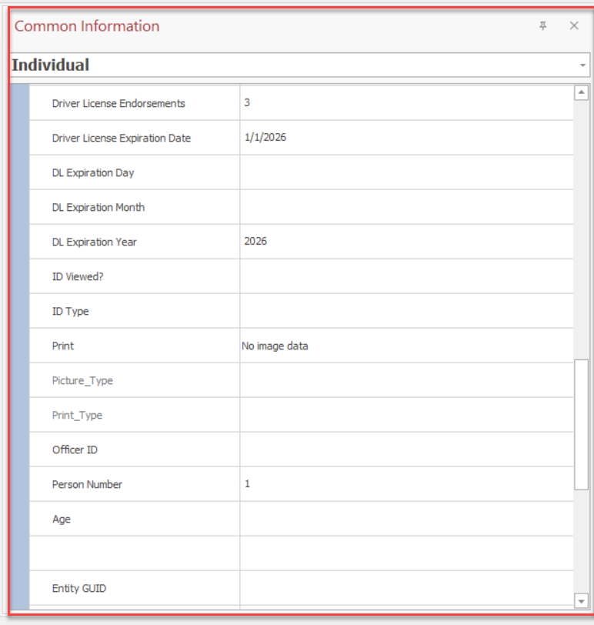
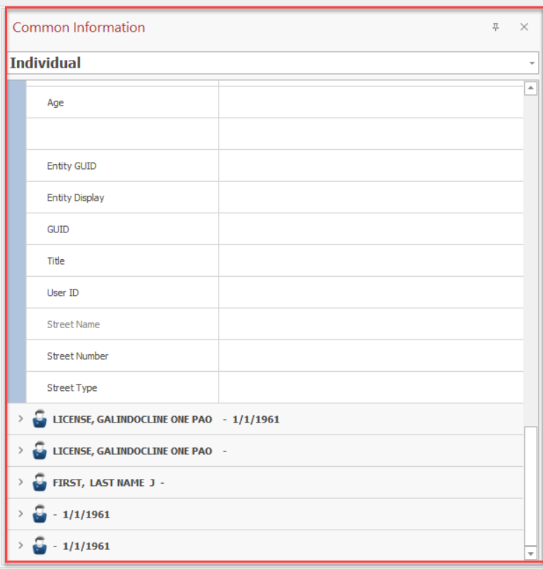
Individual Search Criteria (Cont.)

Slide 17
Wild Card Searches- * (asterisk)

Slide 18
Wild Card Searches- * (asterisk)

Slide 19
Wild Card Searches- _ (underscore)

Slide 20
Wild Card Searches- _(underscore)

Slide 21
Wild Card Searches- ,(comma)

Slide 22
Wild Card Searches- ,(comma)

Slide 23
Wild Card Searches- ~(tilde’)

Slide 24
Wild Card Searches- ~(tilde’)

Slide 25
Special Note
Officers may also use a combination of two or more special characters to assist in their search

Slide 26
Searching by Vehicle

Slide 27
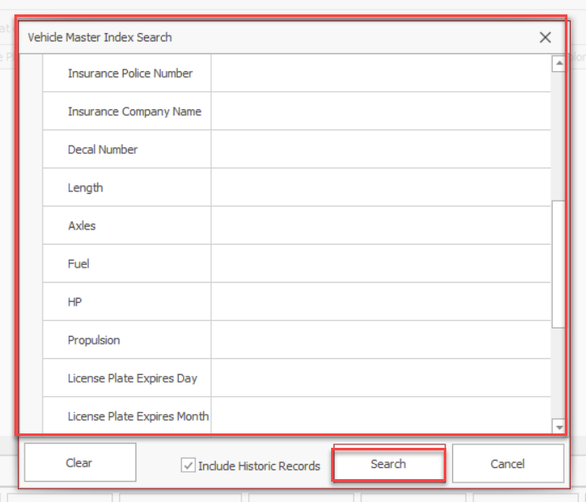
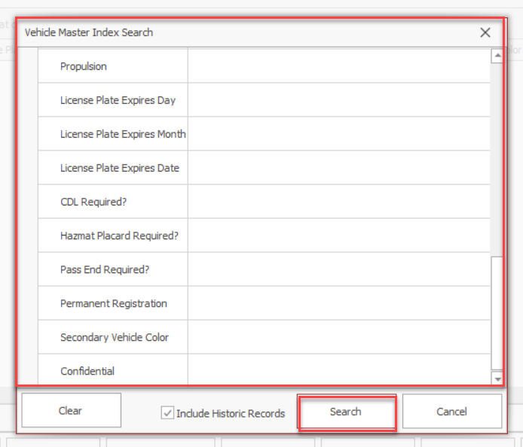
Searching by Vehicle

Slide 28
Searching by Vehicle

Slide 29
Searching by Vehicle

Slide 30
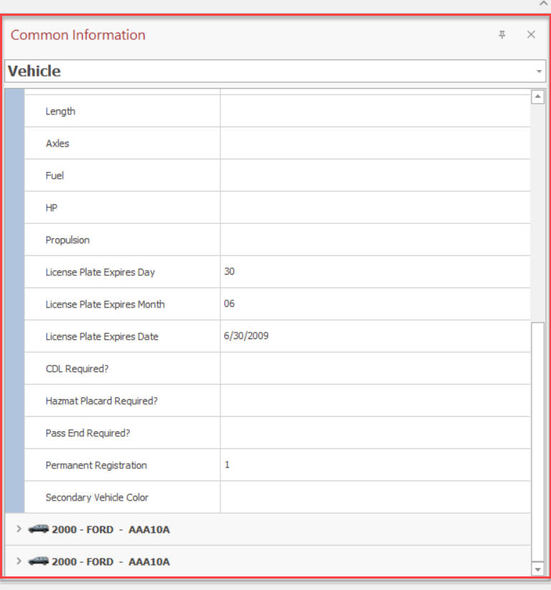
Vehicle Search Criteria

Slide 31
Searching by Location

Slide 32
Location Search Criteria

Slide 33
Location Search Criteria

Slide 34
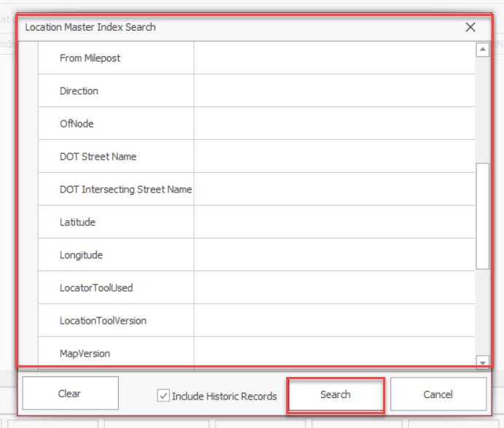
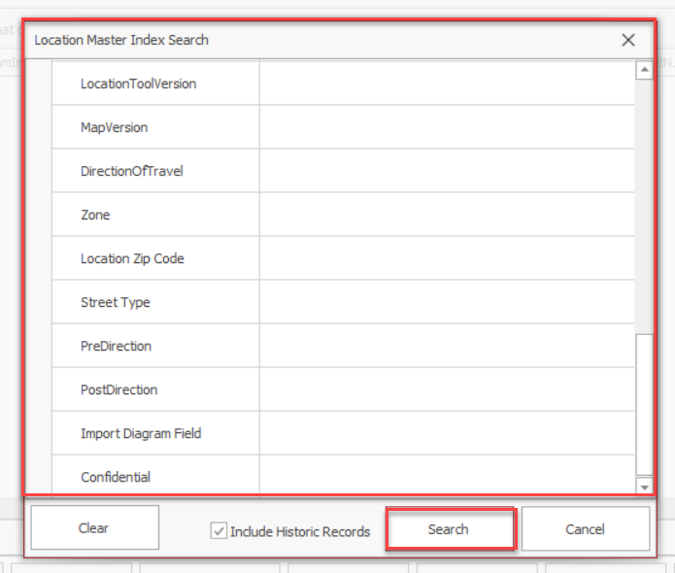
Searching by Location

Slide 35
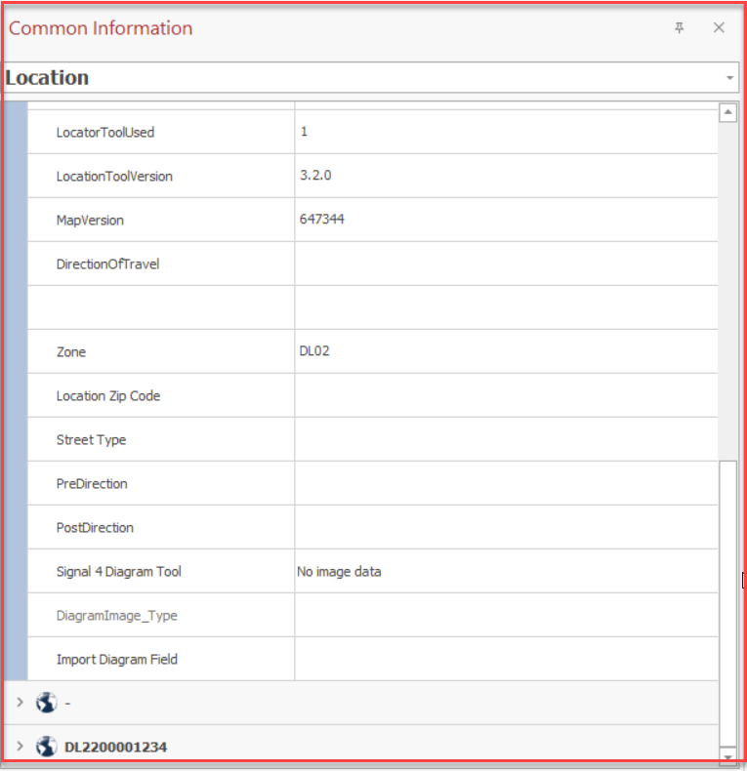
Location Search Criteria (Cont.)

Slide 36
Searching Property

Slide 37
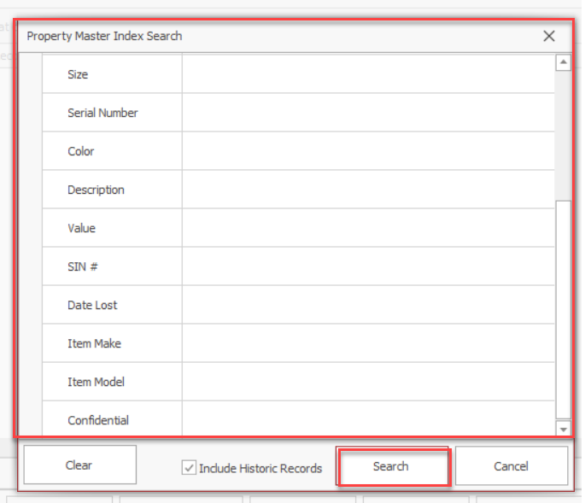
Searching Property

Slide 38
Searching Phonebook

Slide 39
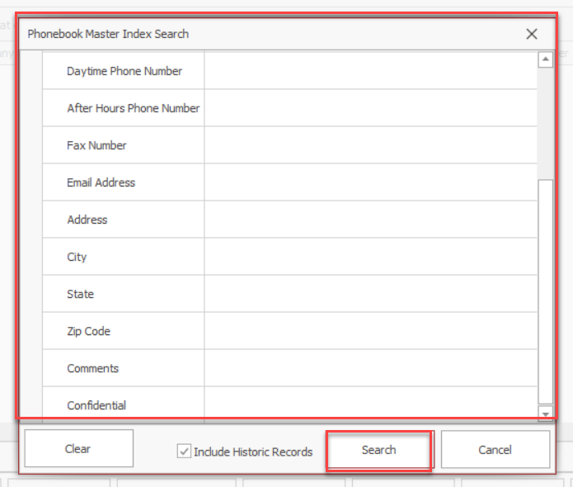
Searching Phonebook

Slide 40
Searching Personnel

Slide 41
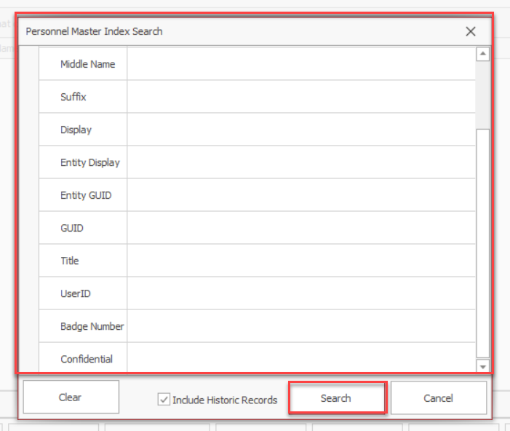
Searching Personnel

Slide 42
Adding Flags- Individuals

Slide 43
Adding Flags- Individuals

Slide 44
Adding Flags- Individuals

Slide 45
Adding Flags- Individuals

Slide 46
Adding Flags- Individuals

Slide 47
Adding Flags- Individuals

Slide 48
Removing Flags- Individuals

Slide 49
Removing Flags- Individuals

Slide 50
Adding Flags- Locations

Slide 51
Adding Flags- Locations

Slide 52
Adding Flags- Locations

Slide 53
Adding Flags- Locations

Slide 54
Adding Flags- Locations

Slide 55
Adding Flags- Locations

Slide 56
Removing Flags- Locations

Slide 57
Removing Flags- Locations

Slide 58
How Flags Appear on Search Results

Slide 59
Modifying Flags

Slide 60
Modifying flags

Slide 61
Modifying Flags

Slide 62
Refining Searches by Date

Slide 63
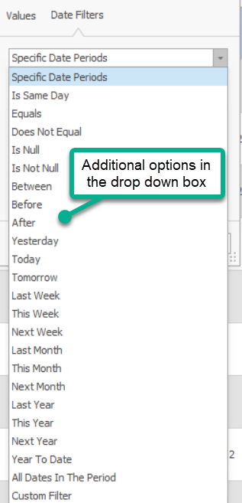
Refining Searches by Date

Slide 64
Refining Searches by Date

Slide 65
Selecting and Viewing

Slide 66
Selecting and Viewing

Slide 67
For assistance contact TraCS Support
Help Desk - 850-410-6237
Email - support@tracsflorida.org
Enter Help Desk Ticket – https://www.tracsflorida.org

