Slide 1
Records User Guide
03-16-23

Slide 2
Records User Guide
Searching Forms
Adding a Shortcut
Saving a Search
Default Search
Making a Favorite Search
Searching by Case Number
Searching by Description Box
Searching by DHSMV Number
Searching by Form Number
Searching Narrative by Keyword
Searching by Officer / Deputy
Searching User by Keyword
Searching by Form Name
Searching by Case number
Searching by Case Status
Searching by User Last Name
Searching by User ID
Searching by Format Date
Searching by Form Time
Printing
Exporting a Single Document
Exporting Multiple Documents
Status of Forms

Slide 3
Searching Forms

Slide 4
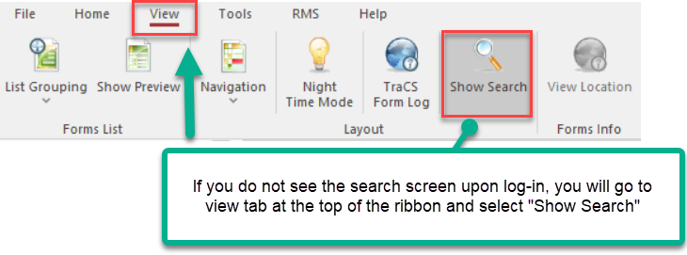
Searching Forms

Slide 5
Searching Forms / Adding shortcut

Slide 6
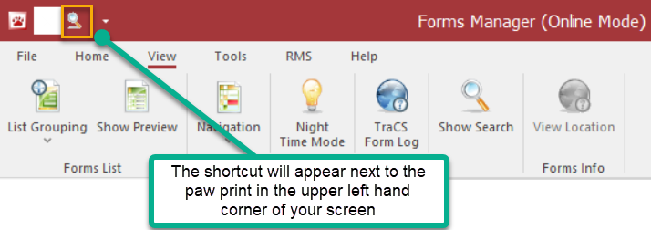
Searching Forms / Adding Shortcut

Slide 7
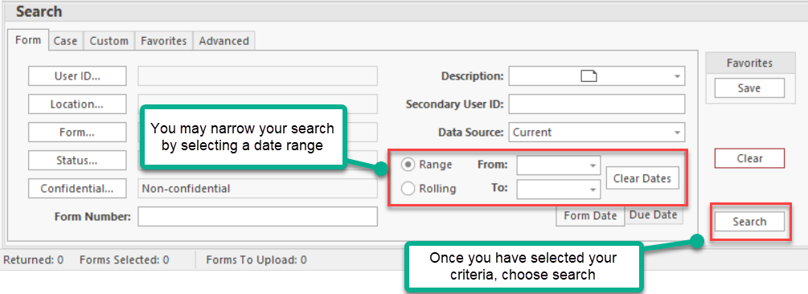
Searching Forms

Slide 8
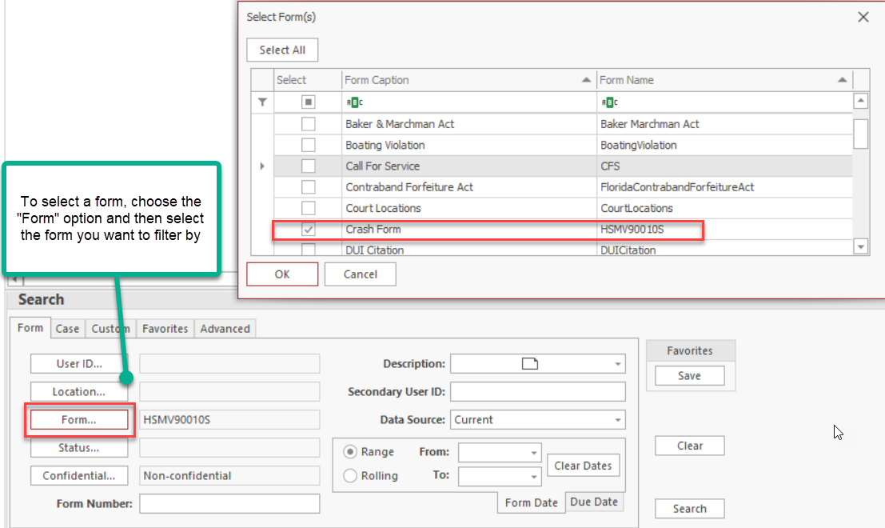
Searching Forms

Slide 9
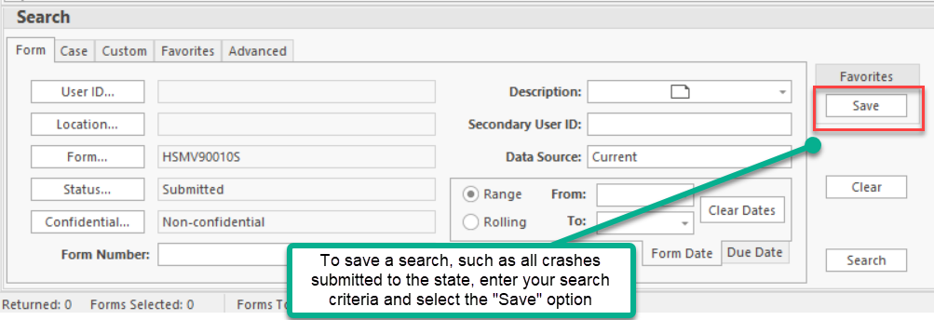
Saving a Search

Slide 10
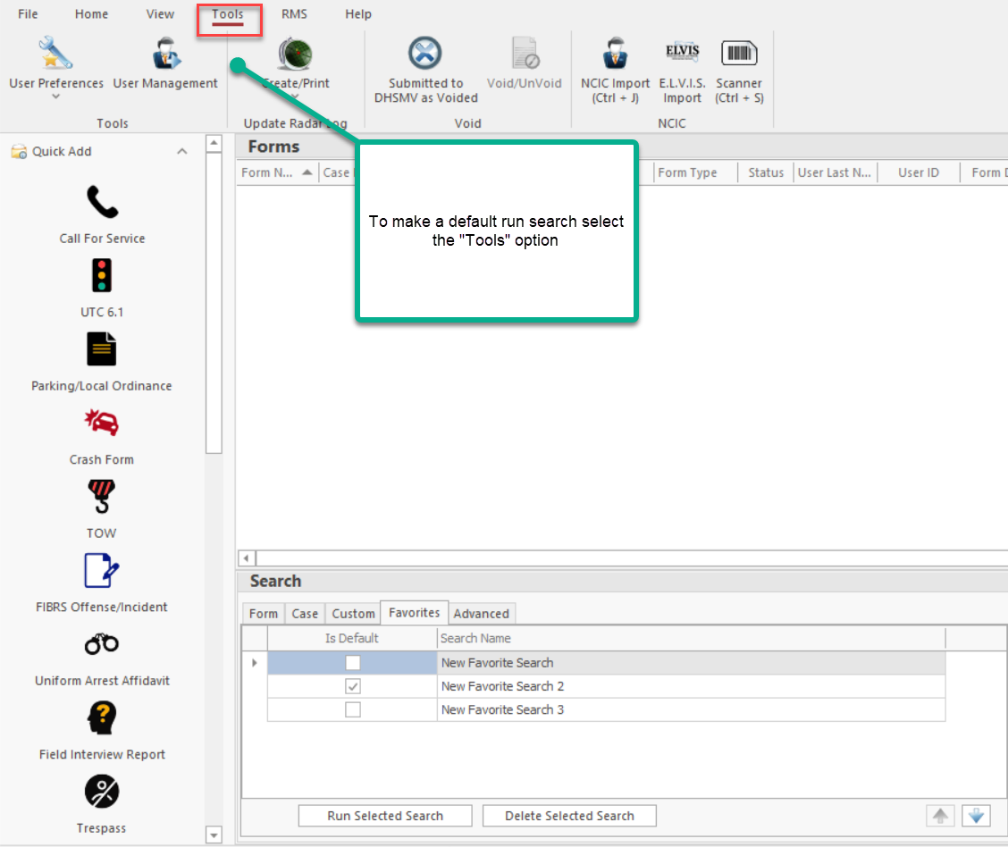
Default Search

Slide 11
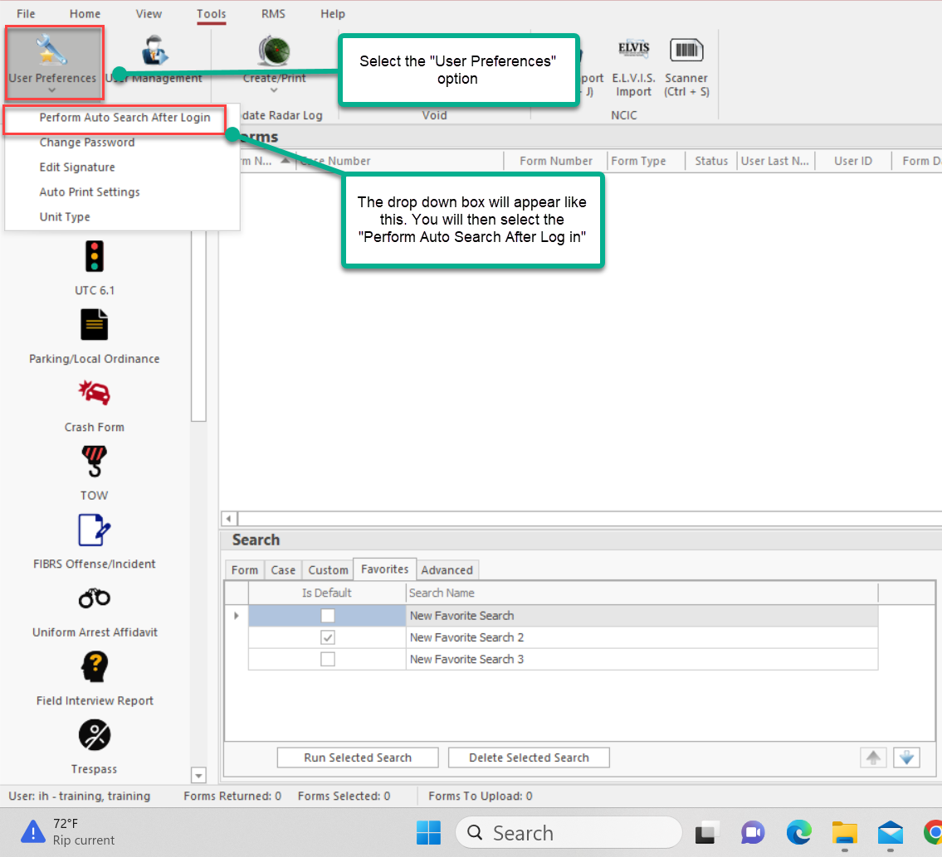
Default Search

Slide 12
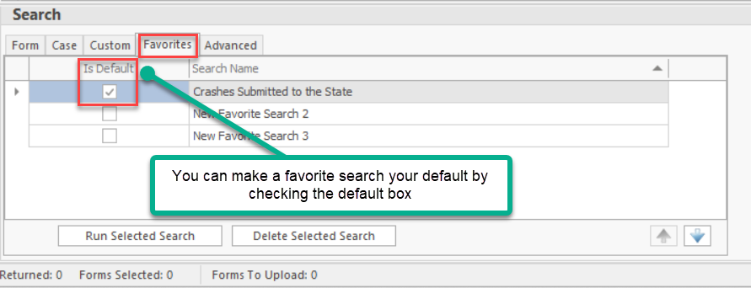
Making a Favorite Search

Slide 13
Searching by Case Number

Slide 14
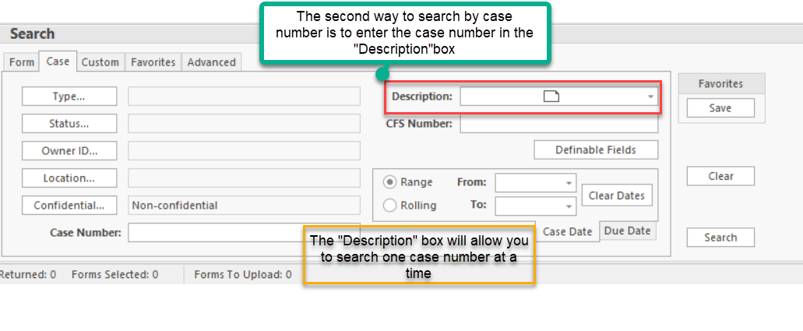
Searching Case Number using the “Description Box”

Slide 15
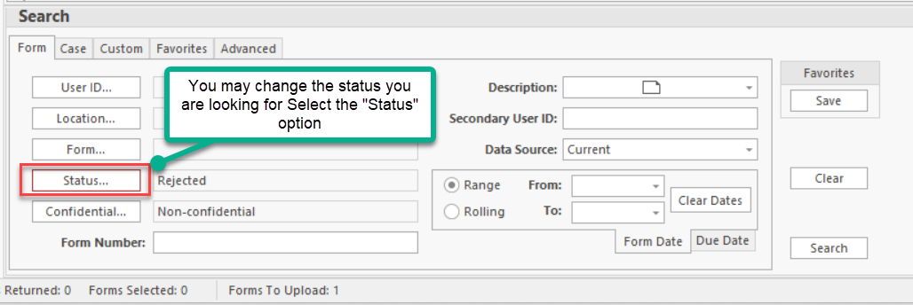
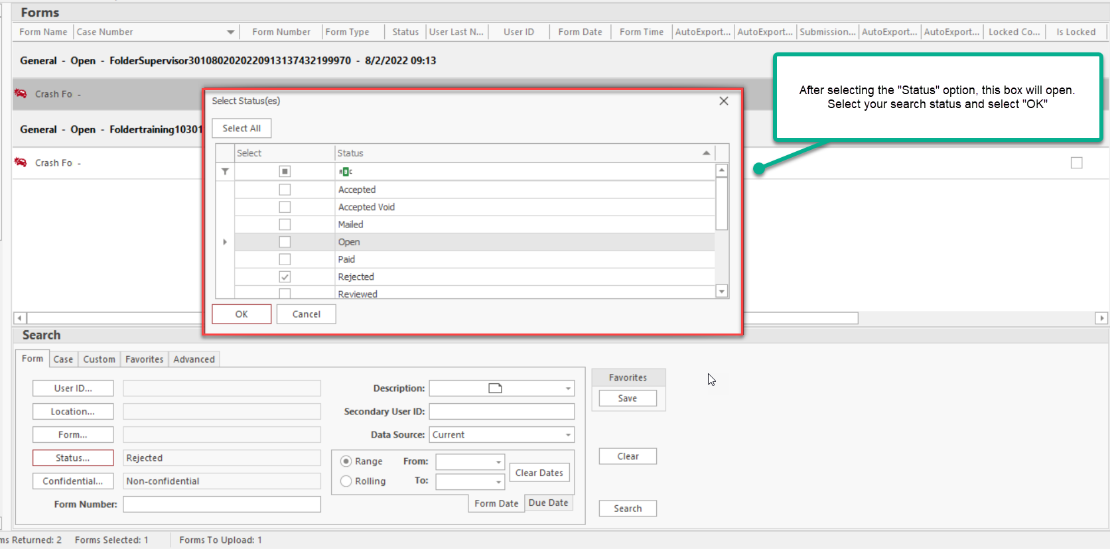
Selecting a Search Status

Slide 16
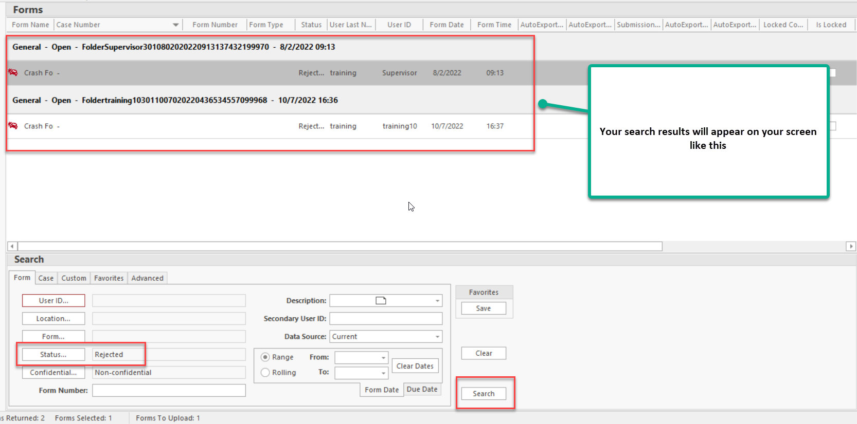
Search Results

Slide 17
Searching by DHSMV Number

Slide 18
Searching by Form Number

Slide 19
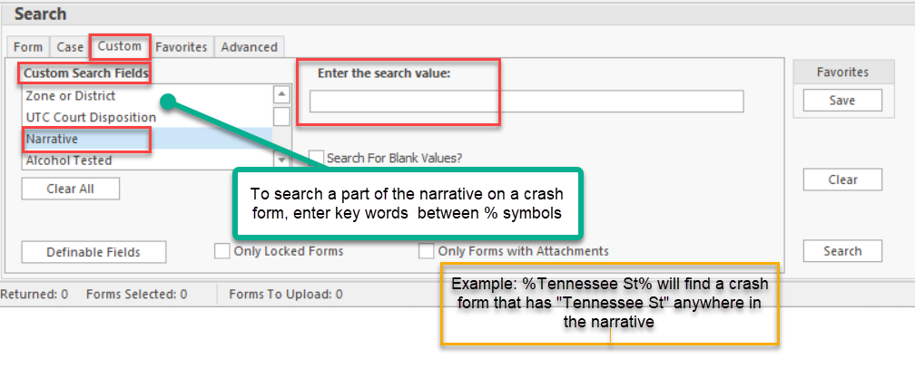
Searching the Narrative by Key Word

Slide 20
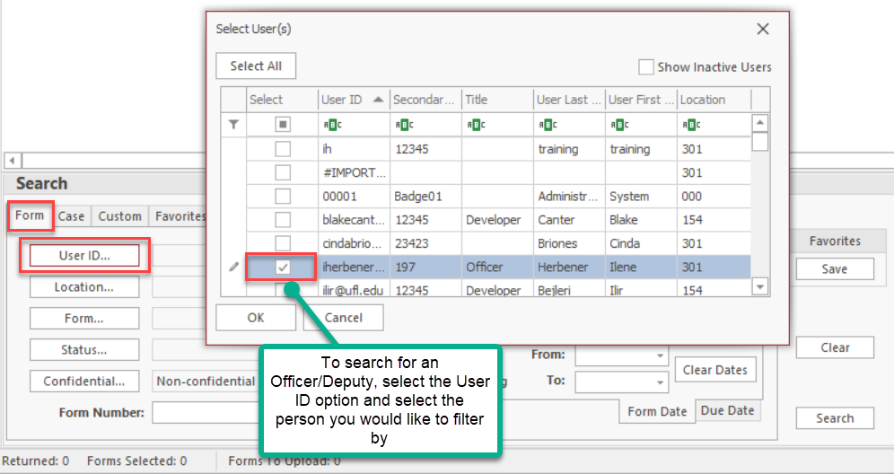
Searching by Officer/Deputy

Slide 21
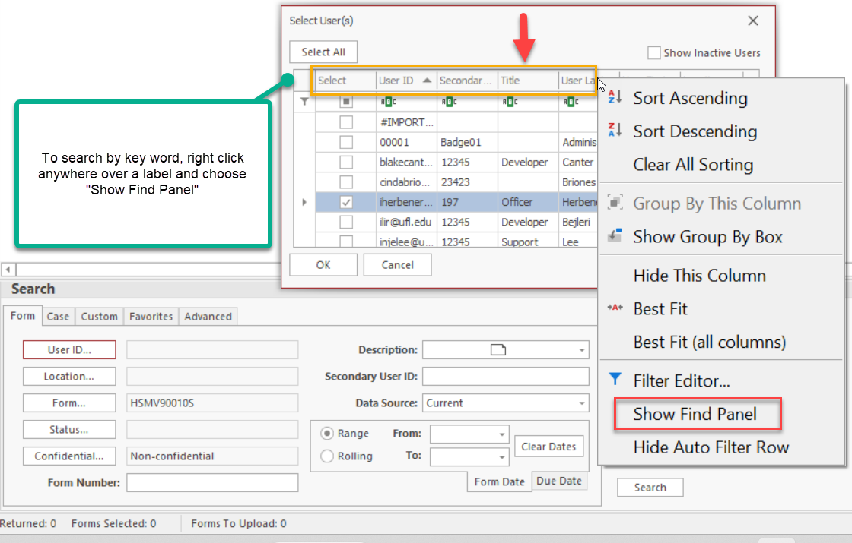
Searching User by Key Word

Slide 22
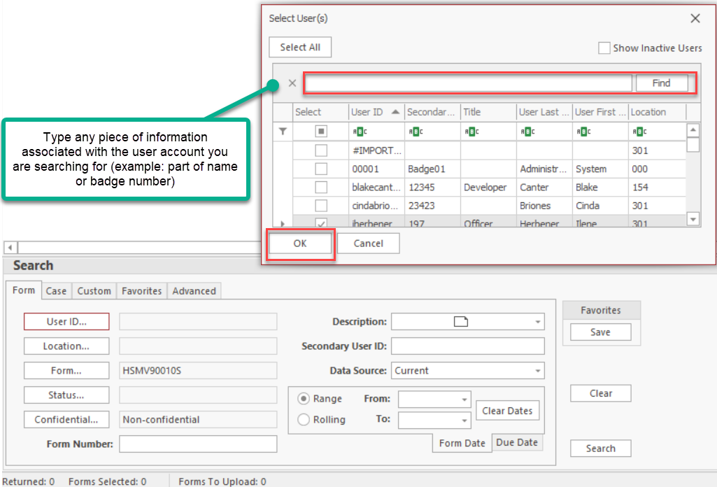
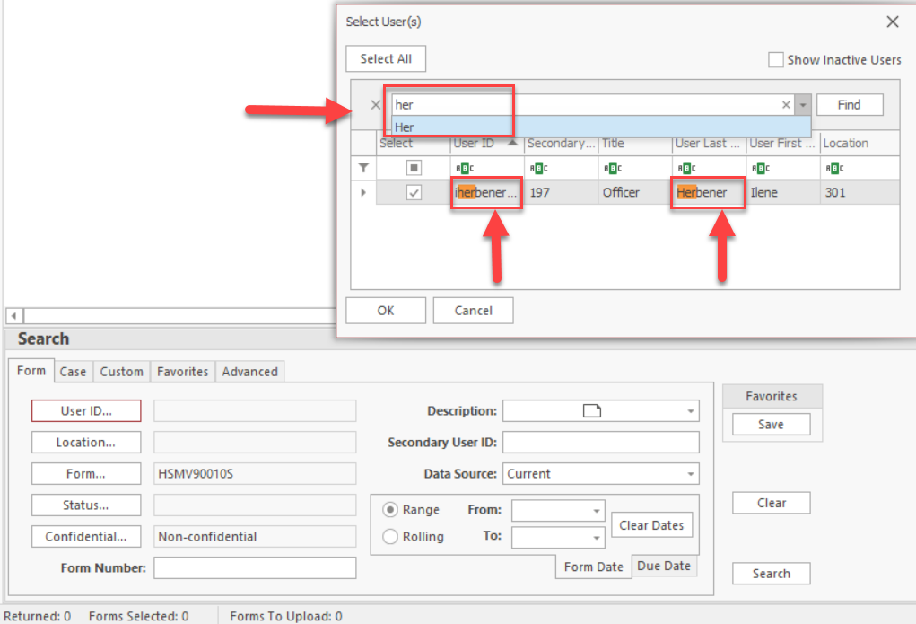
Searching User by Key Word

Slide 23
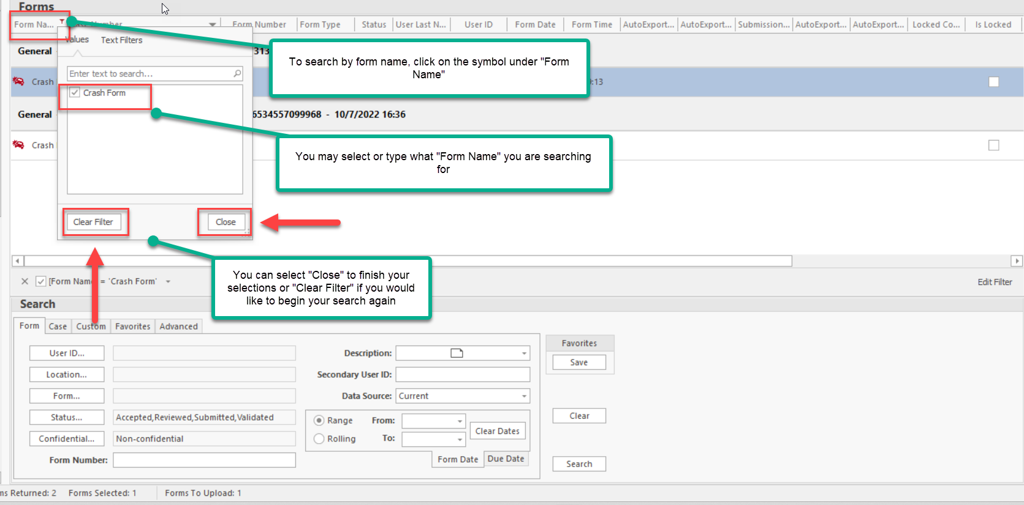
Searching by Form Name

Slide 24
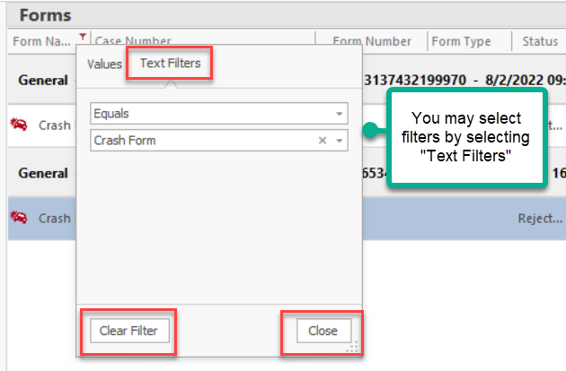
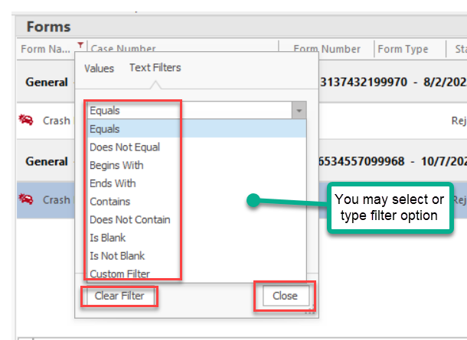
Filters for Searching by Form Name

Slide 25
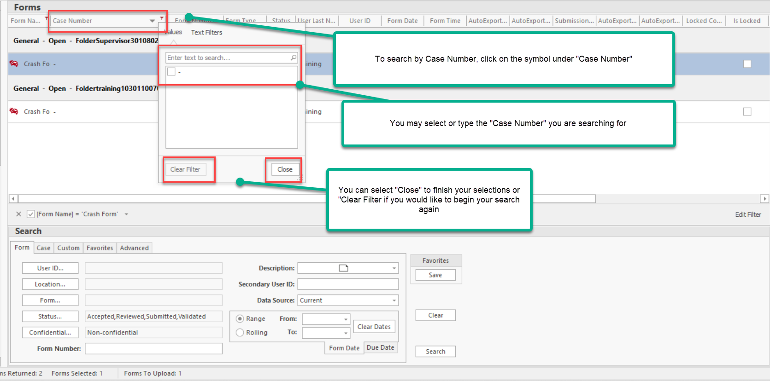
Searching by Case Number

Slide 26
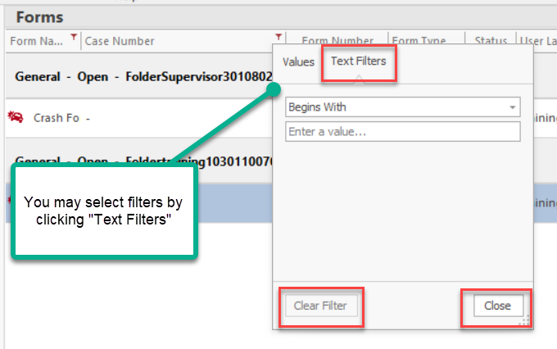
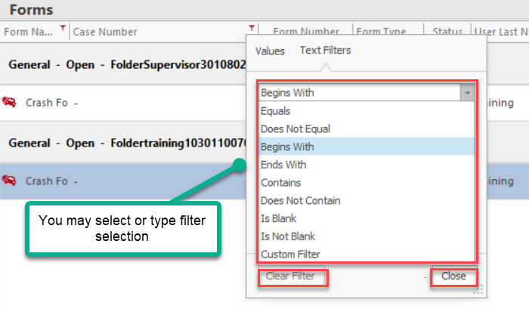
Filters for Searching by Case Number Search

Slide 27
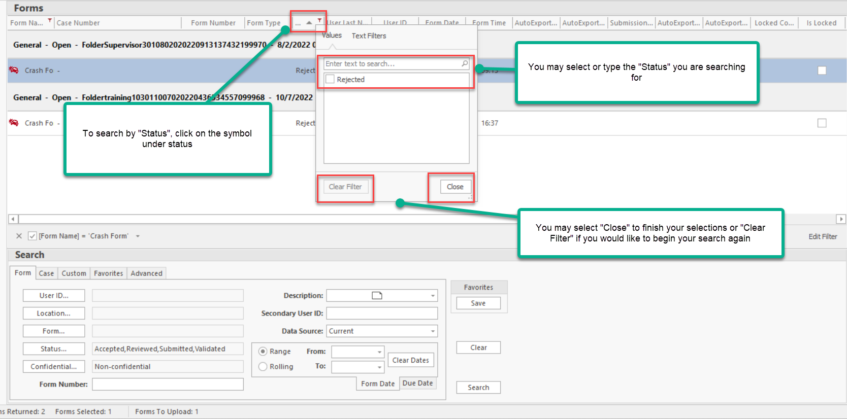
Searching by Status

Slide 28
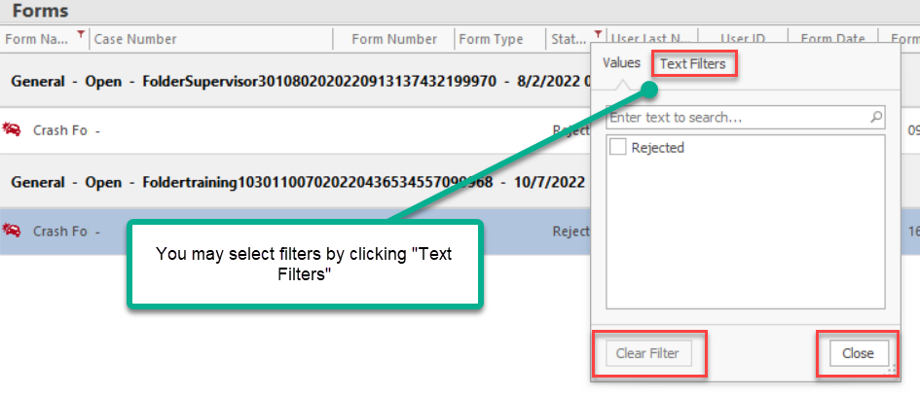
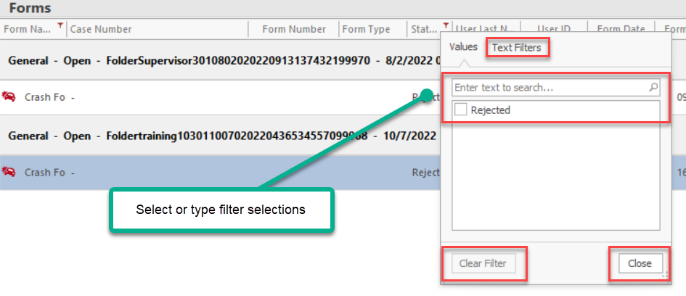
Filters for Searching by Status

Slide 29
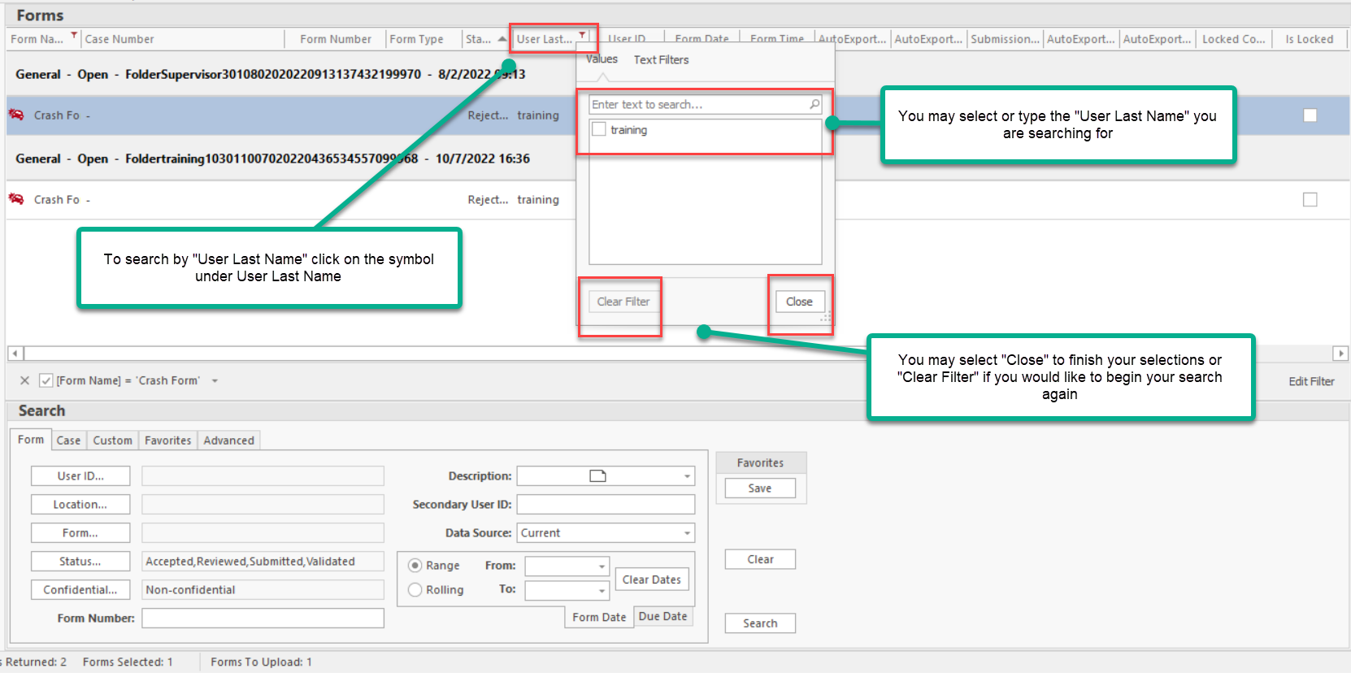
Searching by User Last Name

Slide 30
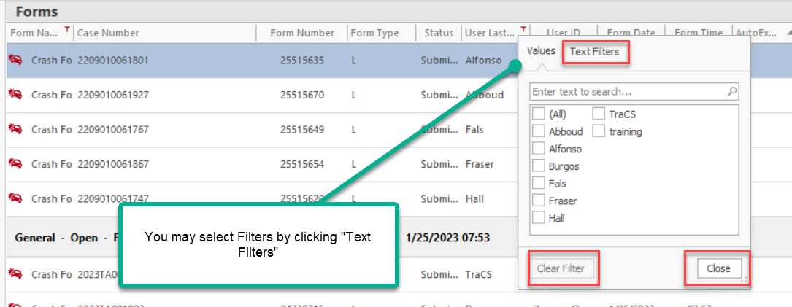
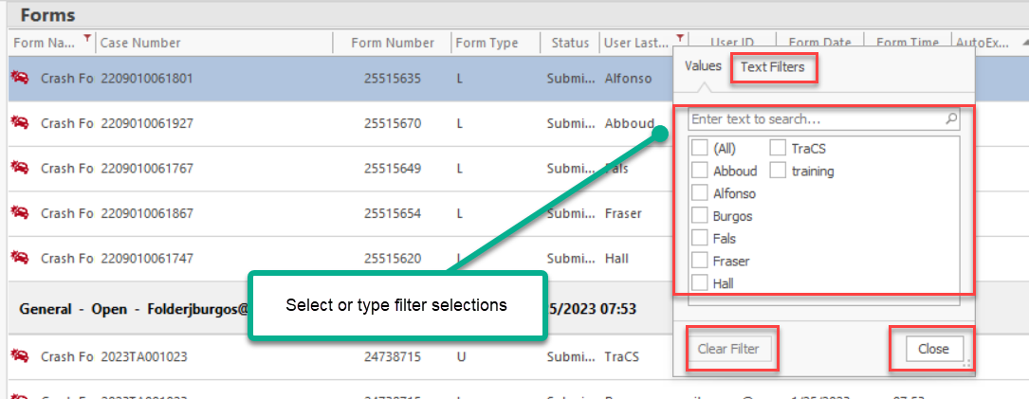
Filters for Searching by Last Name

Slide 31
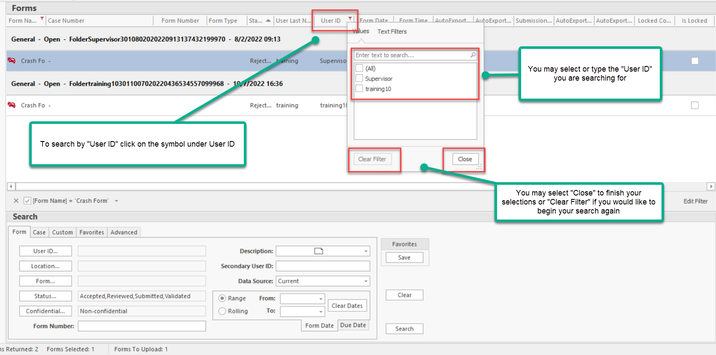
Searching by User ID

Slide 32
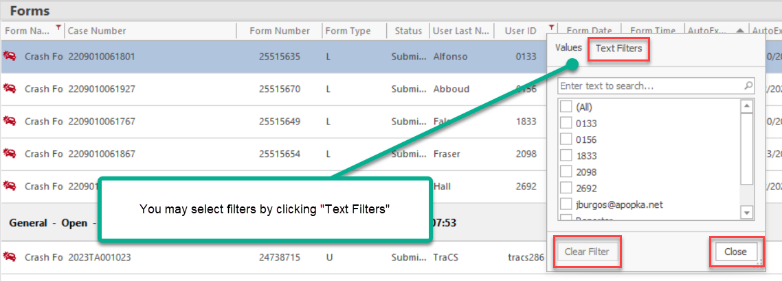
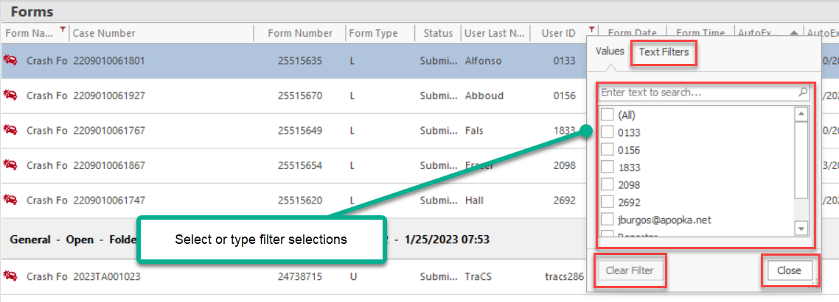
Filters for Searching by User ID

Slide 33
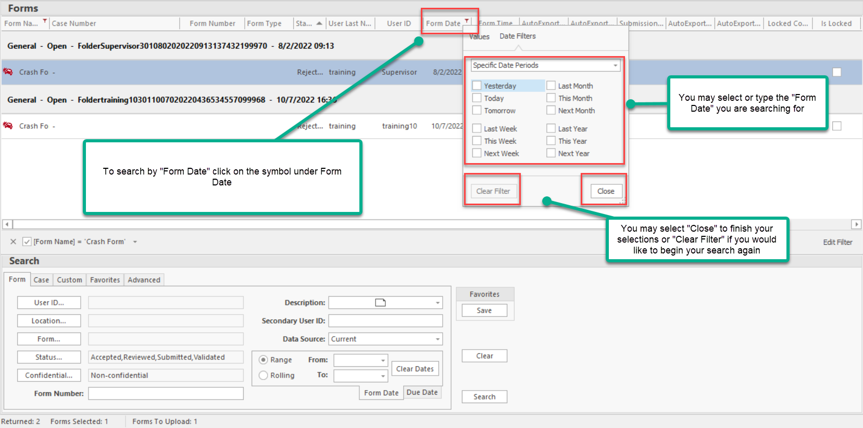
Searching by Form Date

Slide 34
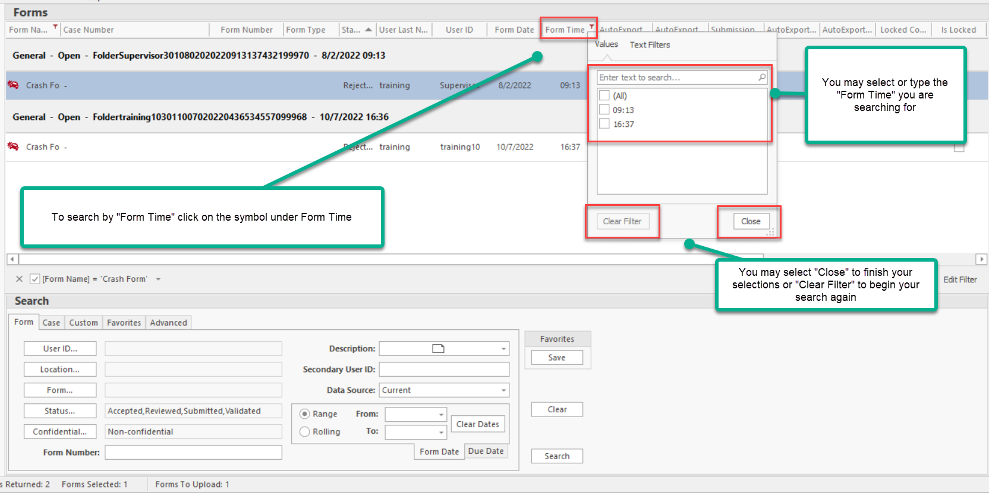
Searching by Form Time

Slide 35
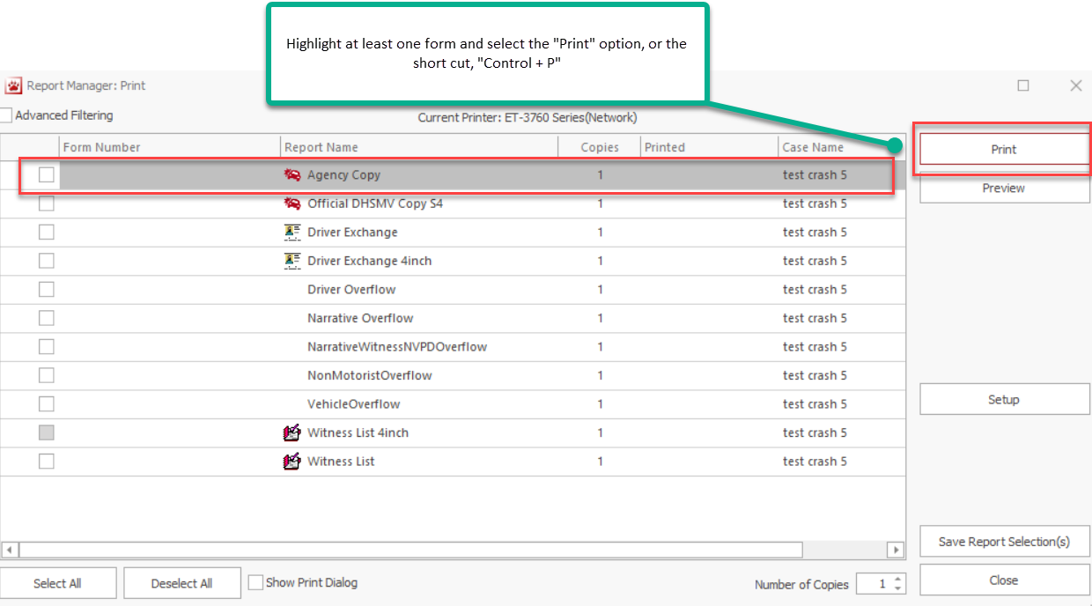
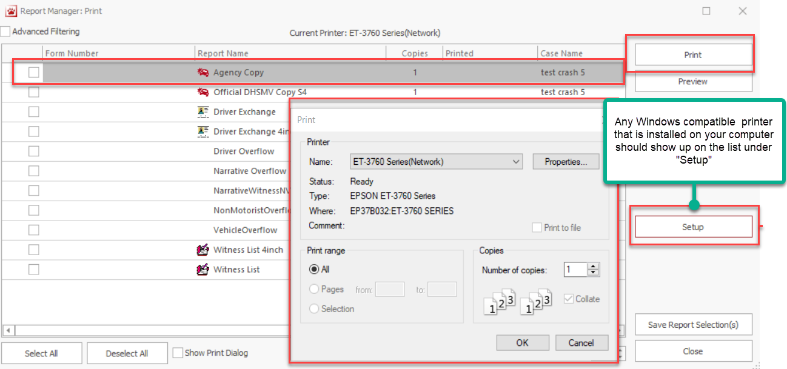
Printing

Slide 36
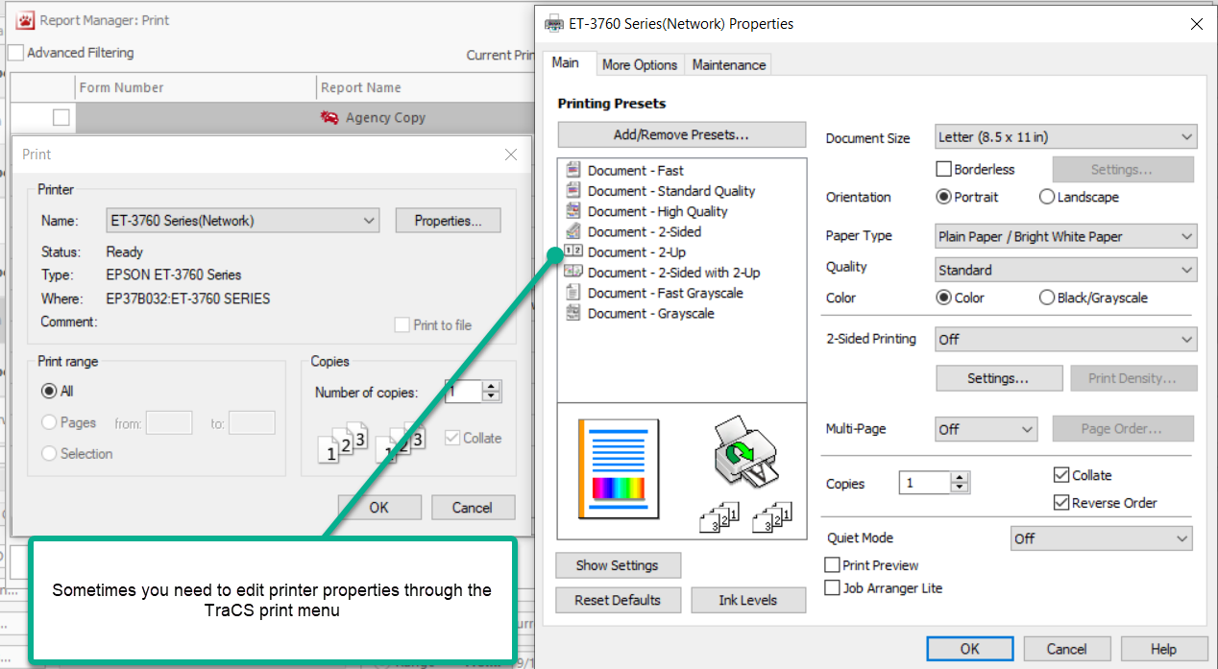
Printing

Slide 37
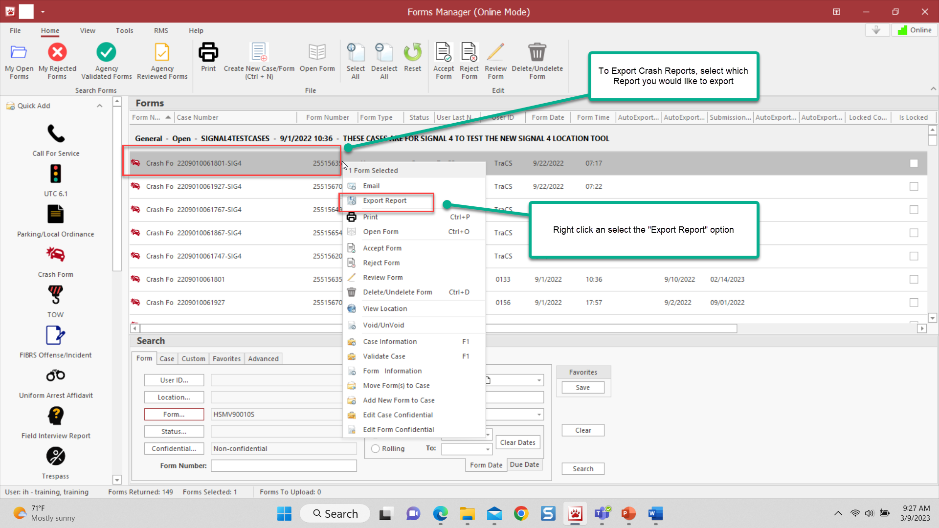
Exporting a Single Report

Slide 38
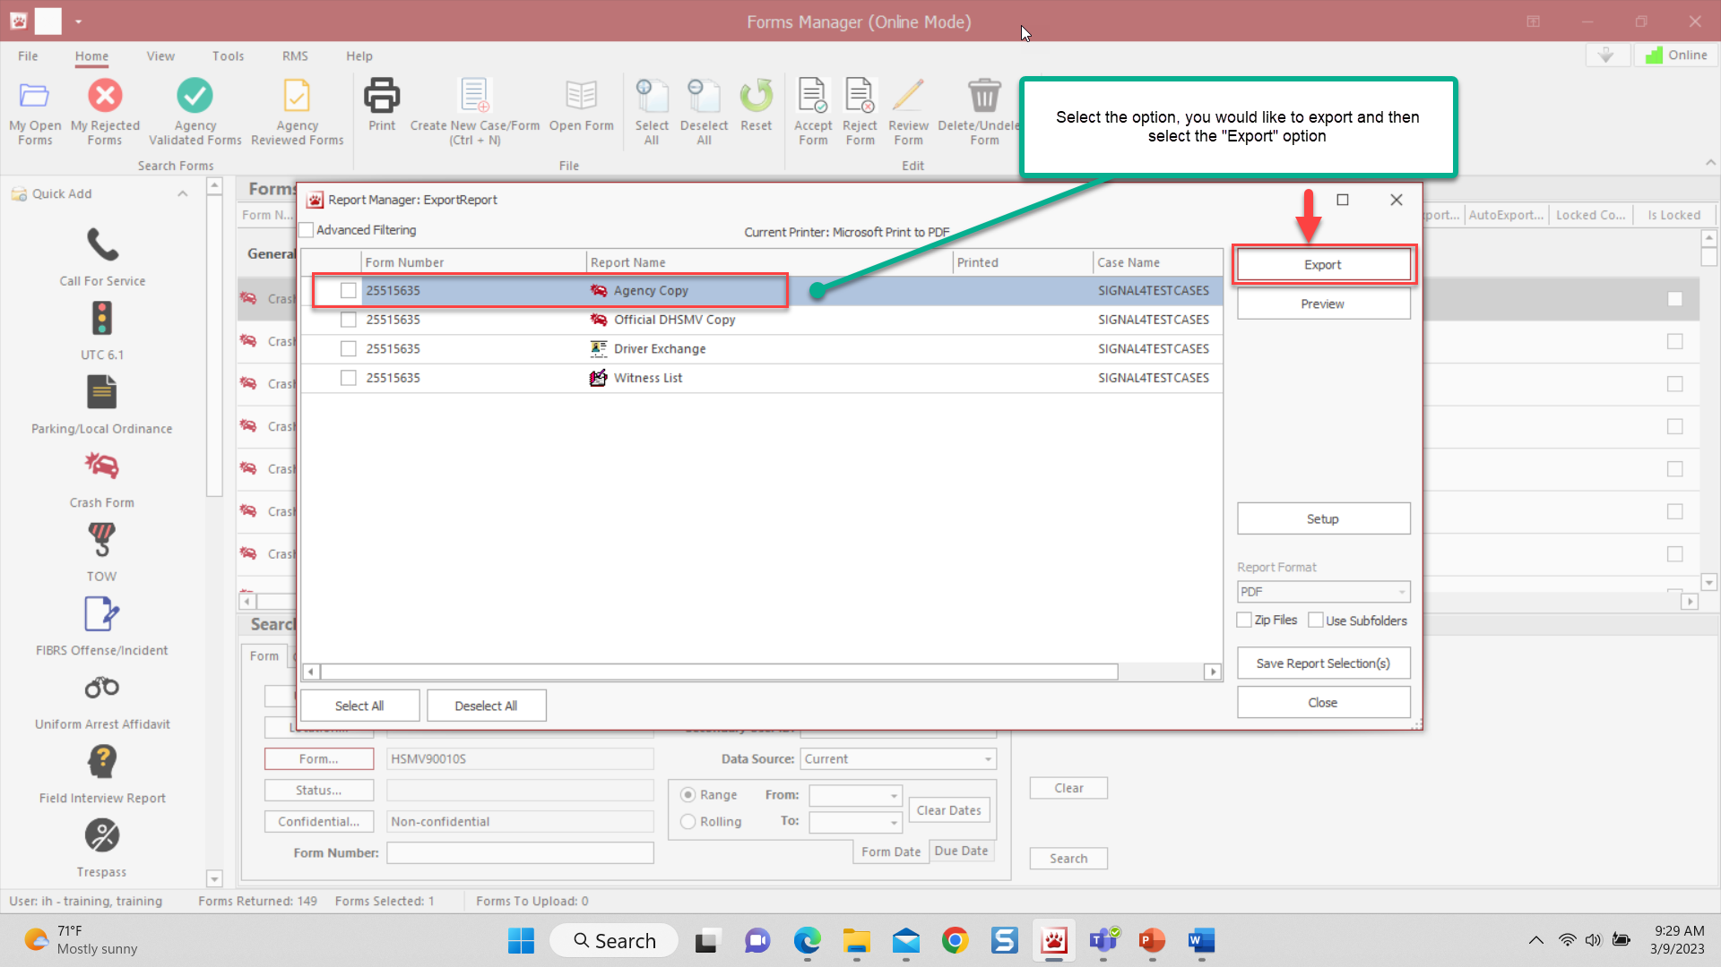
Exporting a Single Report

Slide 39
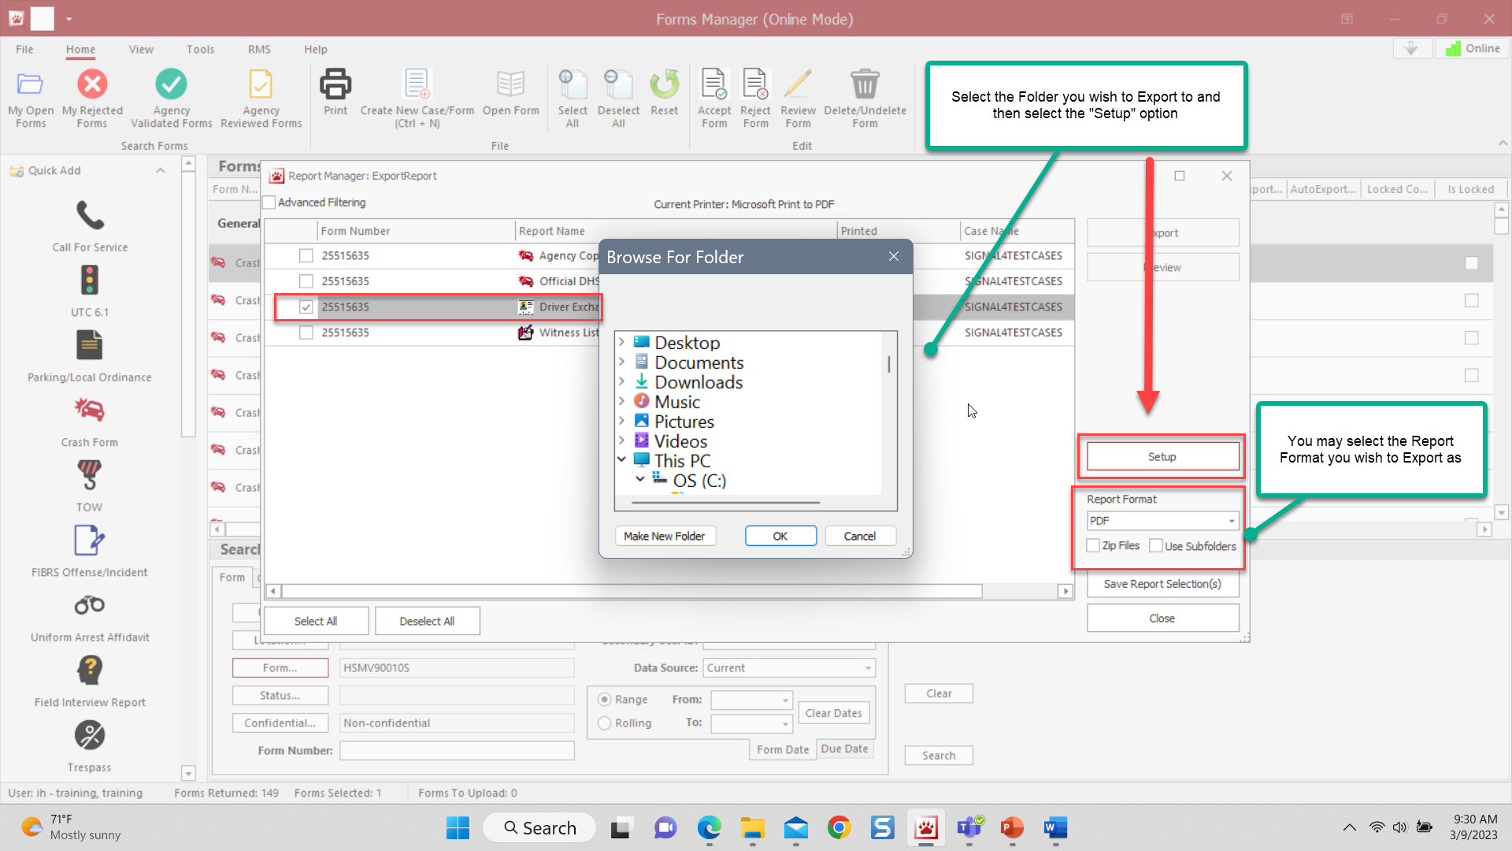
Exporting a Single Report

Slide 40
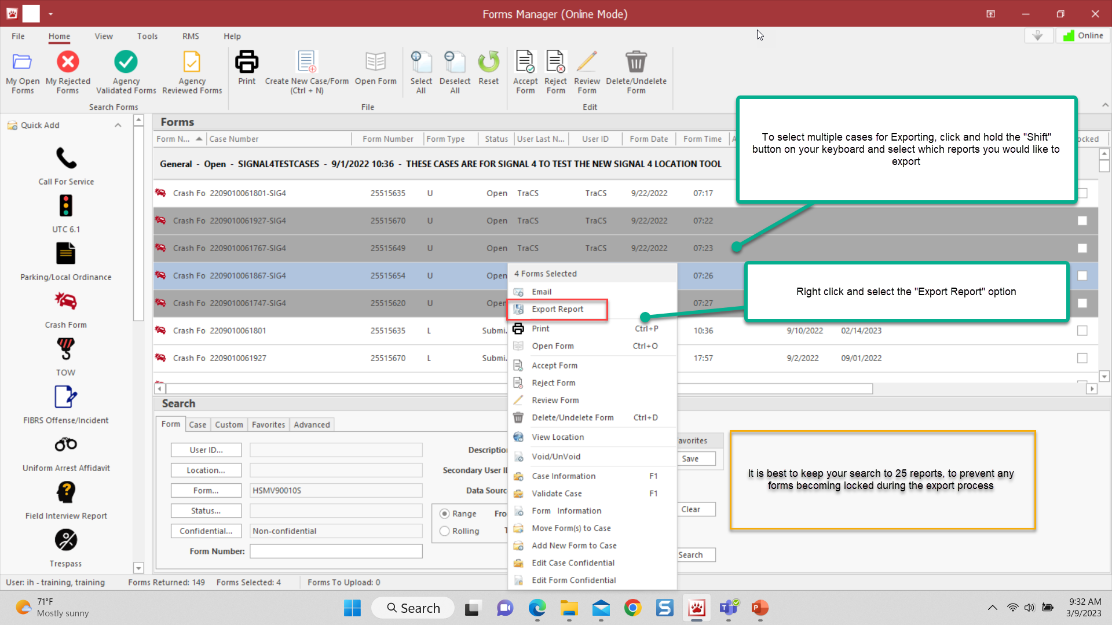
Exporting Multiple Reports

Slide 41
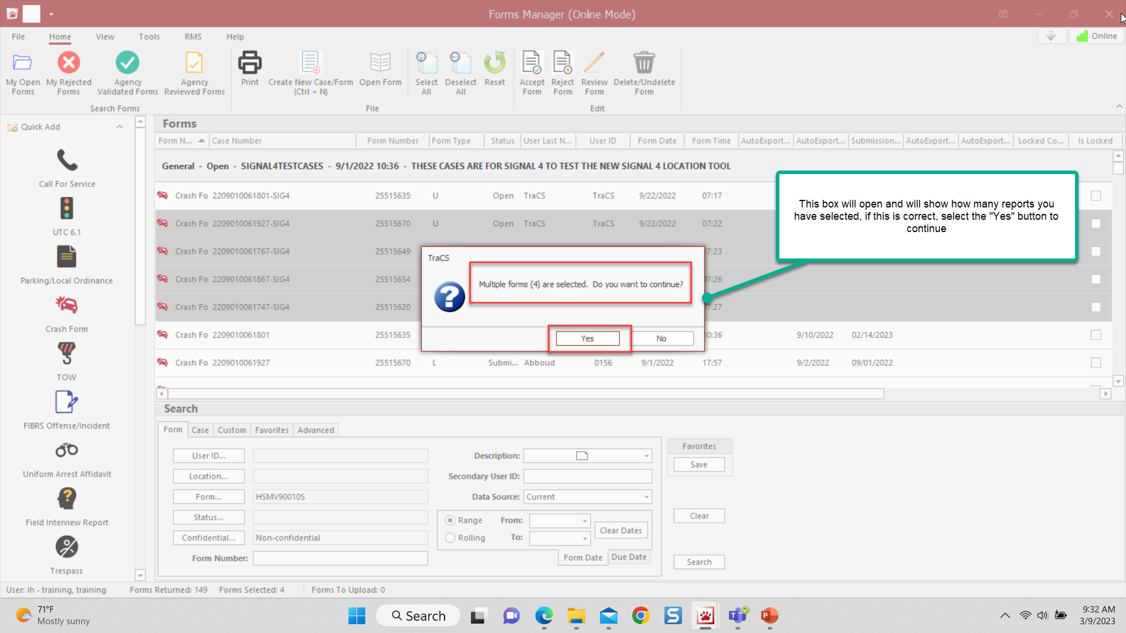
Exporting Multiple Reports

Slide 42
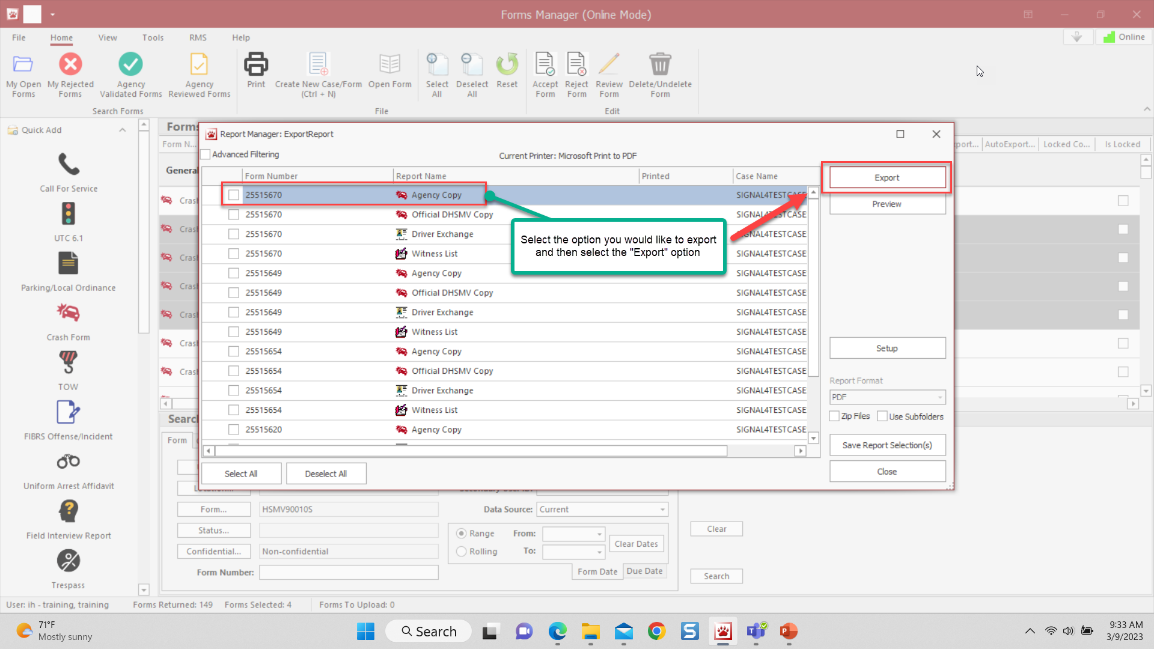
Exporting Multiple Reports

Slide 43
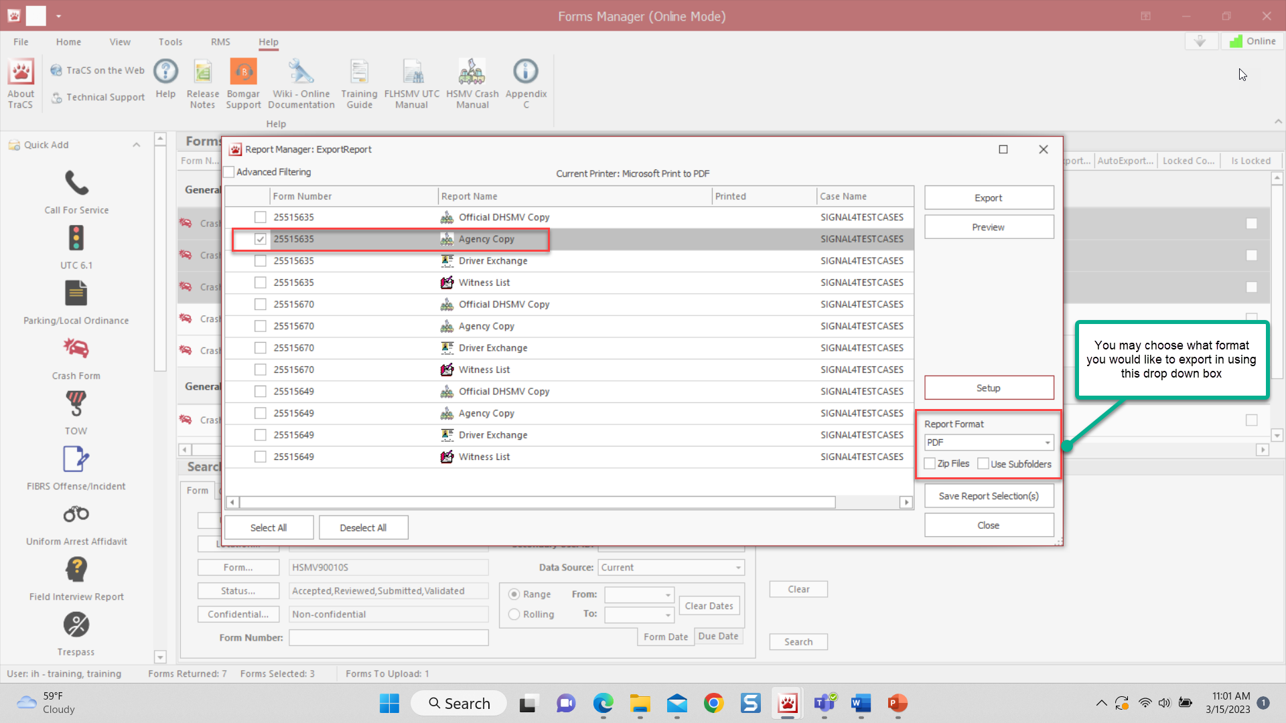
Exporting Multiple Reports

Slide 44
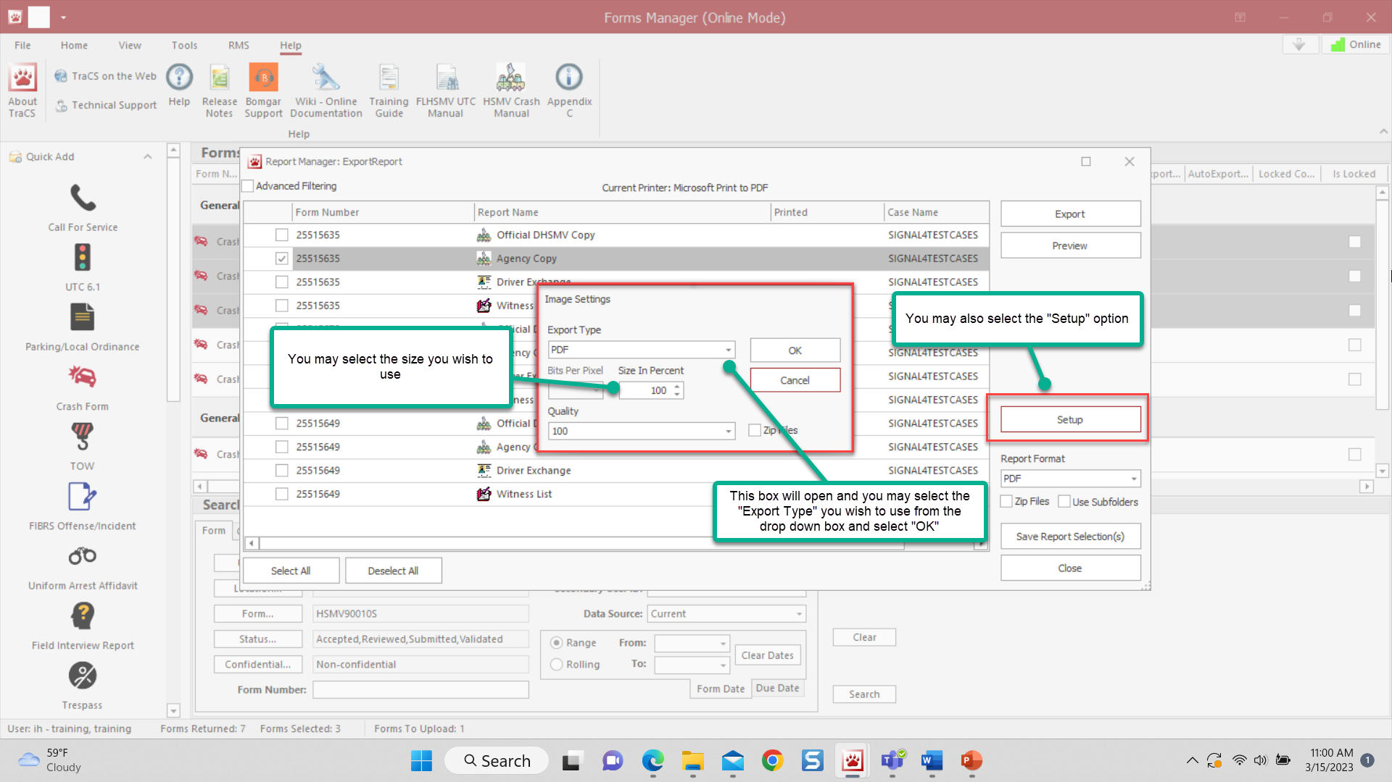
Exporting Multiple Reports

Slide 45
Status of Forms
Open - Officer/Deputy is still working on the form
Validated - The form has passed system edit checks and is ready to be reviewed or accepted by approving supervisors
Rejected - Supervisor sent the form back to the Officer/Deputy for rework
Reviewed - The first supervisor approved the form, and it is ready to be accepted
Accepted - The form is ready to go to DHSMV, Clerk, or RMS
Submitted - The crash form was sent to DHSMV as a final record, or the citation was sent to the Clerk as a final record
Voided - The form was voided
Submitted as Voided - DHSMV was notified by the agency that the citation number associated with a citation was Voided

Slide 46
For assistance contact TraCS Support
Help Desk - 850-410-6237
Email - support@tracsflorida.org
Enter Help Desk Ticket – https://www.tracsflorida.org

