Slide 1
Tow Sheet

Slide 2
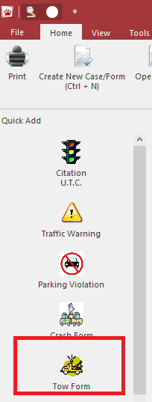
Open Tow Sheet
Click on the Tow icon on the left to open the form independently (outside of a crash)

Slide 3
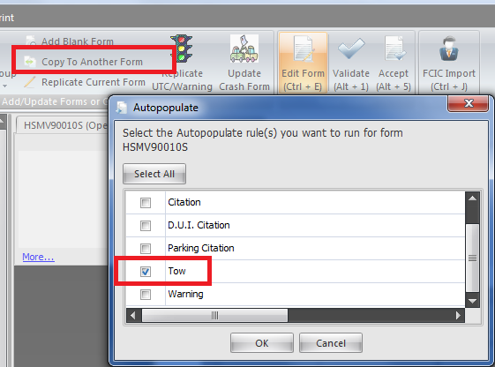
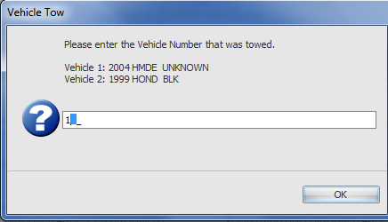
Crash– Add Tow Sheet
To add a tow sheet from a crash form, press the Copy to Another Form button and pick Tow
If more than one vehicle exists you will be asked which vehicle requires a tow sheet
Note: You’ll notice you can generate several other forms from a crash as well by pushing this button

Slide 4
Crash – Add Tow Sheet
You can create a tow sheet from a driver exchange
All but a few fields will be filled out since almost every field on the crash is also on the tow sheet

Slide 5
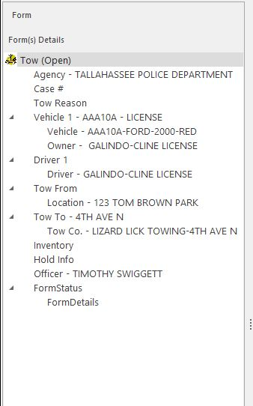
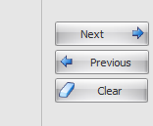
Navigating through the form
There are 5 ways to move from field to field:
Enter button
Tab button
Next button in the databar
Click on a field using your touchpad/mouse
Click in the Navigation Panel to jump around the form

Slide 6
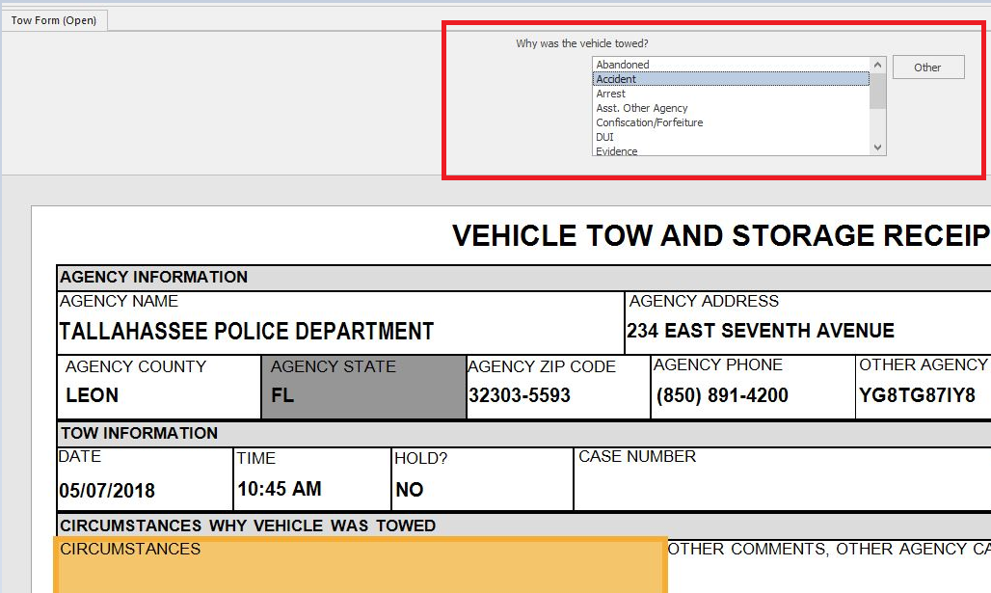
How to enter data
The databar is where you type in data
Help tips are provided

Slide 7
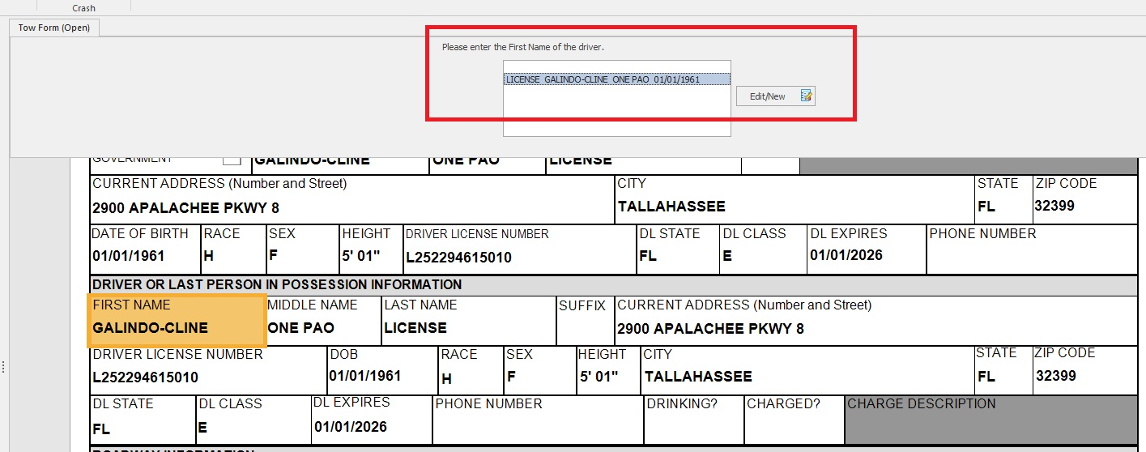
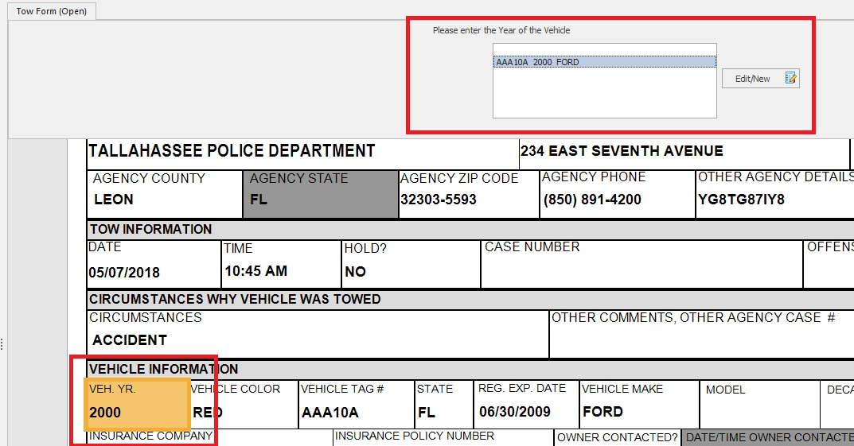
Import Persons and Vehicles
You can import from FCIC NCIC by click on the first name field or the vehicle year field.

Slide 8
Tow Company List
Tow locations can be selected from a list as long as your agency admin sets this up

Slide 9
Hold and Release Information
Hold and release information is at the bottom of the tow sheet

Slide 10
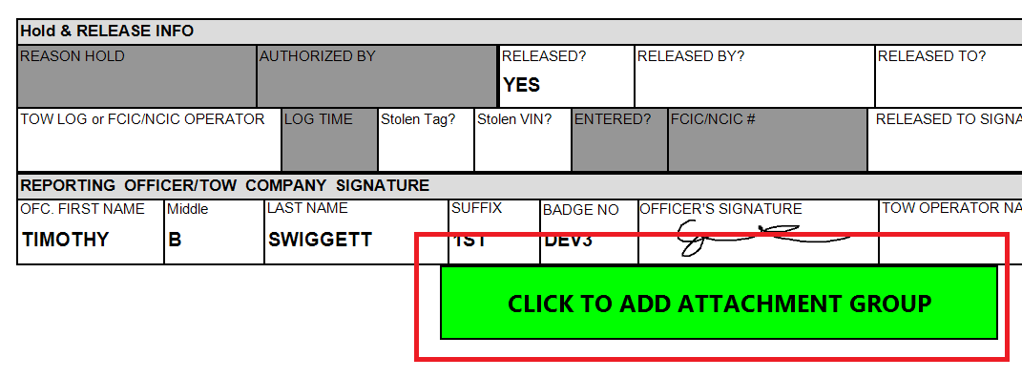
Adding Attachments
You can add pictures or documents associated with the tow to the form by clicking on the “click to add attachment group”

Slide 11
Attachment Details

Slide 12
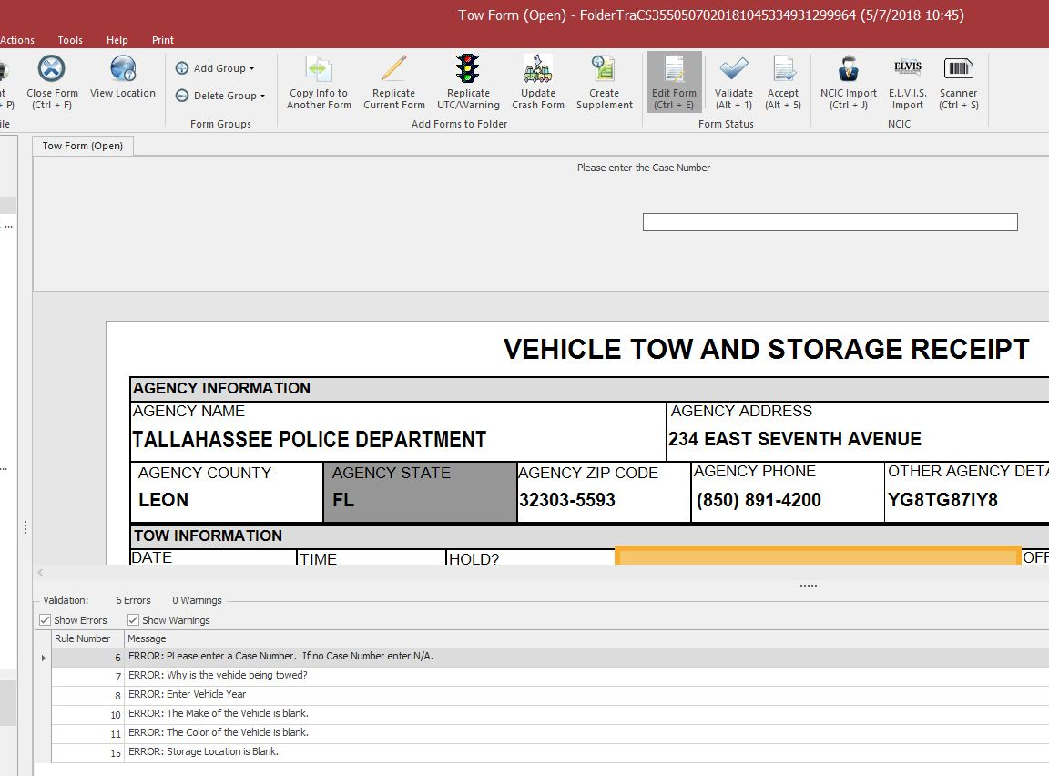
Validation
Once a user has completed filling out a form, the validate button will check the form data against the DHSMV edit rules to help ensure acceptance of the form once it is submitted
Errors and warnings are displayed in the bottom pane
You may double click the item to jump to the field on the form that requires correcting
Warnings DO NOT prevent validation
You can uncheck the Warnings box so you only see Errors

Slide 13
Accept the Tow Form
After officers Validate the crash form, supervisors will Accept the crash form.

Slide 14
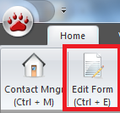
Edit Forms After Closing
If you shut down a form and reopen it, you must click on the Edit Form button

Slide 15
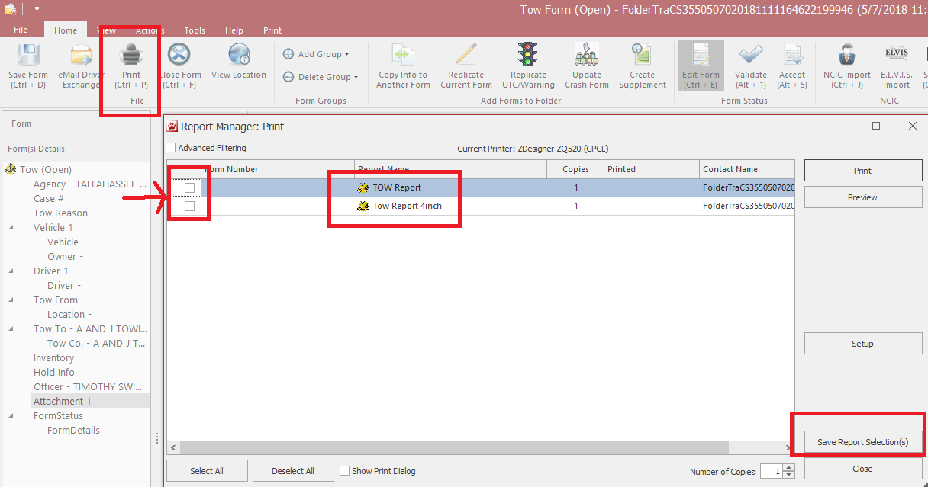
Printing Reports
The print button (control + P shortcut) will display print options for full page and 4inch.
You can check the one you always use then select “Save Report Selection(s)” so you don’t have to click the button every time.
Never select a printer through setup button, always pick your default windows printer BEFORE logging into TraCS.

Slide 16
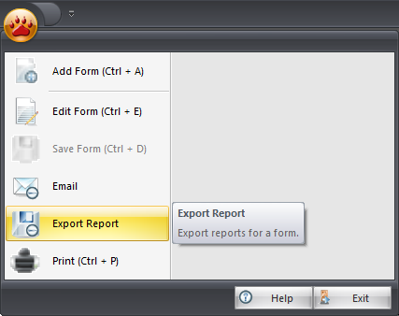
Export Reports
If users would like to export a crash report as a PDF, tiff, or other format, use the Export option.

Slide 17
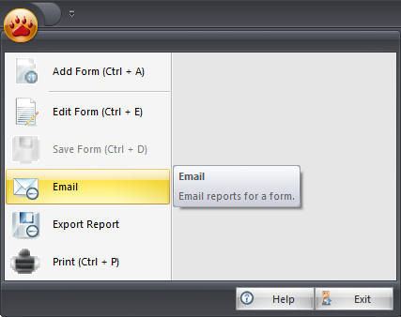
Email Reports
If you have an Outlook profile on your local machine, email should be automated
Otherwise, please use the Export function to email reports with other email providers

