Slide 1
User Management Guide
02-09-23

Slide 2
Tracs User Management
Navigate to:
Searching Users
Adding New Users
User Access Levels
Security Settings / Reset Password
Inactivate User
Unlock User Account
Setting Security Features
Associated Users
Advanced Settings
Changing User ID’s
Miscellaneous

Slide 3
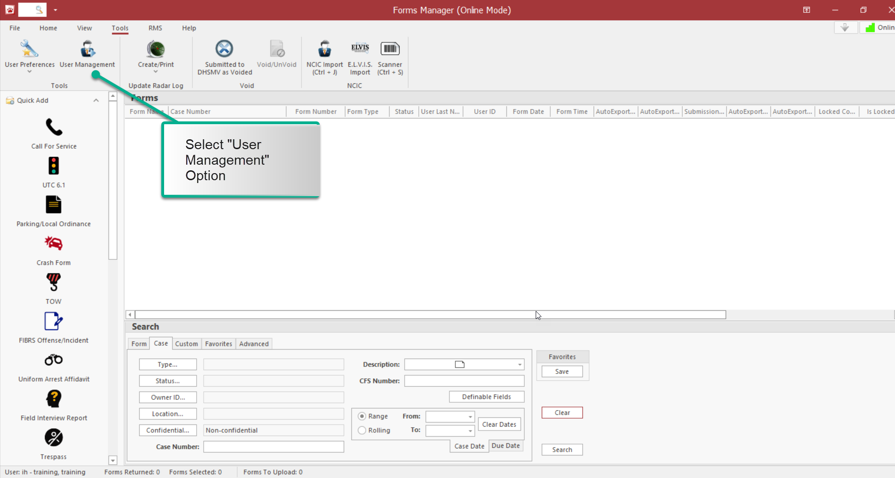
Launching User Management Web Portal

Slide 4
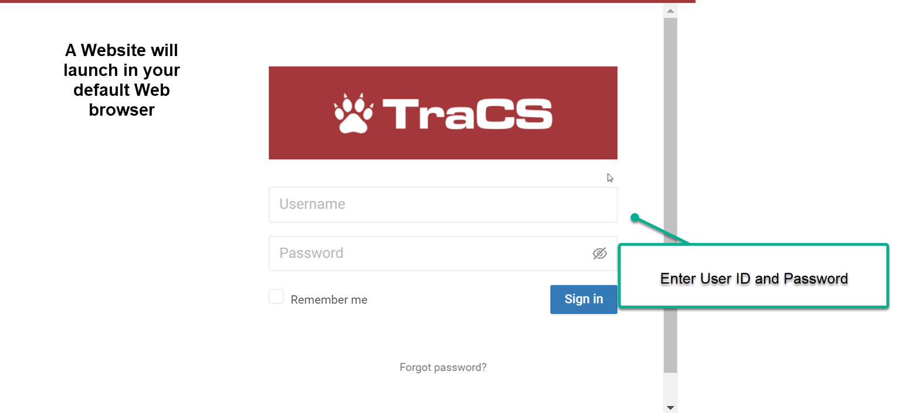
Sign Into User Management Web Portal

Slide 5
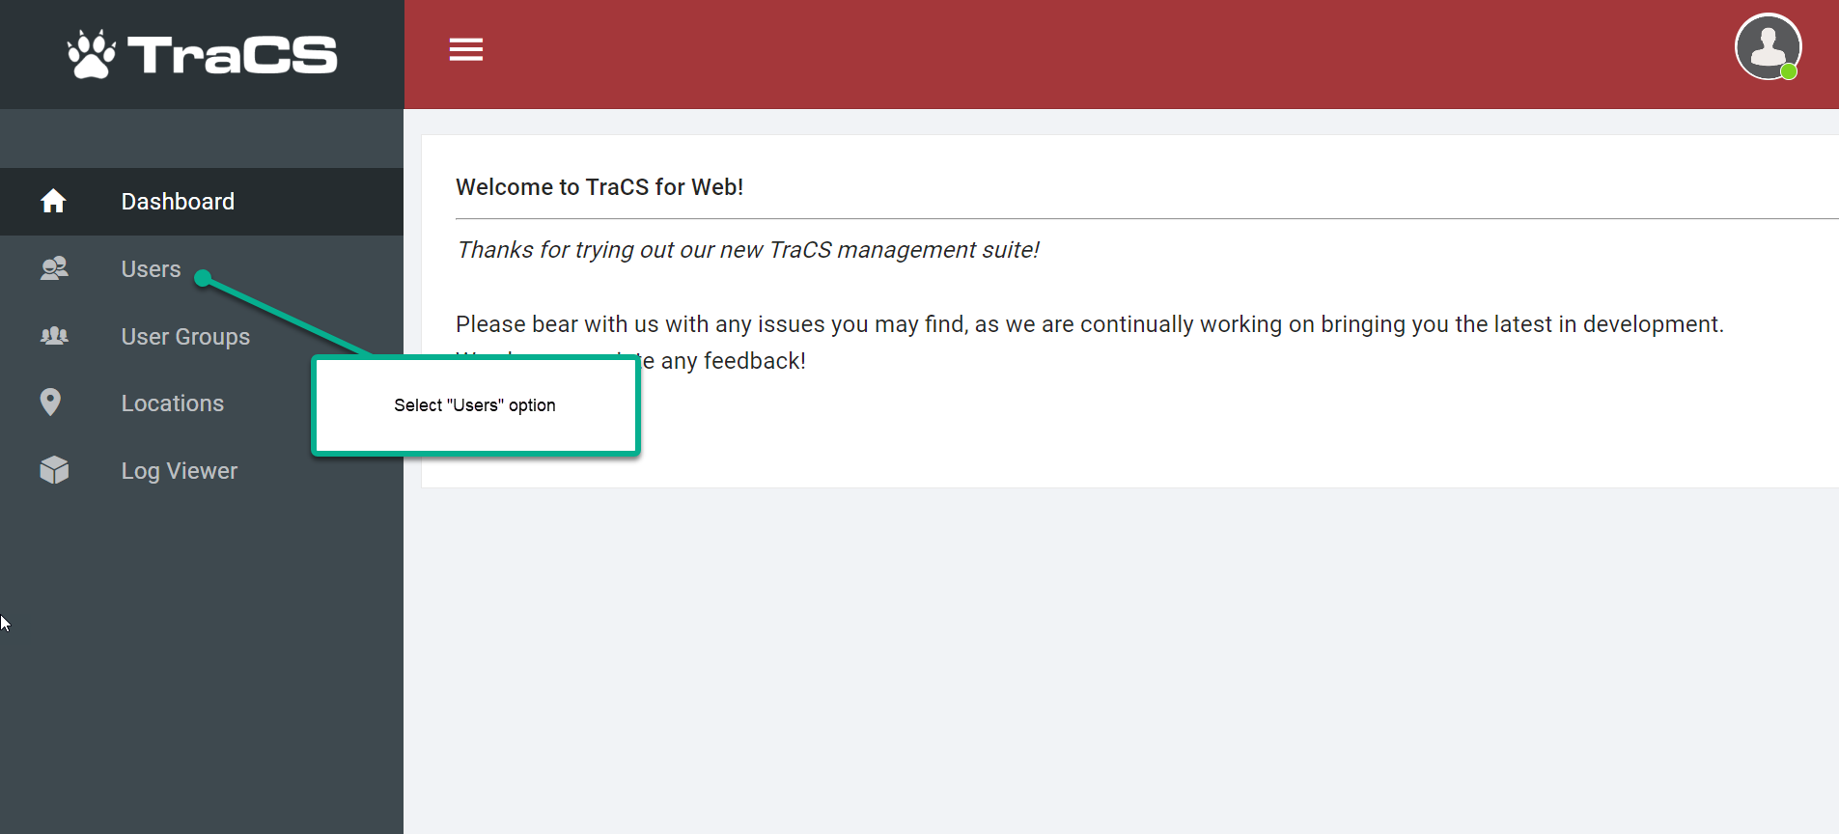
Accessing User Information

Slide 6
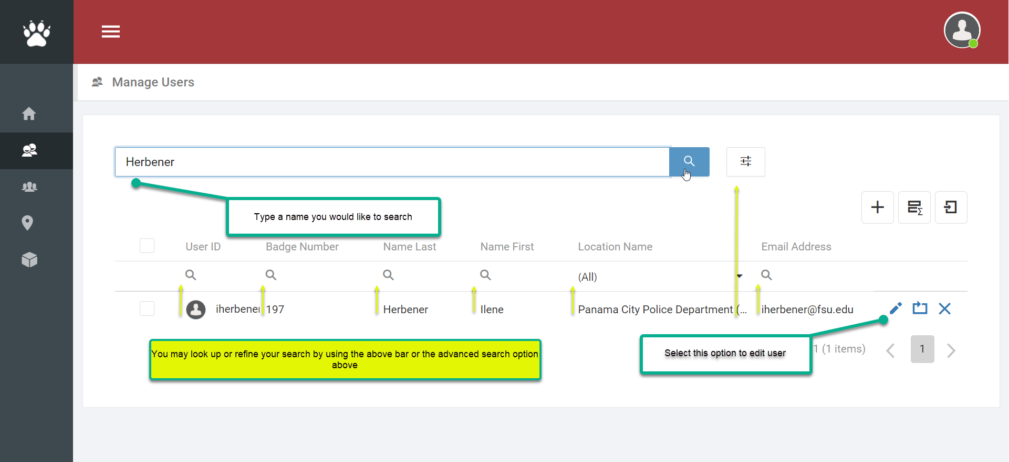
Searching Users

Slide 7
Refining User Search

Slide 8
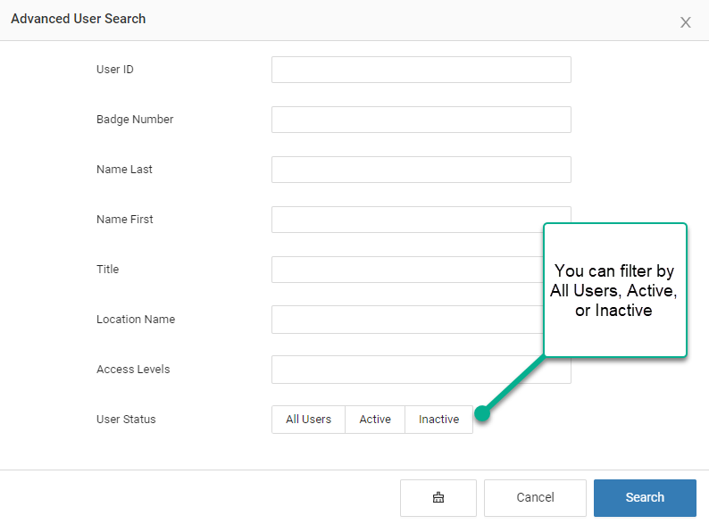
Refining User Search

Slide 9
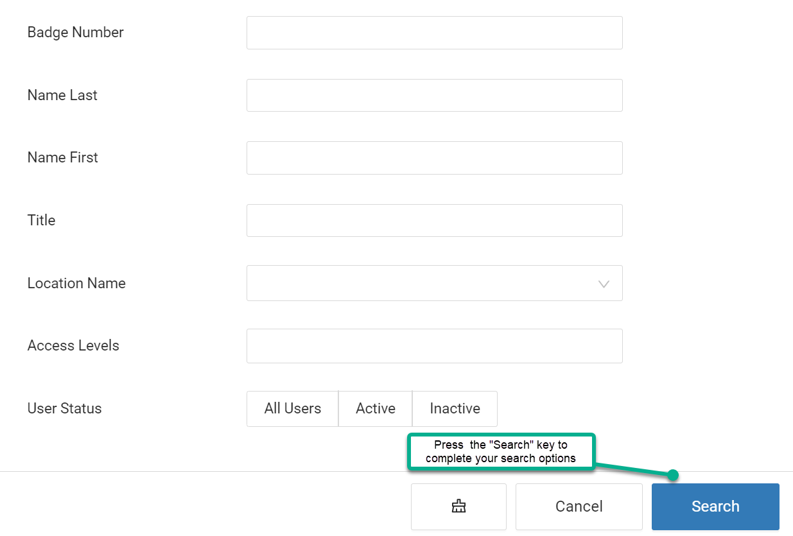
Refining User Search

Slide 10
Adding a New User – Copy From Another User

Slide 11
Adding a New User

Slide 12
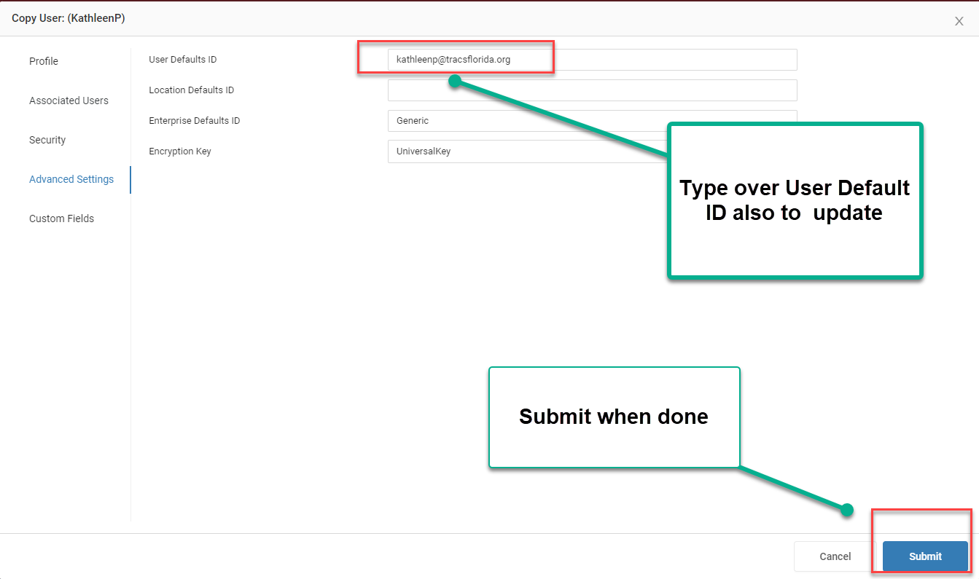
Adding a New User

Slide 13
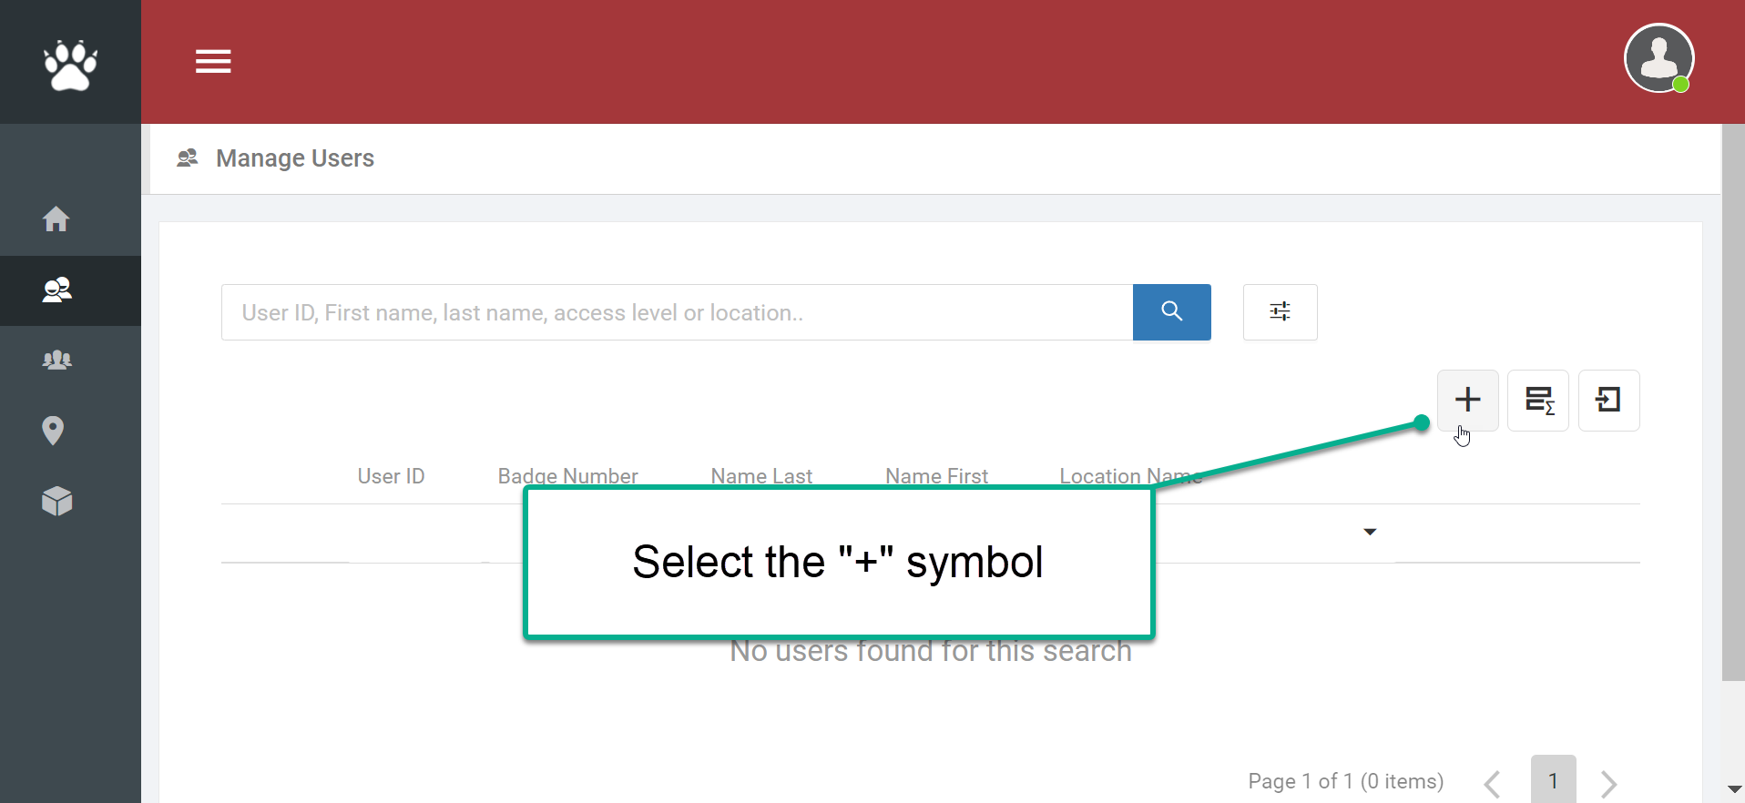
Adding a New User – From Scratch

Slide 14
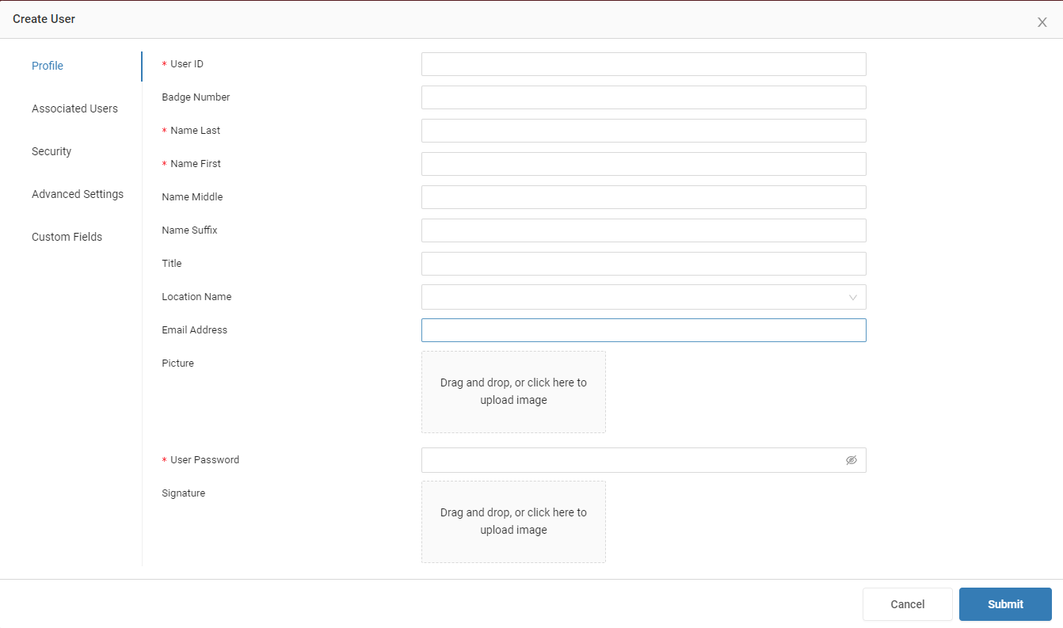
Adding a New User

Slide 15
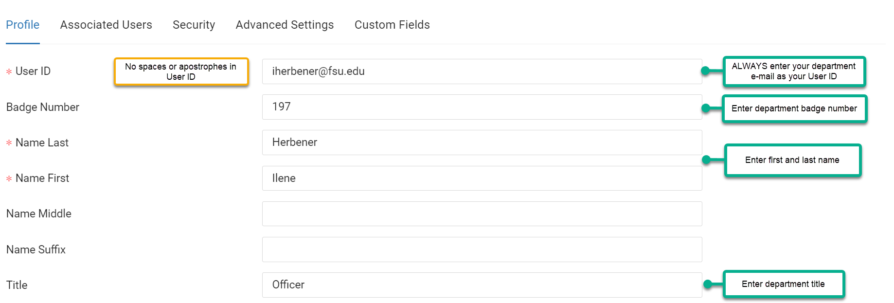
Adding a New User

Slide 16
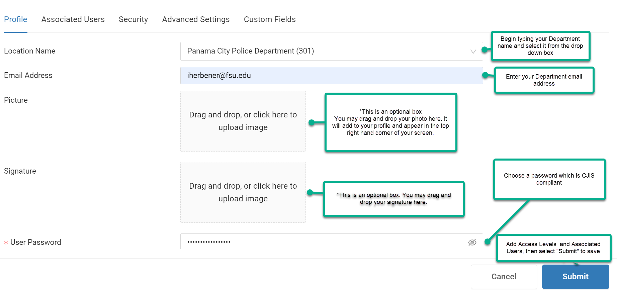
Adding a New User

Slide 17
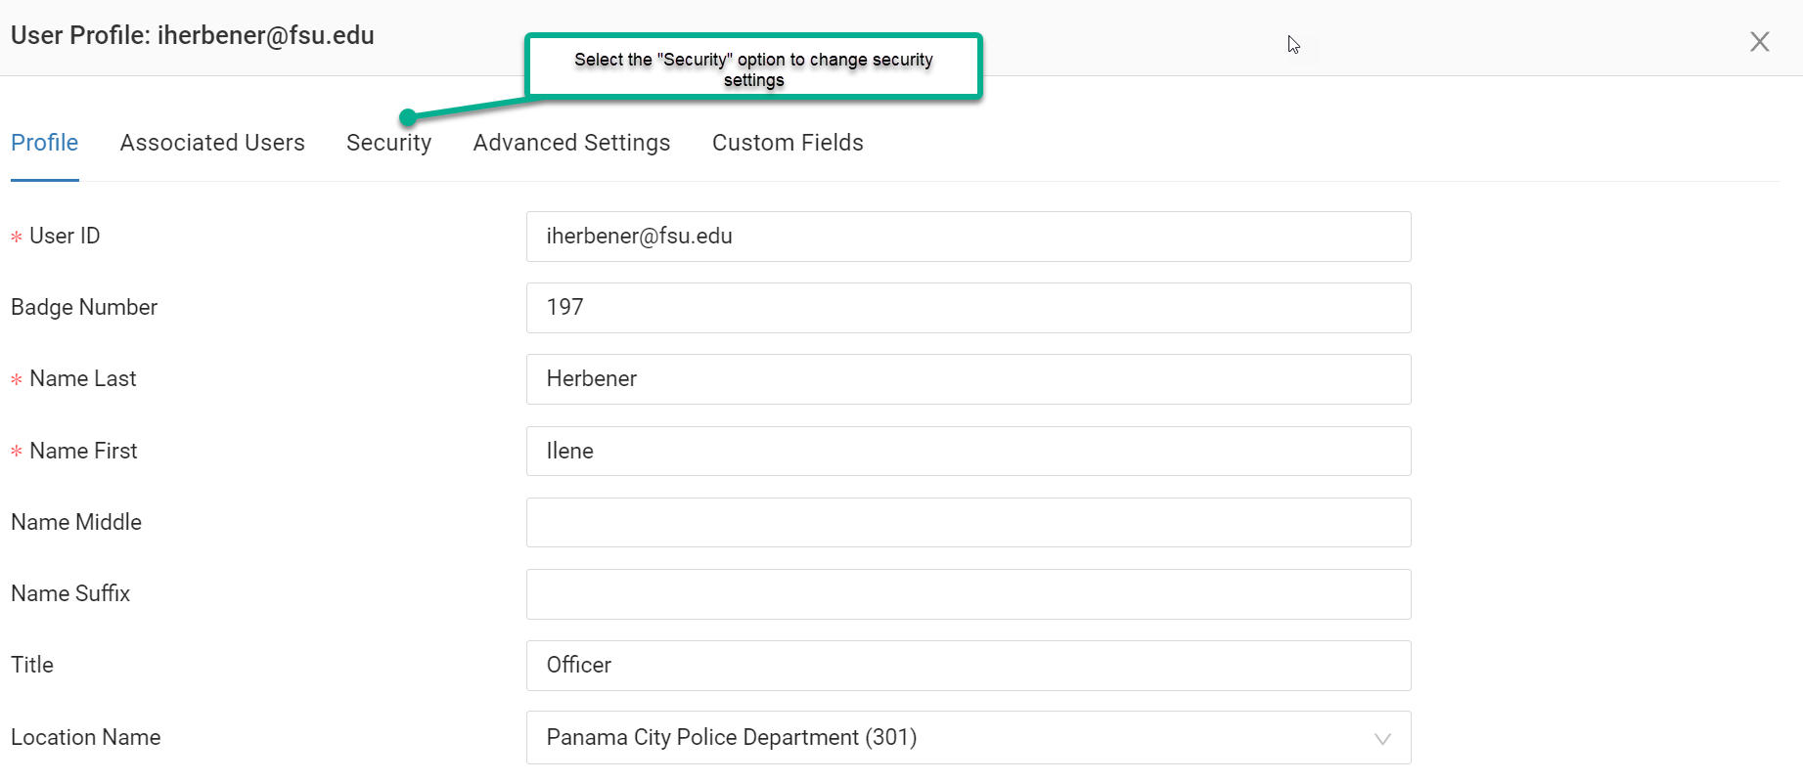
User Access Levels

Slide 18
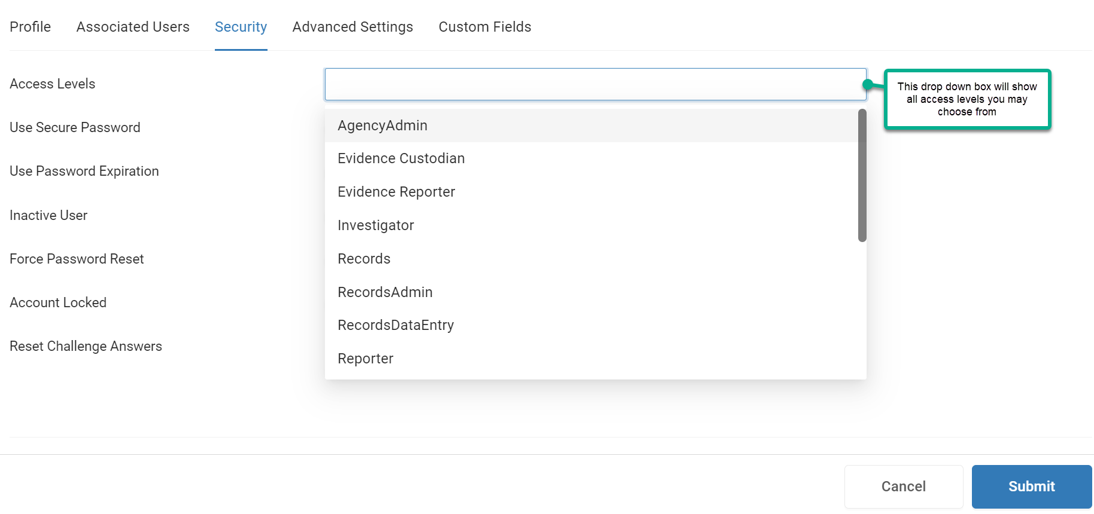
User Access Levels

Slide 19
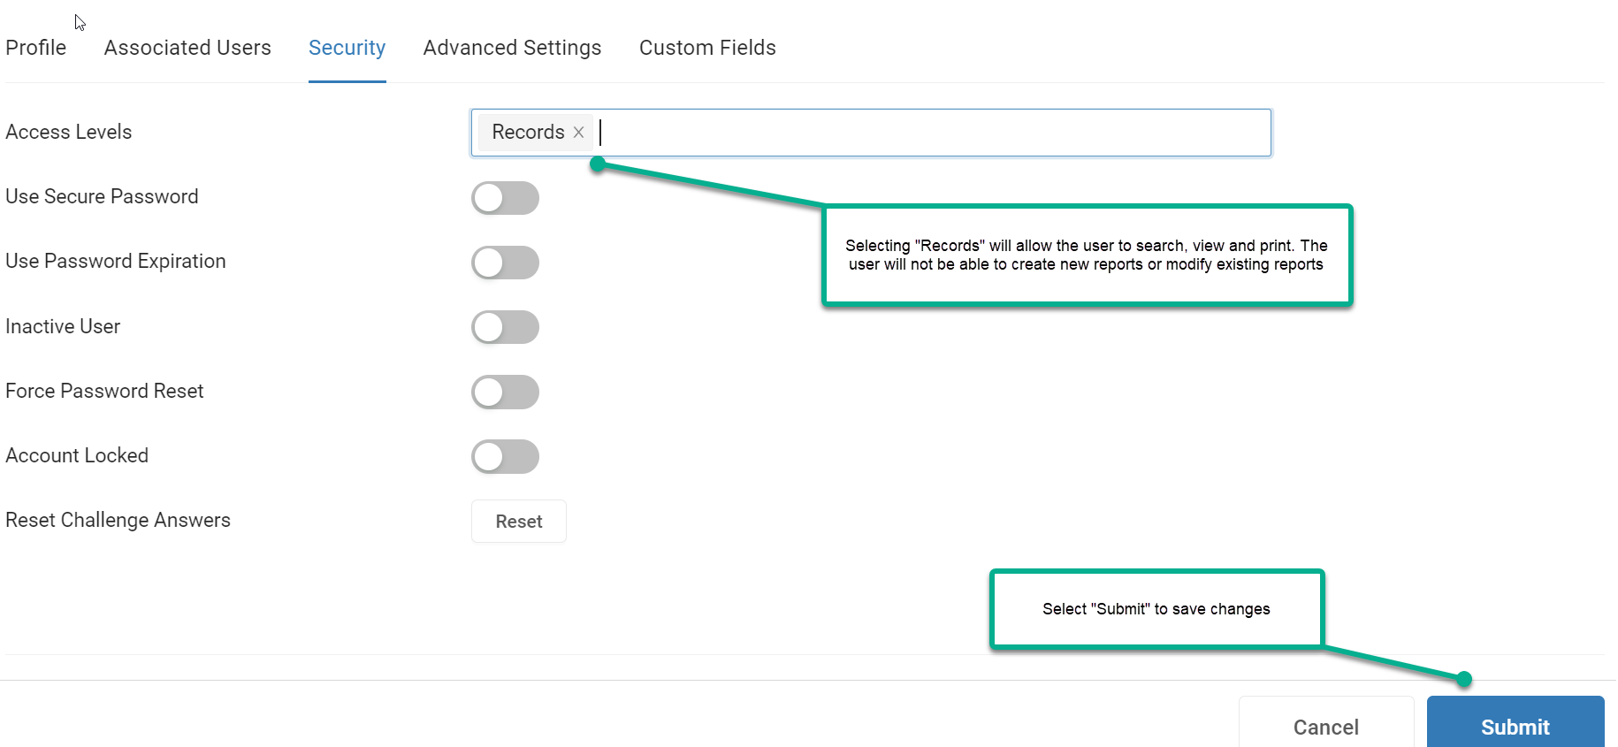
User Access Levels

Slide 20
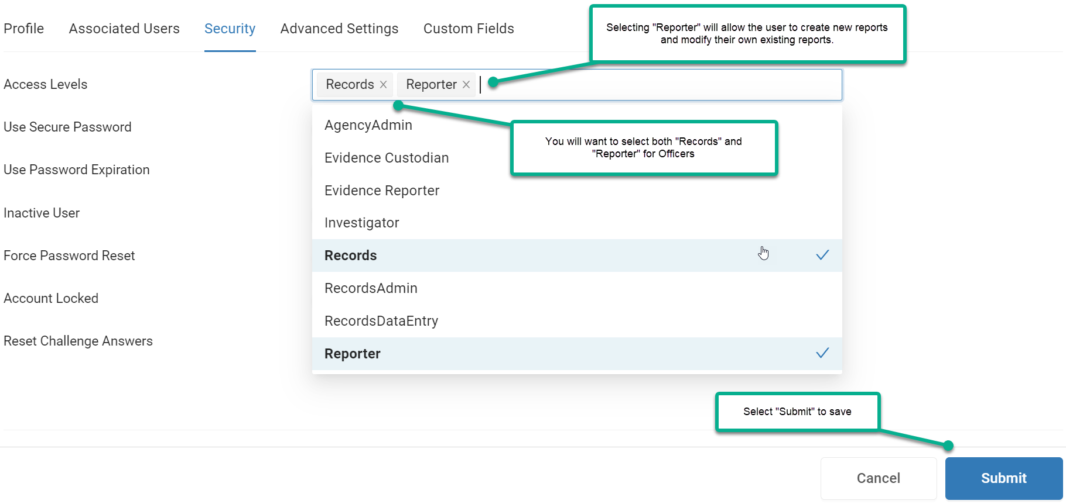
User Access Levels

Slide 21
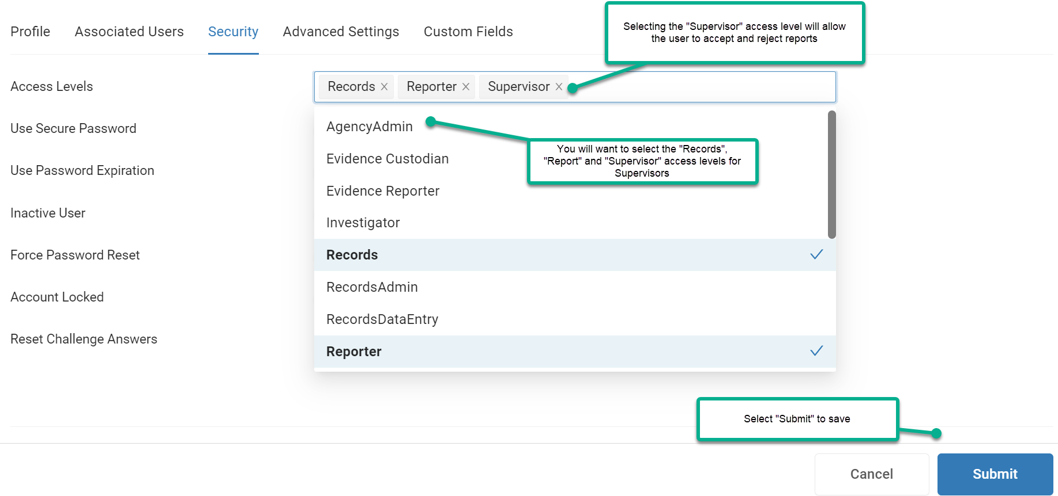
User Access Levels

Slide 22
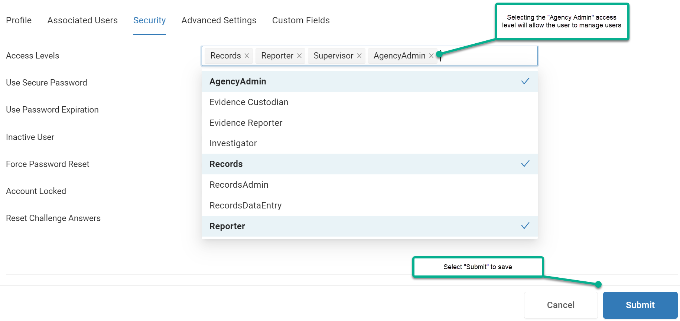
User Access Levels

Slide 23
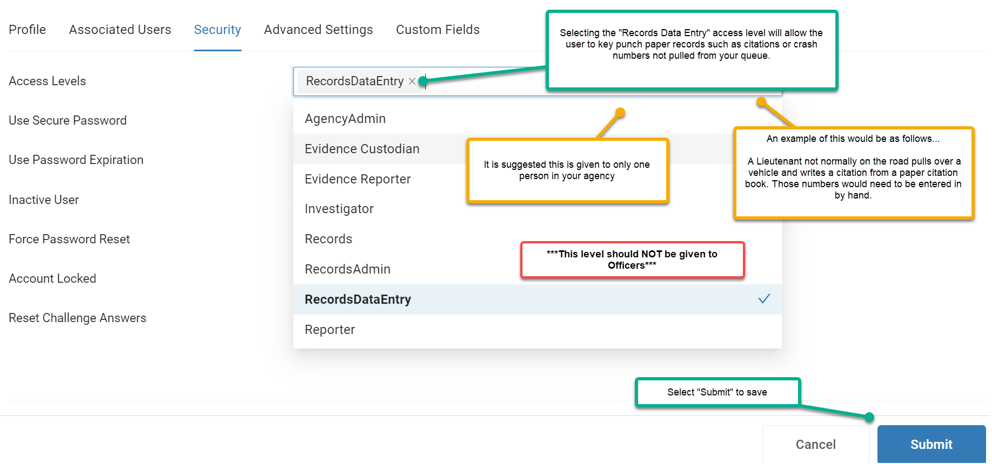
User Access Levels

Slide 24
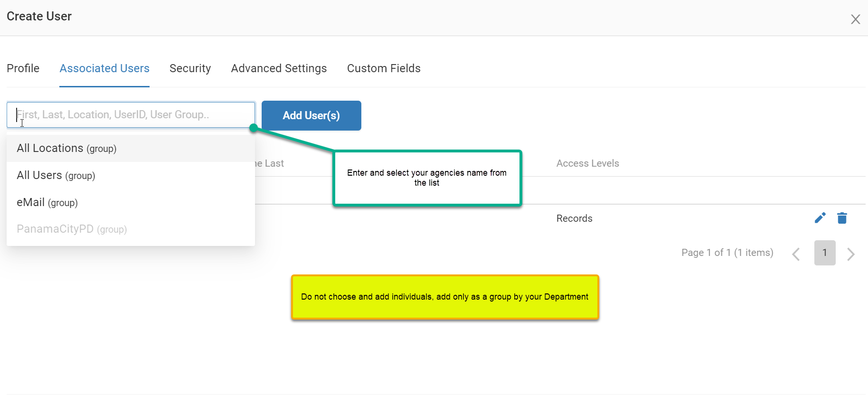
Associated Users

Slide 25
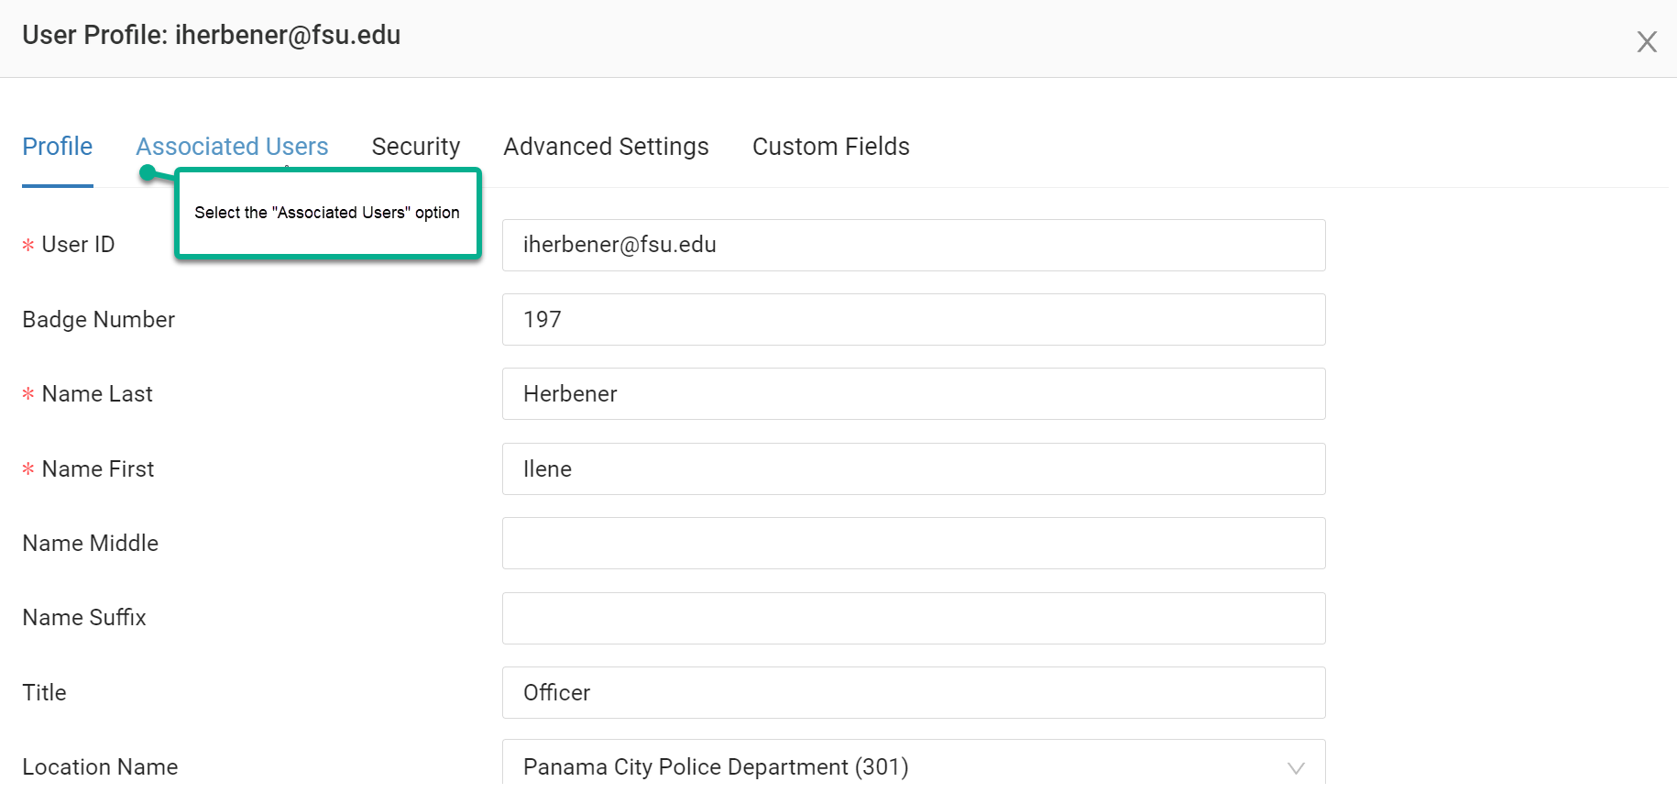
Associated Users

Slide 26
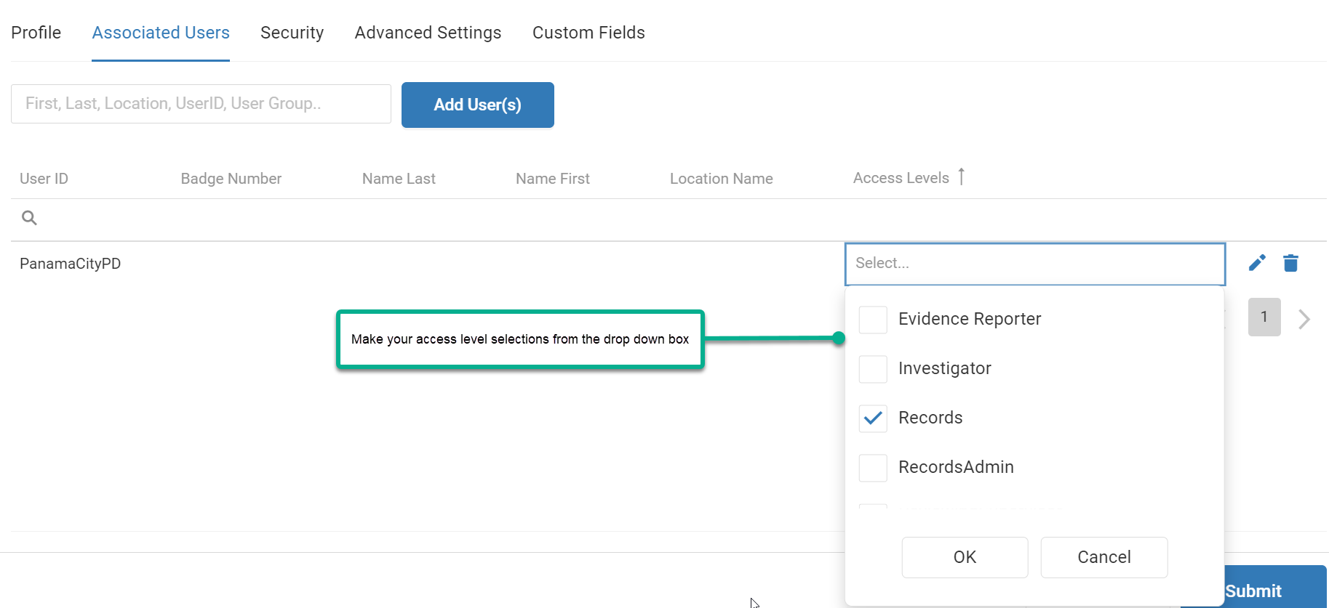
Associated Users

Slide 27
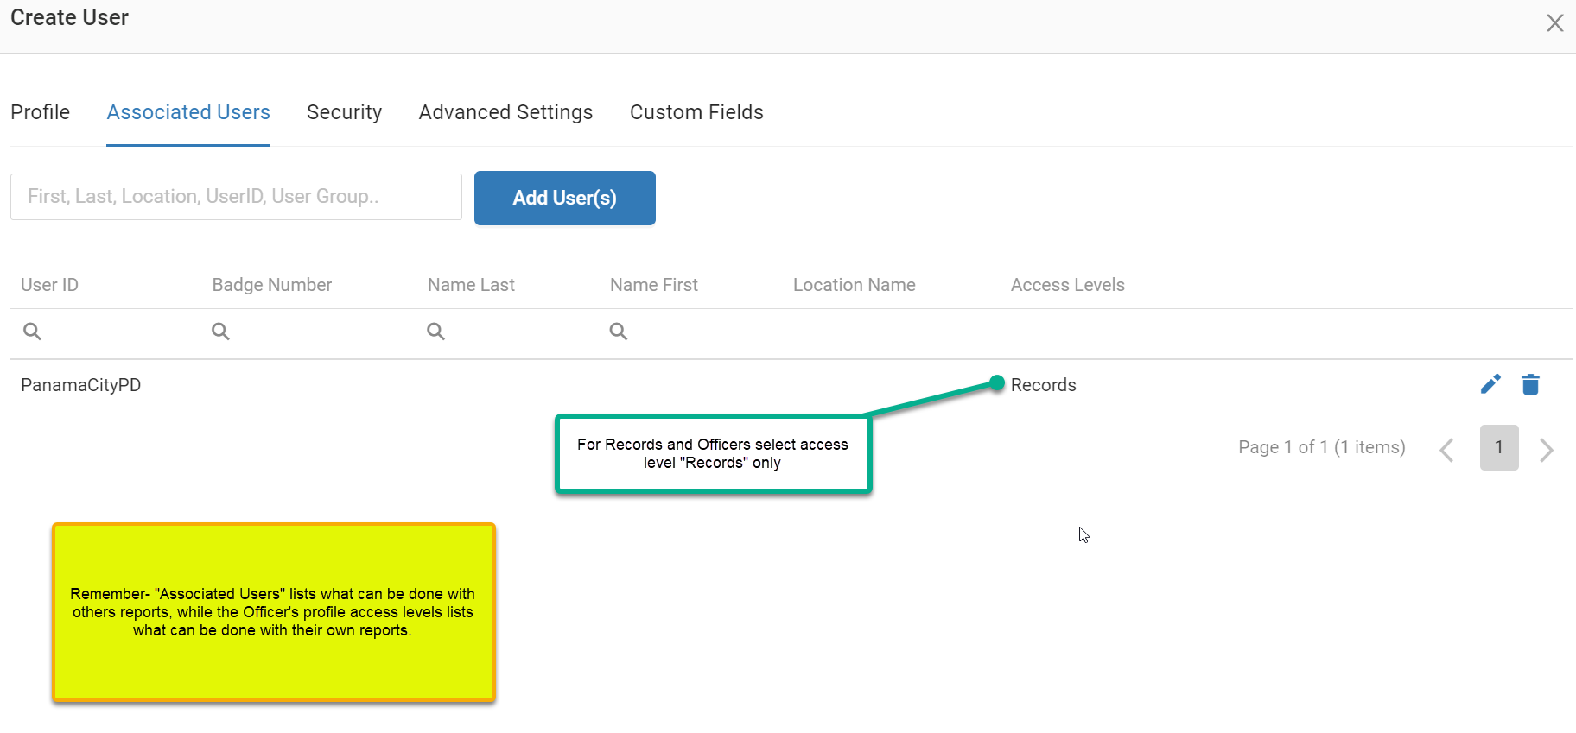
Associated Users

Slide 28
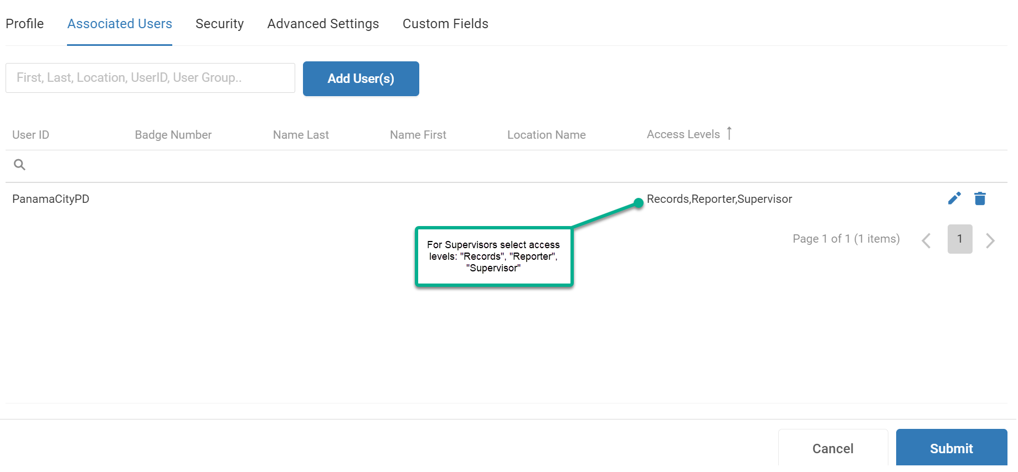
Associated Users

Slide 29
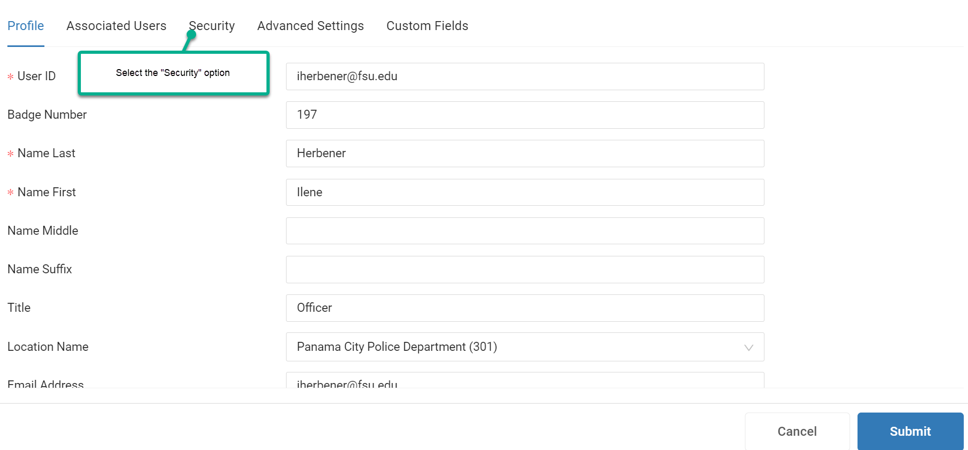
Security Settings

Slide 30
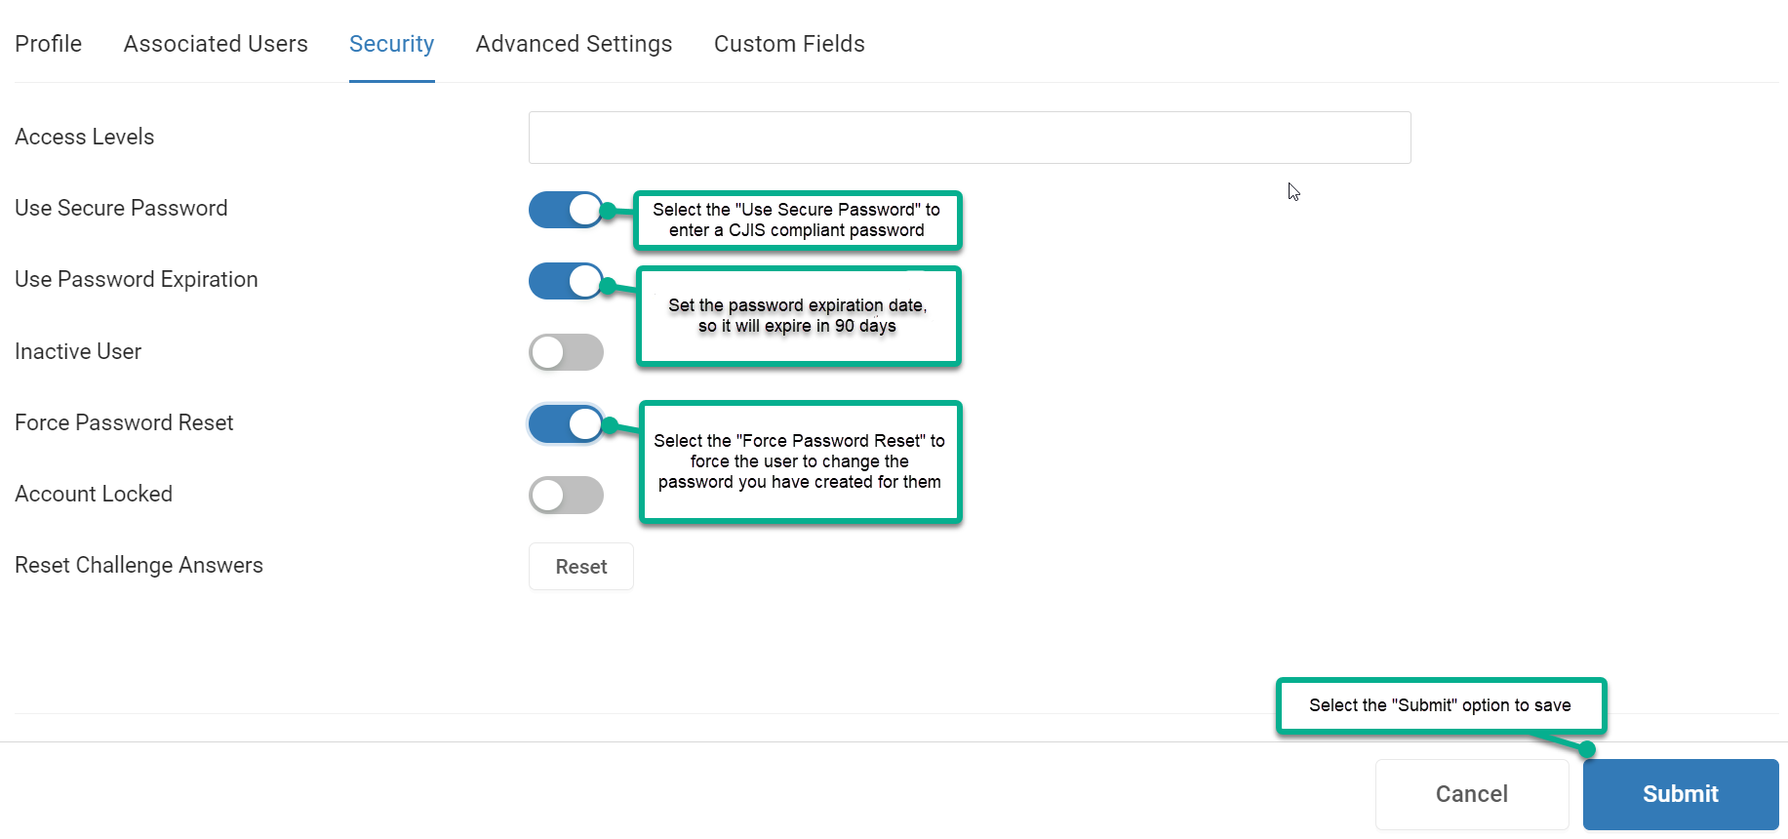
Security Settings / Reset Password

Slide 31
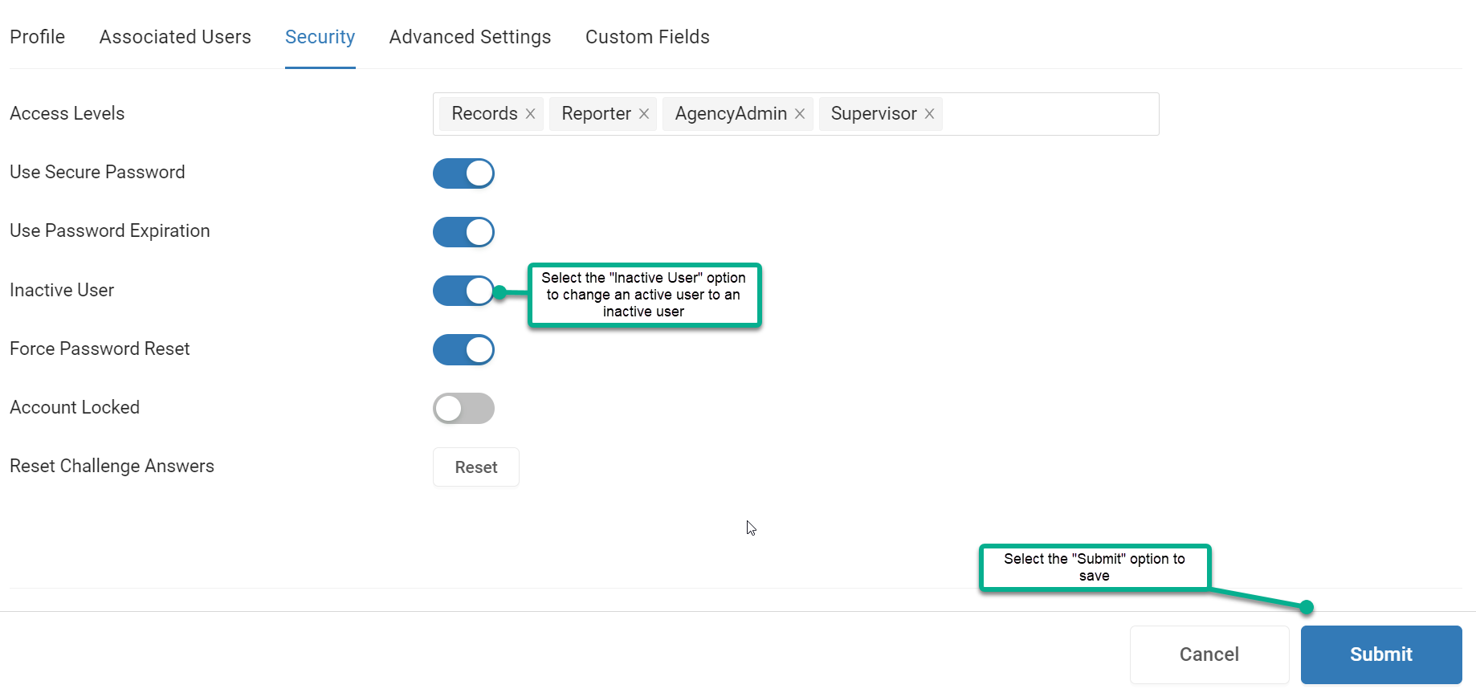
Inactivate User

Slide 32
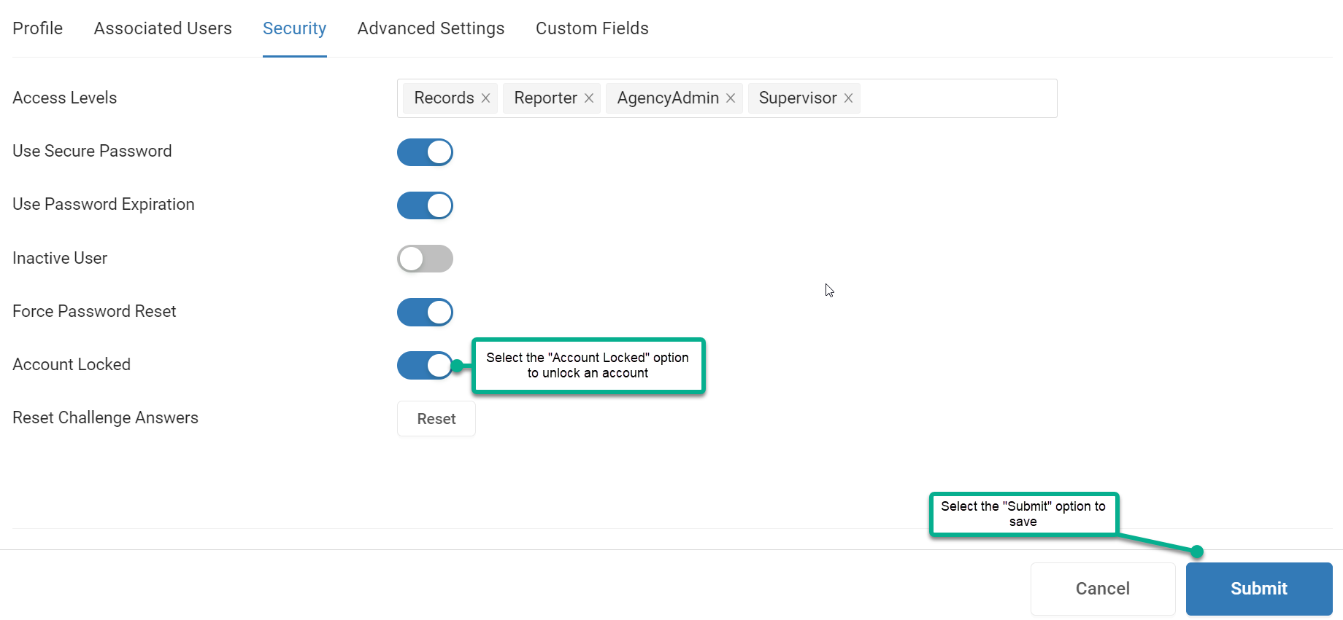
Unlock User Account

Slide 33
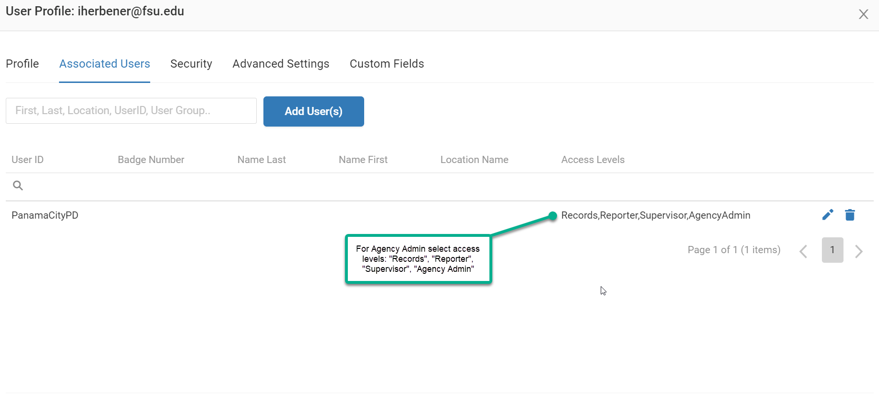
Advanced Settings

Slide 34
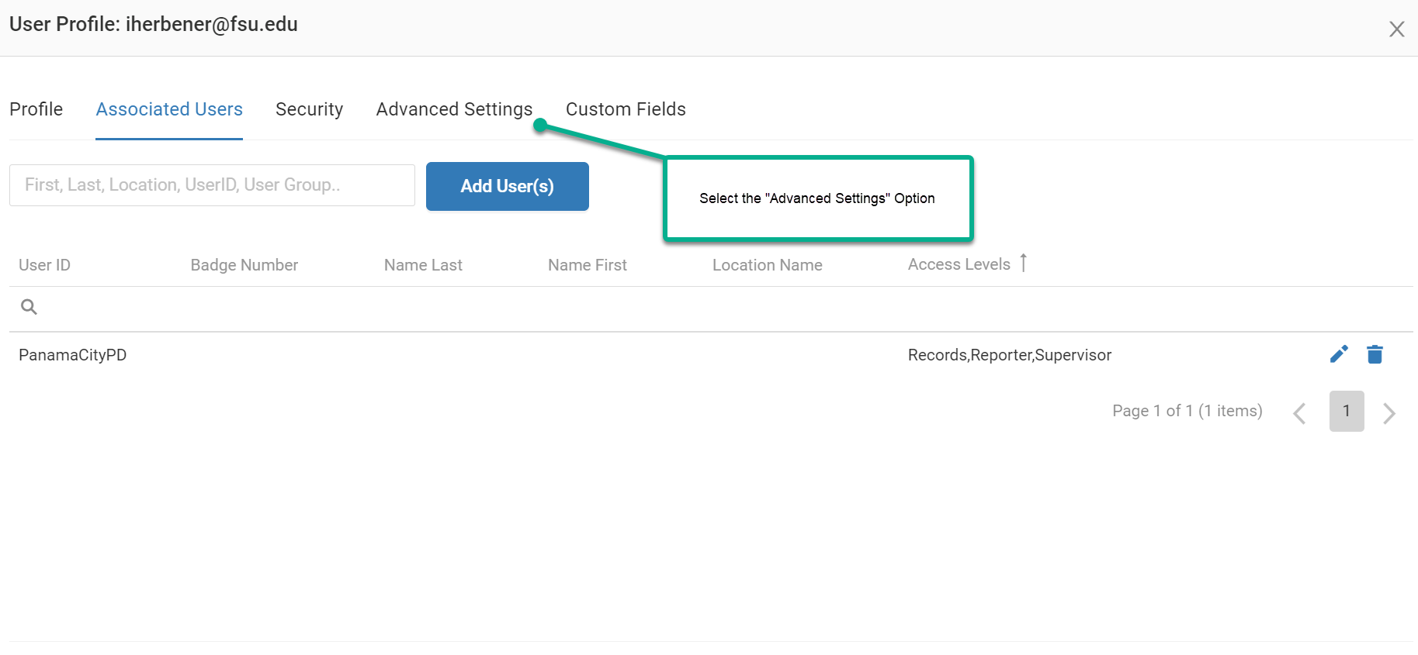
Advanced Settings

Slide 35
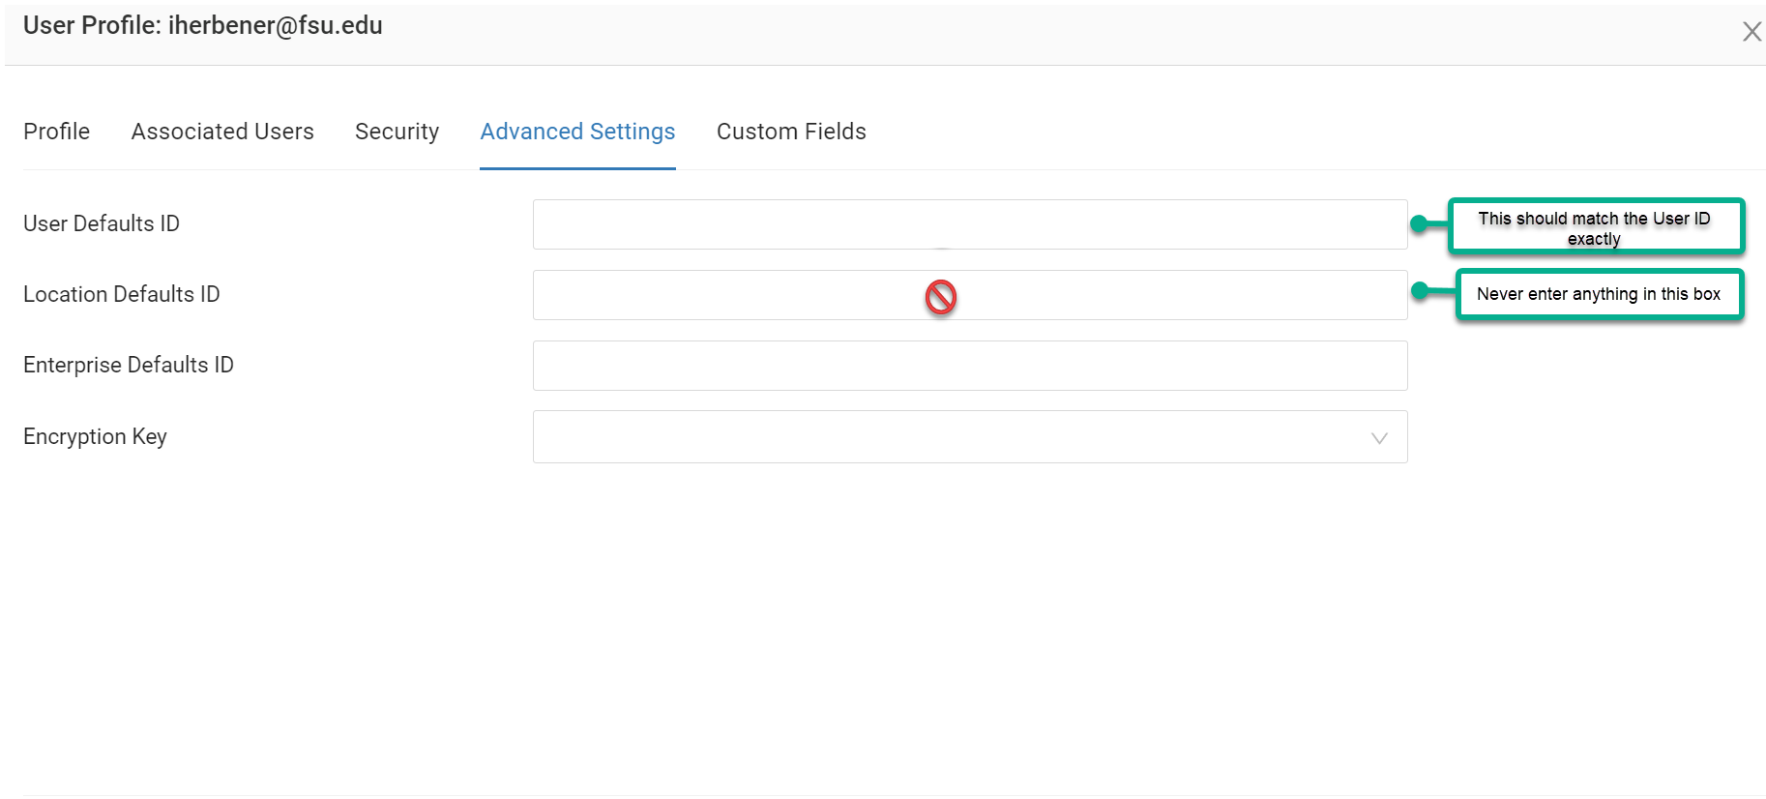
Advanced Settings

Slide 36
Advanced Settings

Slide 37
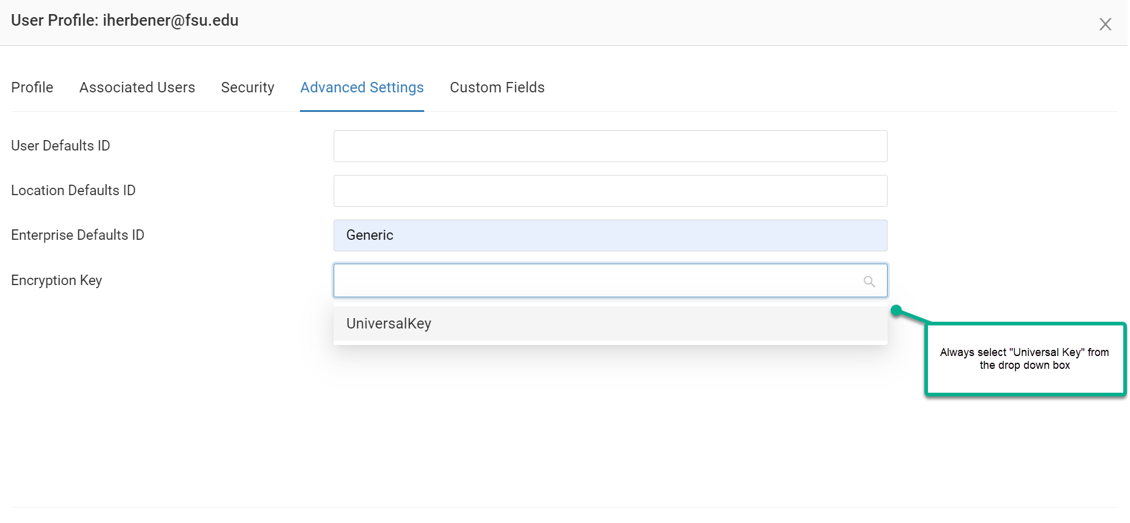
Advanced Settings

Slide 38
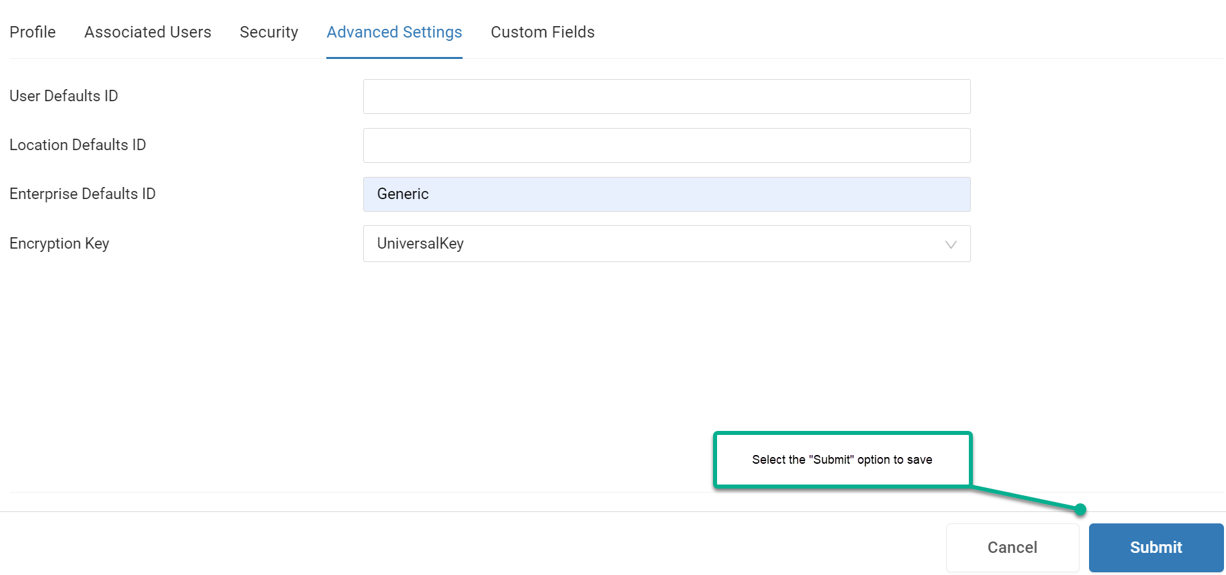
Advanced Settings

Slide 39
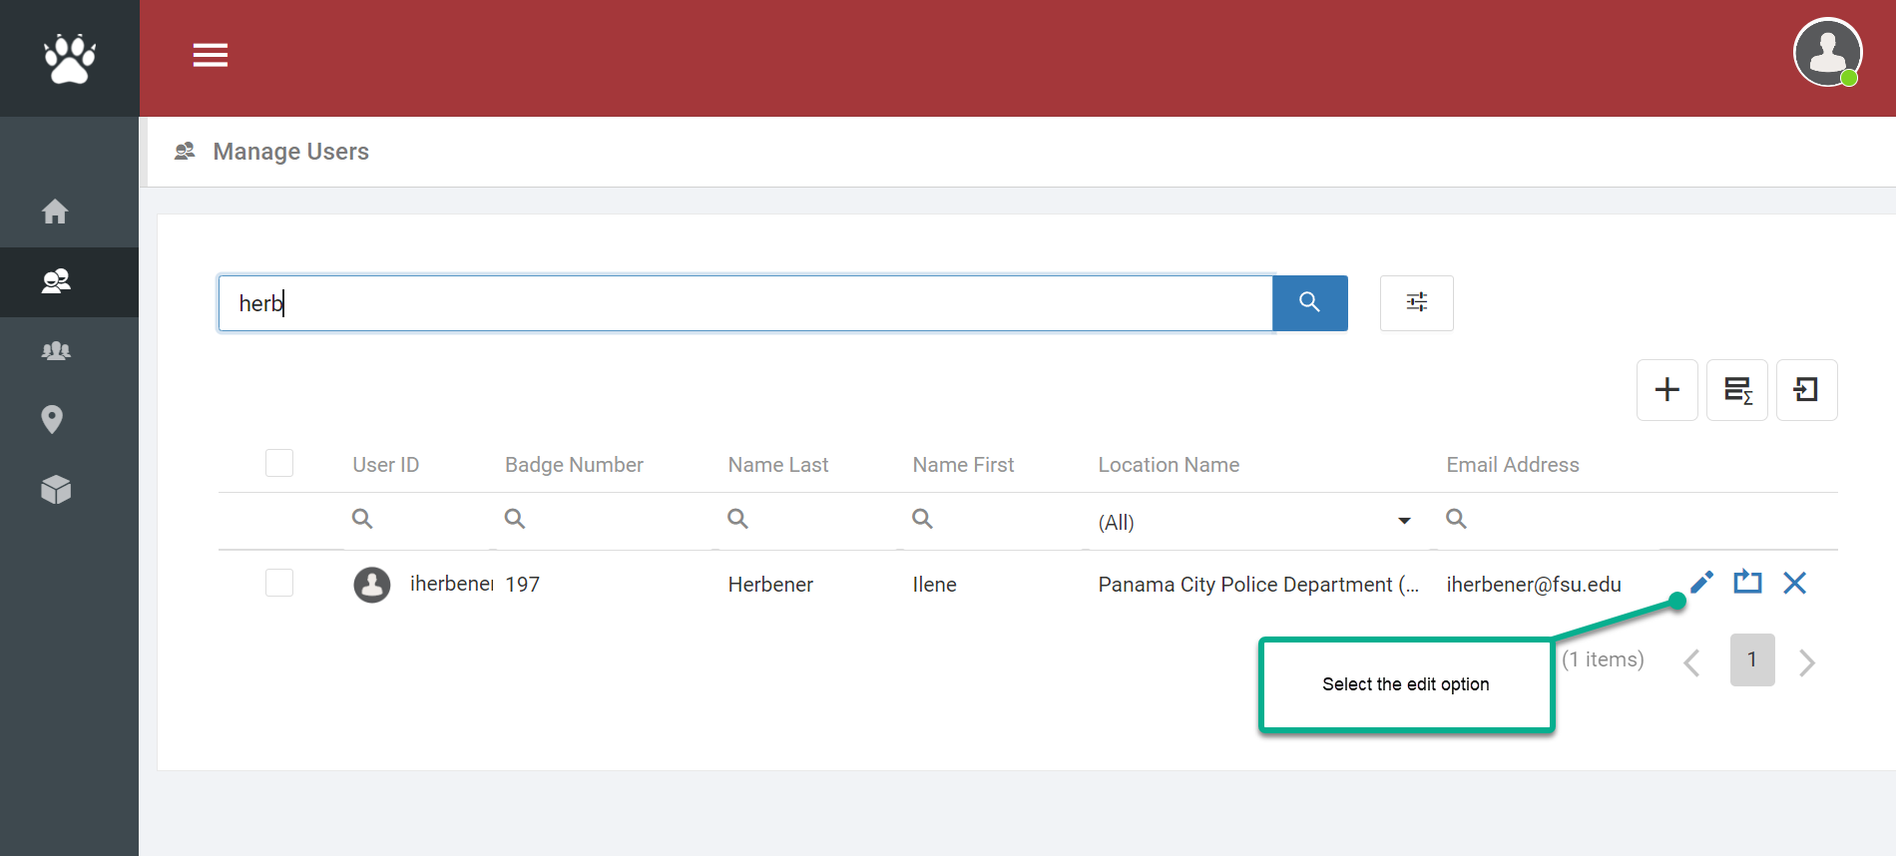
Change User ID (exp. Marriage)

Slide 40
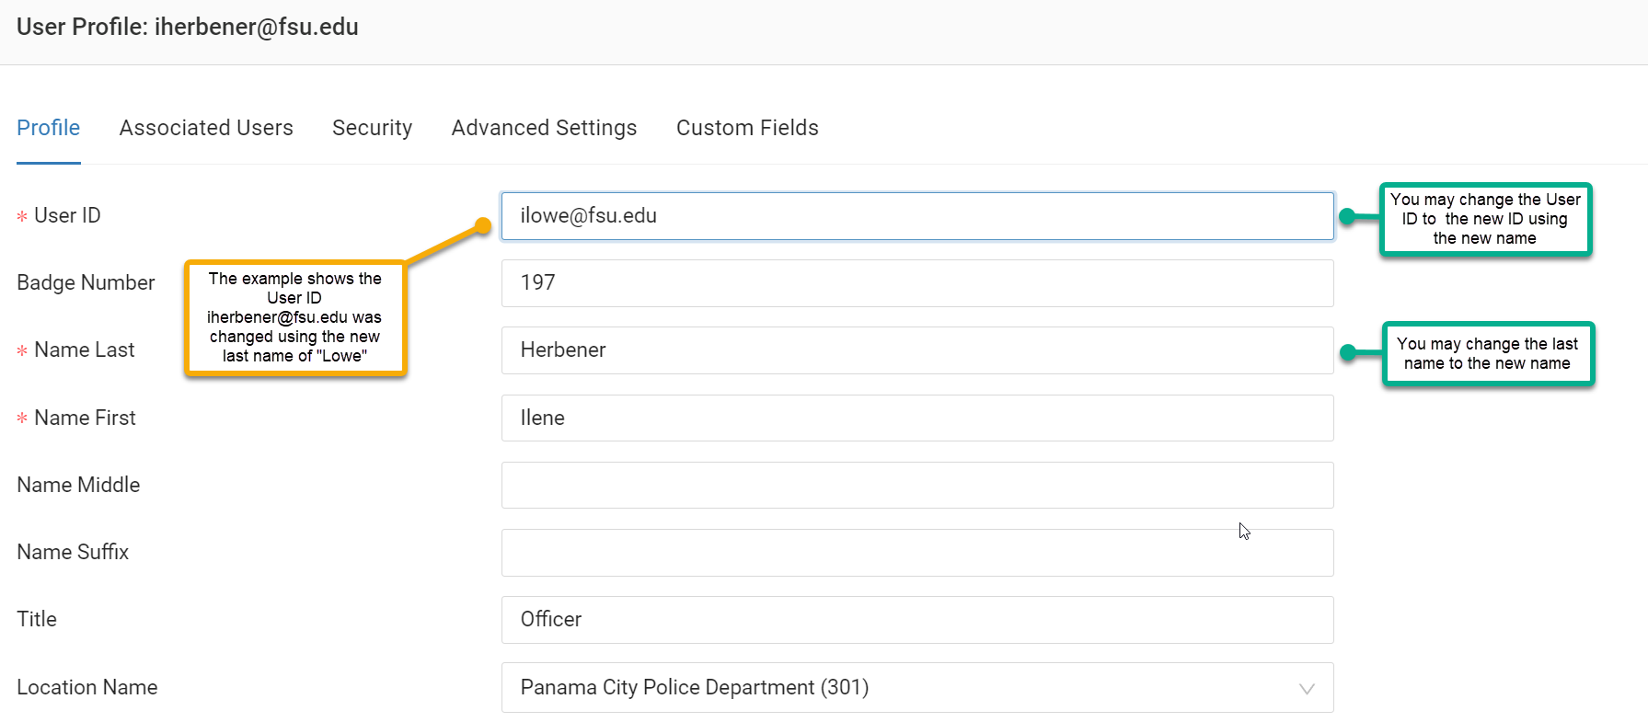
Change User ID (exp. Marriage)

Slide 41
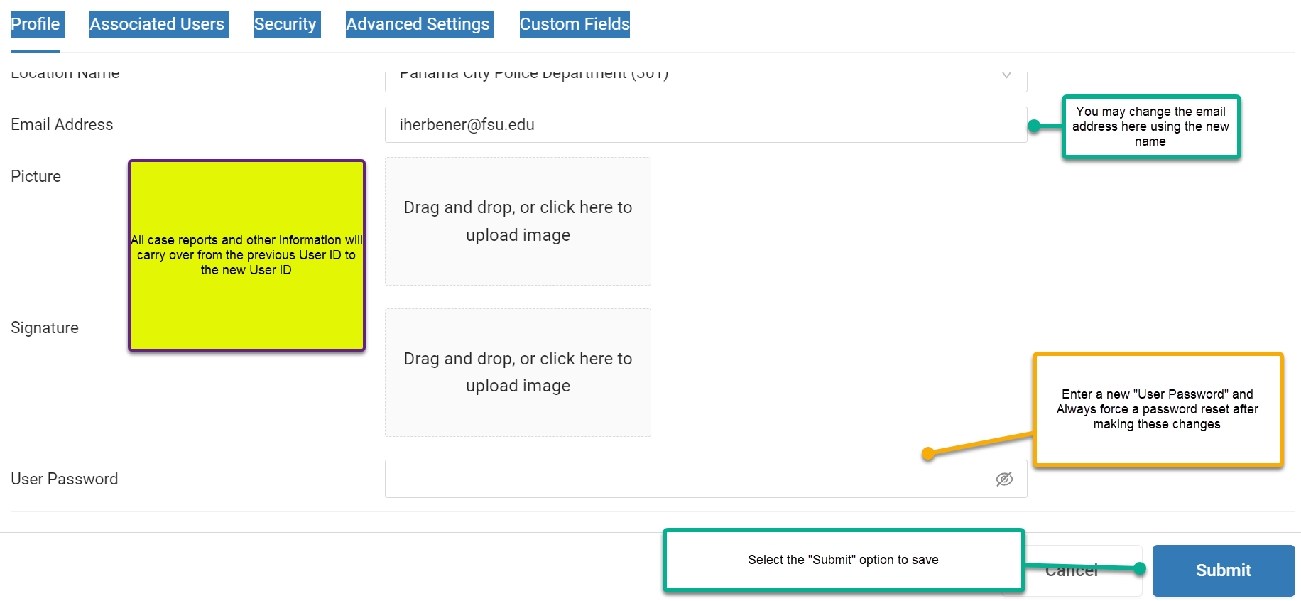
Change User ID (exp. Marriage)

Slide 42
Change Password

Slide 43
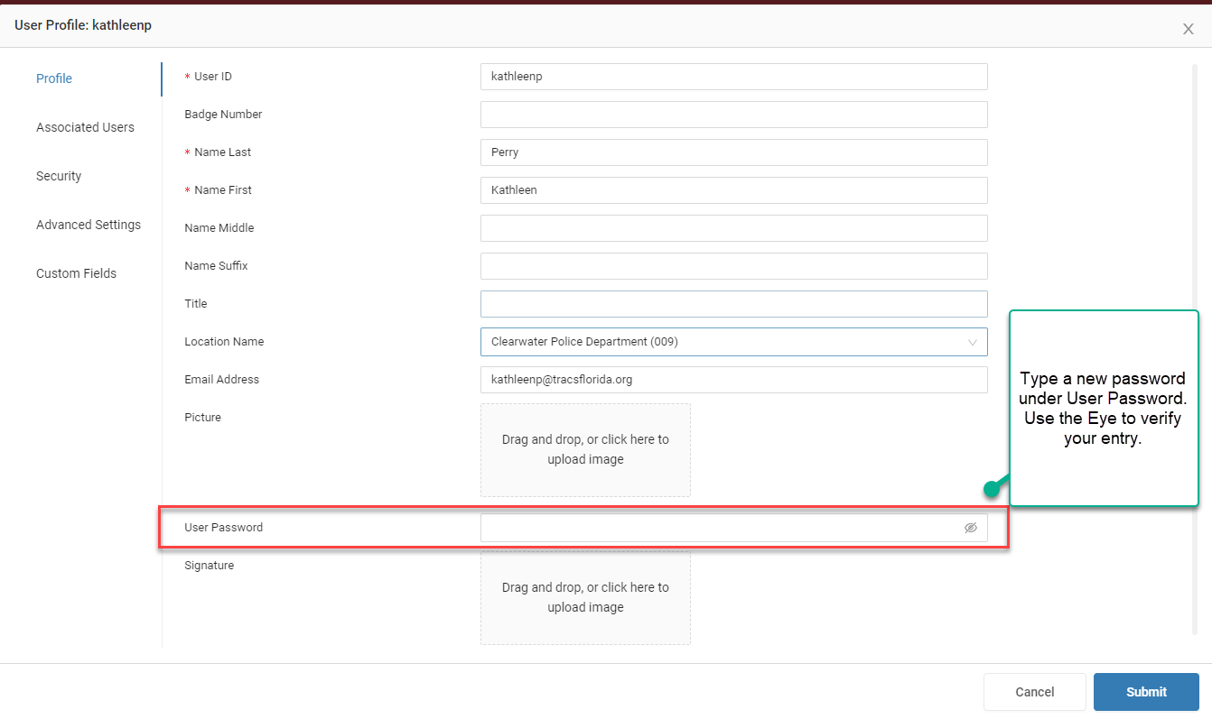
Change Password

Slide 44
Change Password

Slide 45
Deactivate a User

Slide 46
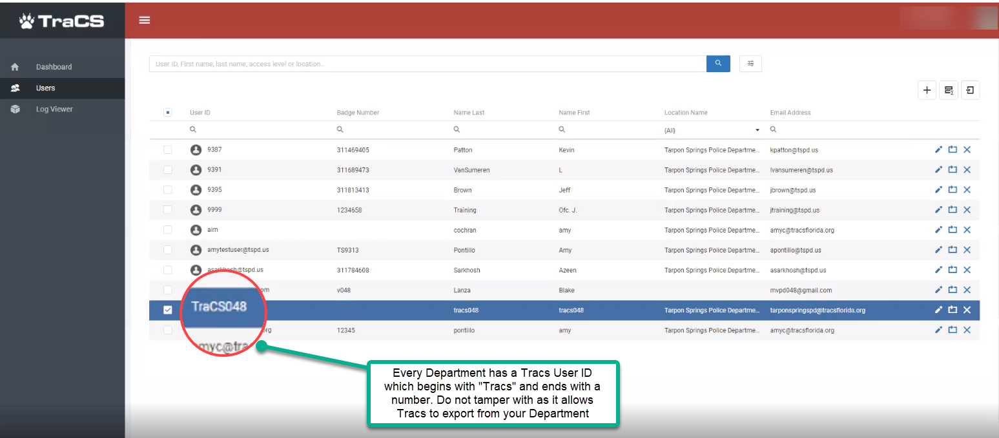
TRACS ID Numbers

Slide 47
Online Configuration Software
For assistance contact TraCS Support
Help Desk - 850-410-6237
Email - support@tracsflorida.org
Enter Help Desk Ticket – https://www.tracsflorida.org

