Slide 1
Uniform Traffic Citation
User Guide

Slide 2
First Time Users

Slide 3
Initial Setup
Set your default search
Create a default officer signature
Choose your theme

Slide 4
Default Search

Slide 5
Favorite Searches – Officers
Select your User ID in the General search tab
Select Open and Rejected under Status in the General Search tab

Slide 6
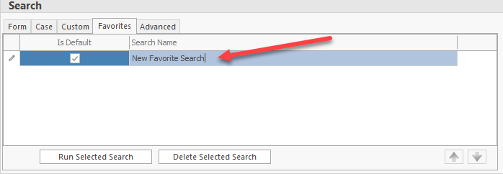
Favorite Searches - Officers
Press the Save button under the Favorites label
Name your favorite default search and check Is Default
Under Tools/User Preferences, Check Perform Auto Search After Login
Now upon logging in, officers will automatically see all open and rejected forms, or rather, they will see all work that they’ve yet to validate which requires their attention

Slide 7
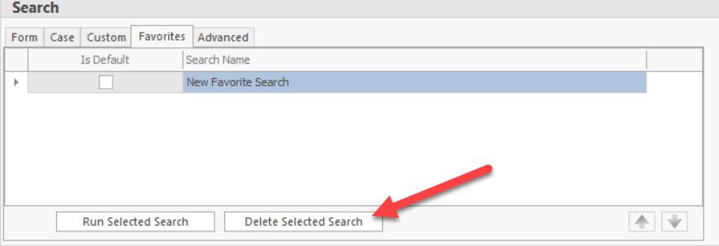
Favorite Searches - Supervisors
Supervisors may have multiple custom searches
Supervisors may pick their squad members from the User ID field
Supervisors may have a search for Validated reports for status
Supervisors may also have a search for Open and Rejected for their squad to make sure officers are validating reports in a timely manner
If members of a squad change, supervisors may delete the favorite search and create a new one

Slide 8
Create a Signature

Slide 9
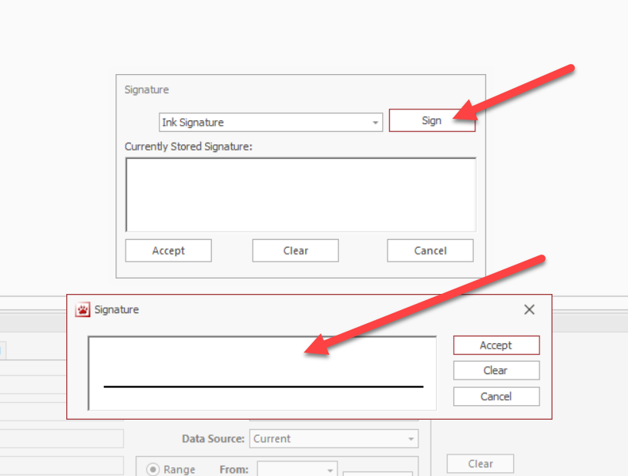
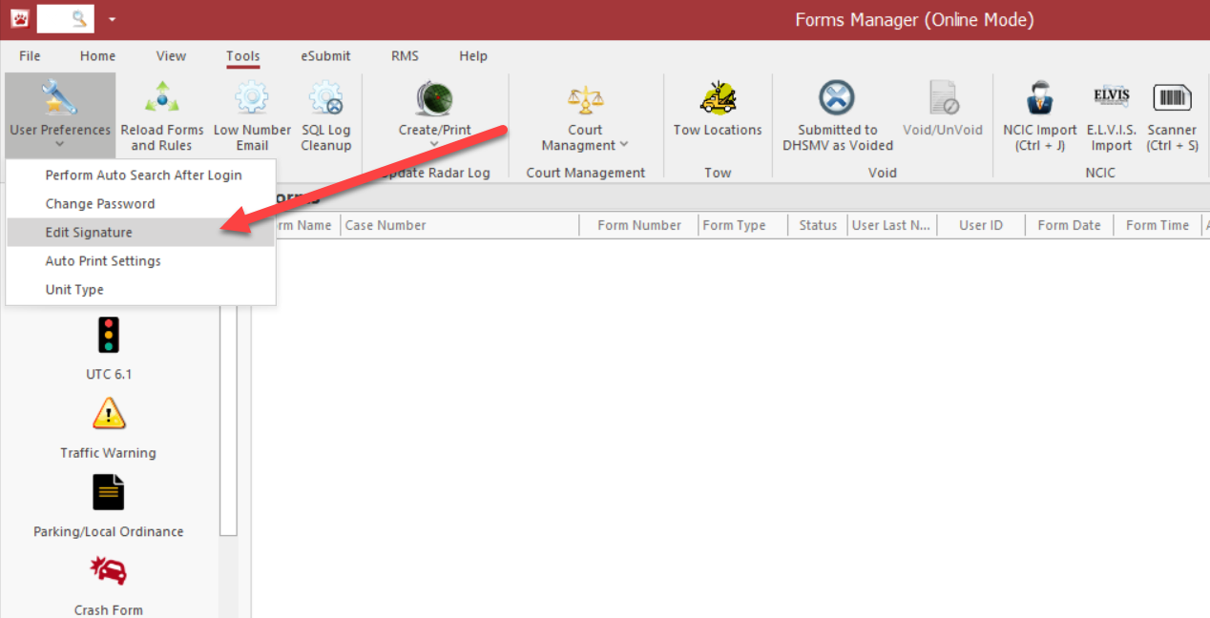
How to Add a Signature Using a Mouse
From the top left toolbar: select Tools/User Preferences/Edit Signature
Select Ink and press Sign
Use the Mouse and select Accept

Slide 10
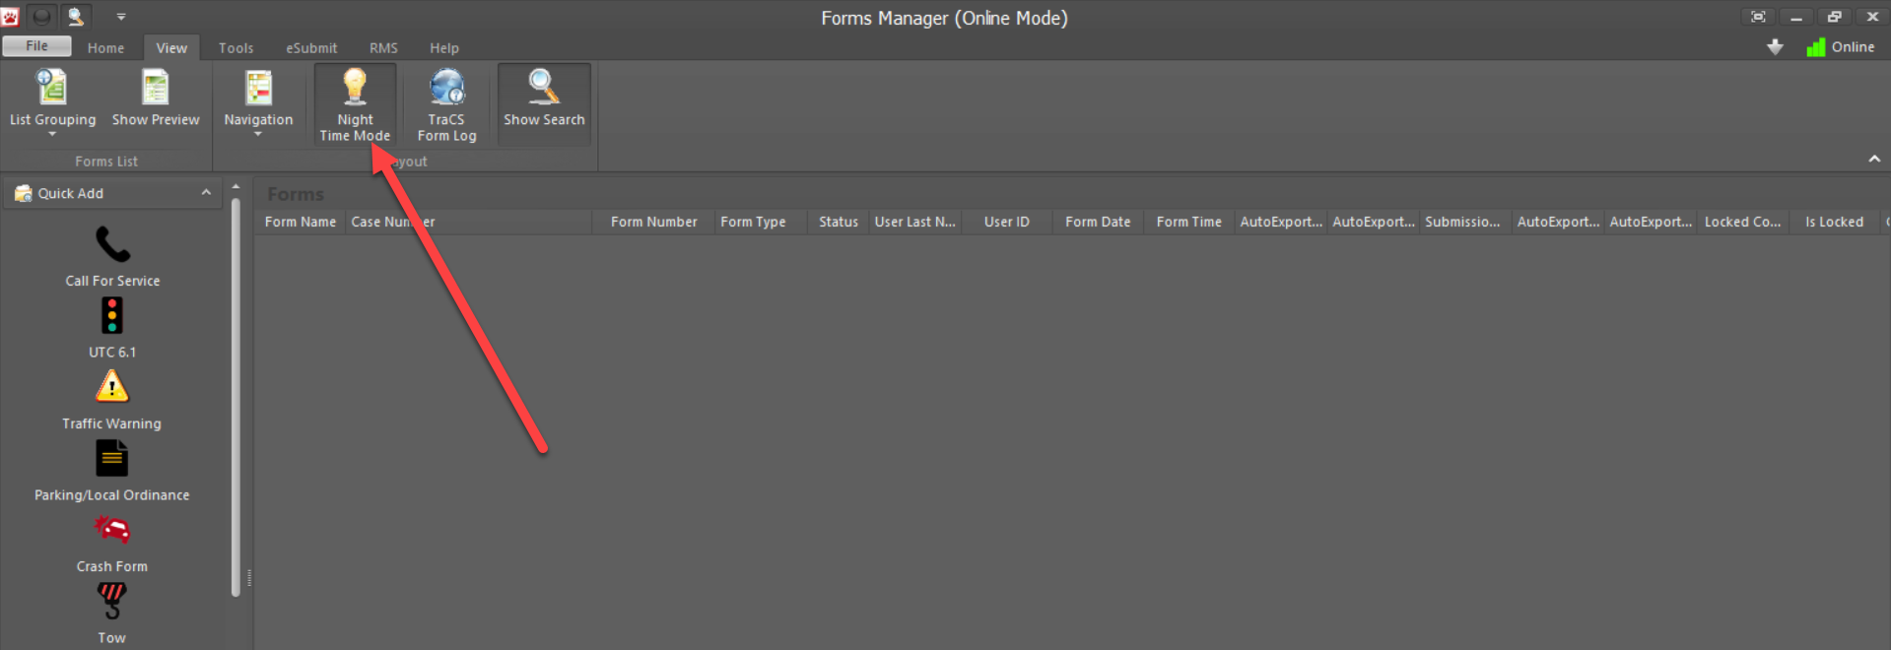
Night Mode
From the top task bar, select View
Select Night-time mode

Slide 11
Importing Tags/DLs into TraCS

Slide 12
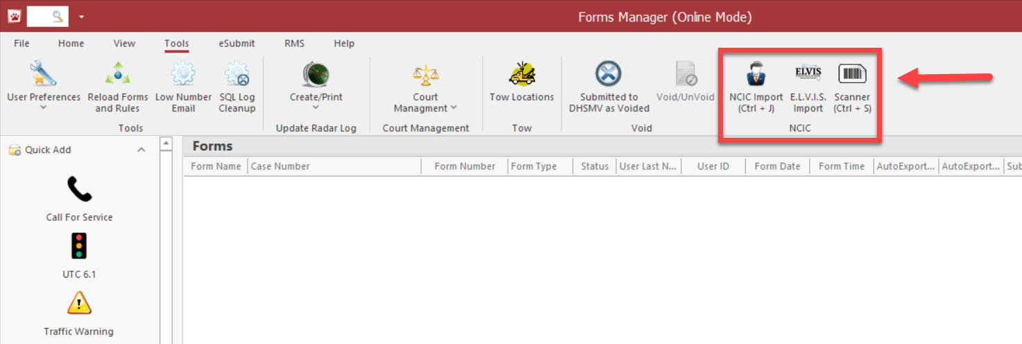
Importing: Using FCIC
Before you start your report, run your DLs and Tags in your FCIC/CAD so the information can be imported for use on the TraCS forms
Once you’ve run the information, you can select Tools from the top task bar, follow by selecting NCIC or using the hotkey (Ctrl + J) to import

Slide 13
Importing: Using ELVIS
If you do not have it, you may obtain ELVIS here
Unlike some other CAD vendors, ELVIS can query all 50 states
TraCS can be set up to auto-launch ELVIS upon opening
Run the information in ELVIS and follow the same steps as the previous slide, however selecting ELVIS, to import to TraCS

Slide 14
Starting a UTC

Slide 15
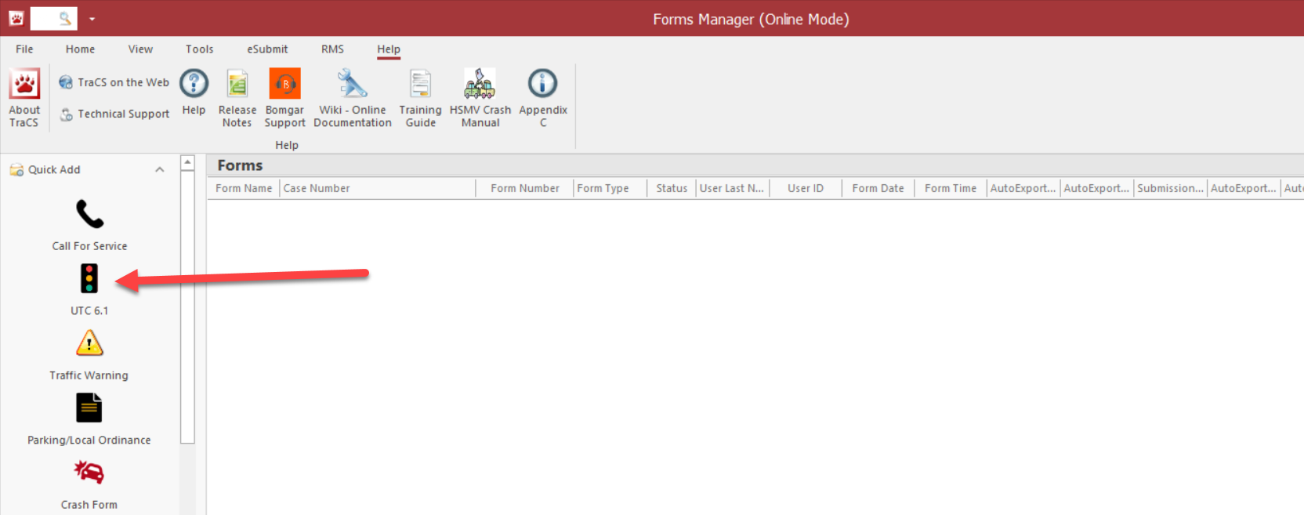
Opening a UTC Form
Select UTC (citation) on the left navigation panel

Slide 16
Starting a Case
Upon opening a form, this box will pop up. Select Create.
You do not have to use it, but if you want to, you are welcome to enter details to help you remember the case you are working
Upon selecting Create, your form will be created and open

Slide 17
Managing the Page View

Slide 18
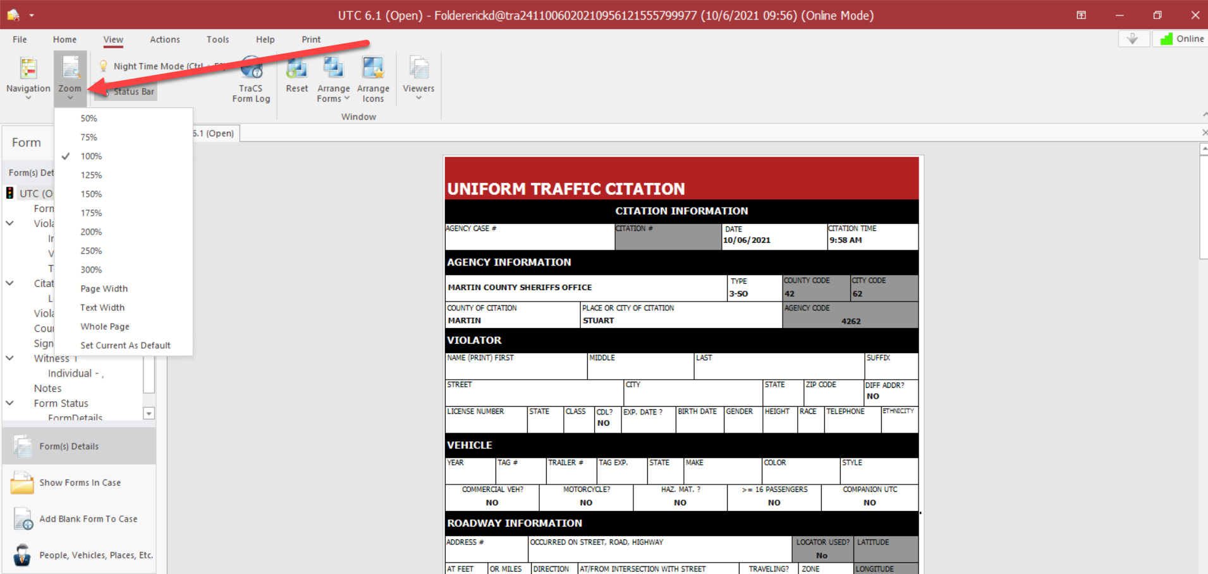
Zooming the form
With your form open: Select the View tab
Select Zoom and set to your preference

Slide 19
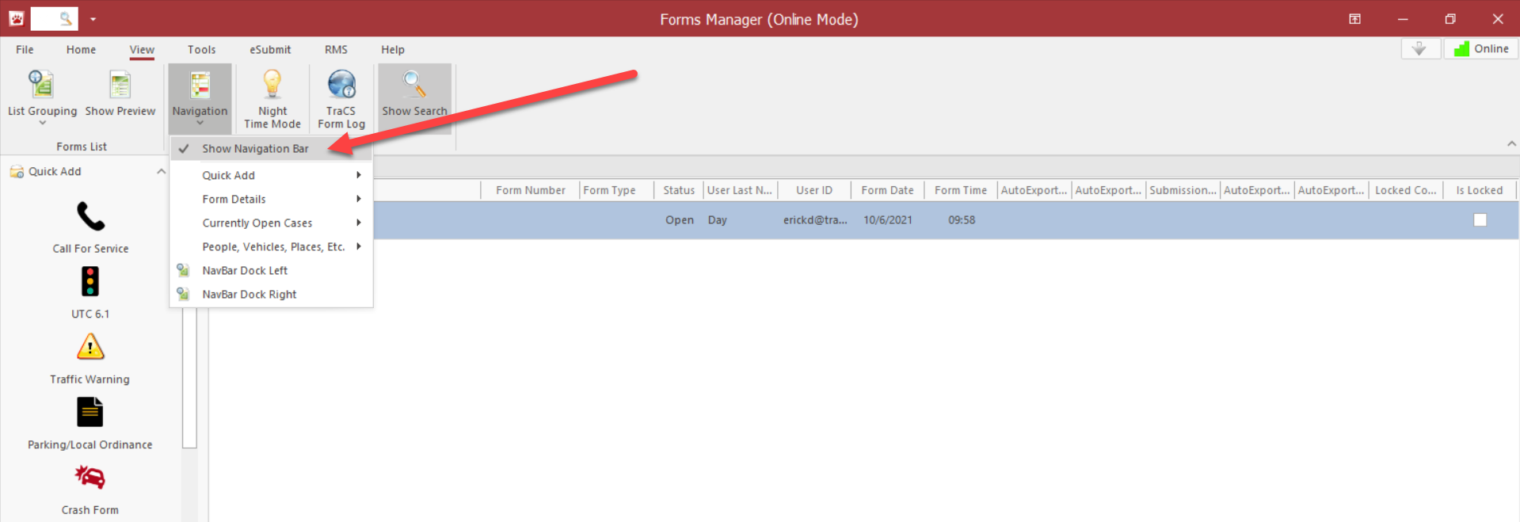
Navigation Panel
Under the View tab/Navigation, you can show/hide the entire left panel

Slide 20
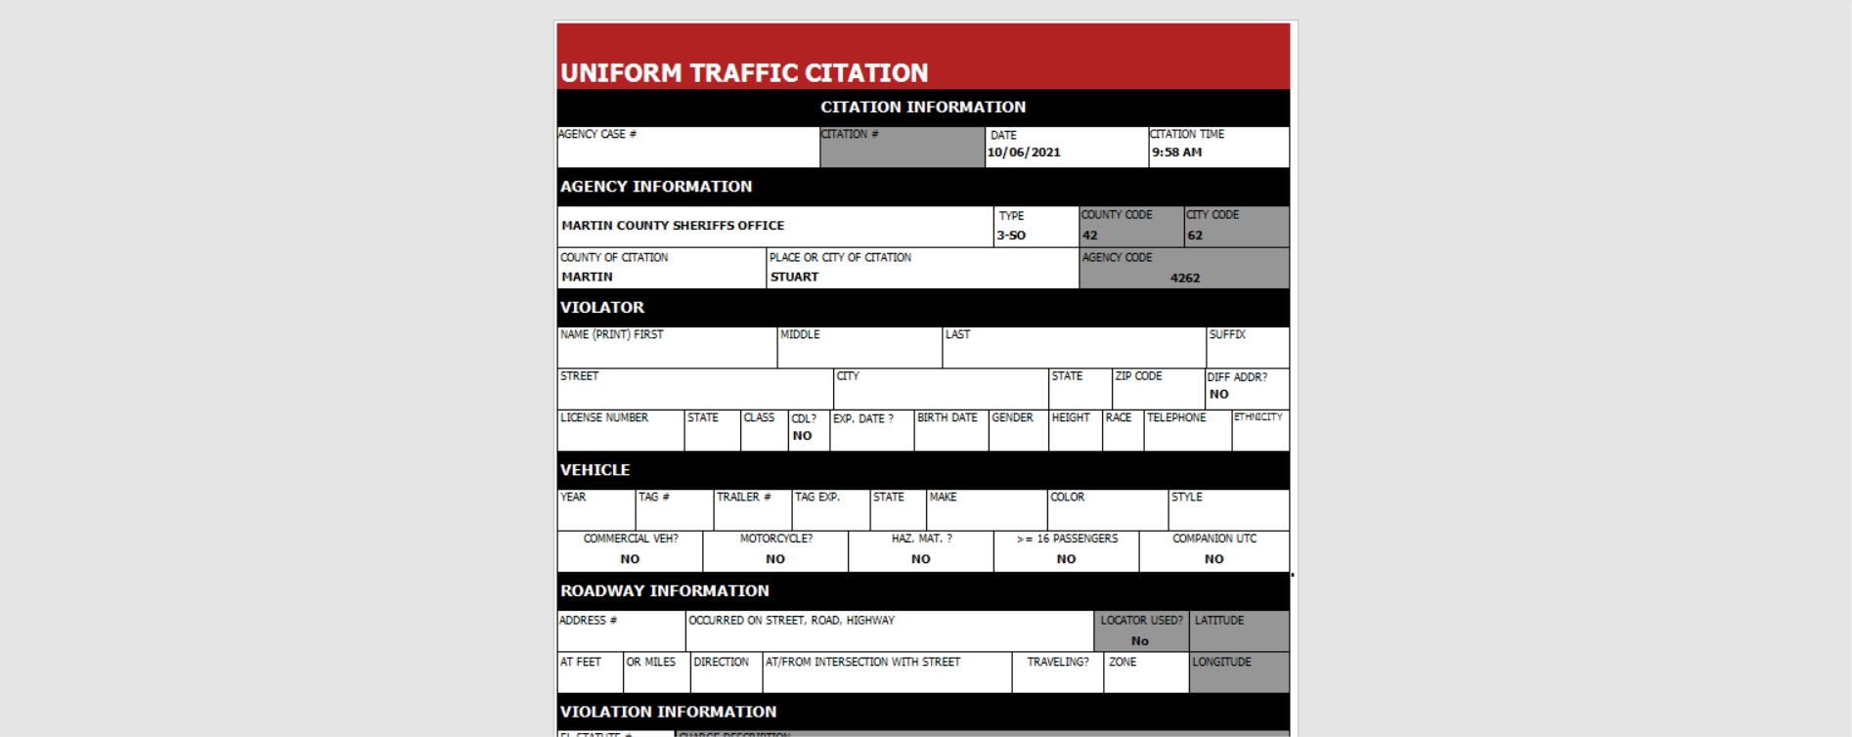
Mobile View (Tablets/Cellular)
For smaller 7’ or 10’ screens, you may want to change your view so that the main focus is just the form itself.

Slide 21
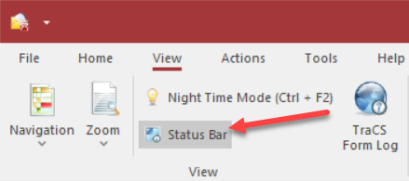
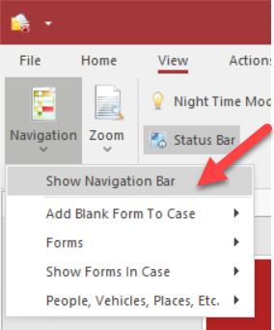
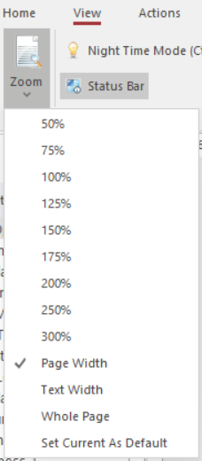
Mobile View (Tablets) Continued
Under View/Zoom, select ‘Page Width’
Go back and select
‘Set Current As Default’
Under View/Navigation, turn off ‘Show Navigation Bar’
Select Status Bar to minimize it
Right click on the Ribbon tabs and select ‘Minimize the Ribbon’

Slide 22
Entering information into the form

Slide 23
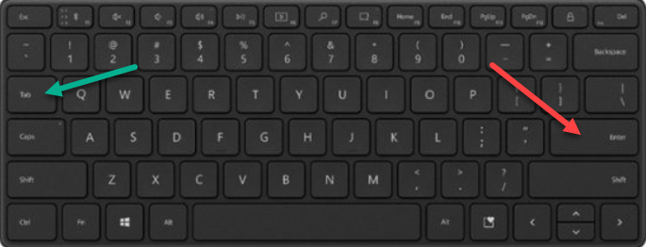
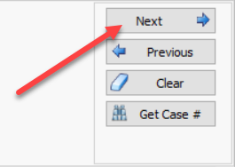
Navigating through the form
There are 5 ways to move from field to field:
Enter button
Tab button
Next button in the databar
Click on a field using your touchpad/mouse
Click in the Navigation Panel to jump around the form

Slide 24
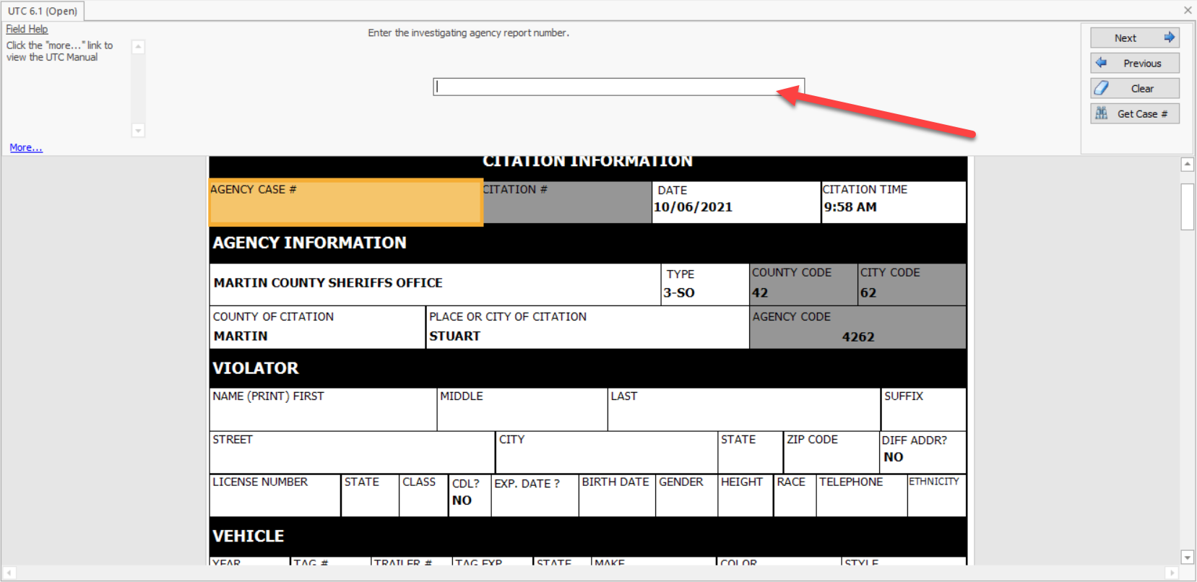
Entering Data into the Form
The databar is where you enter your information
Help tips are provided on the left of the databar

Slide 25
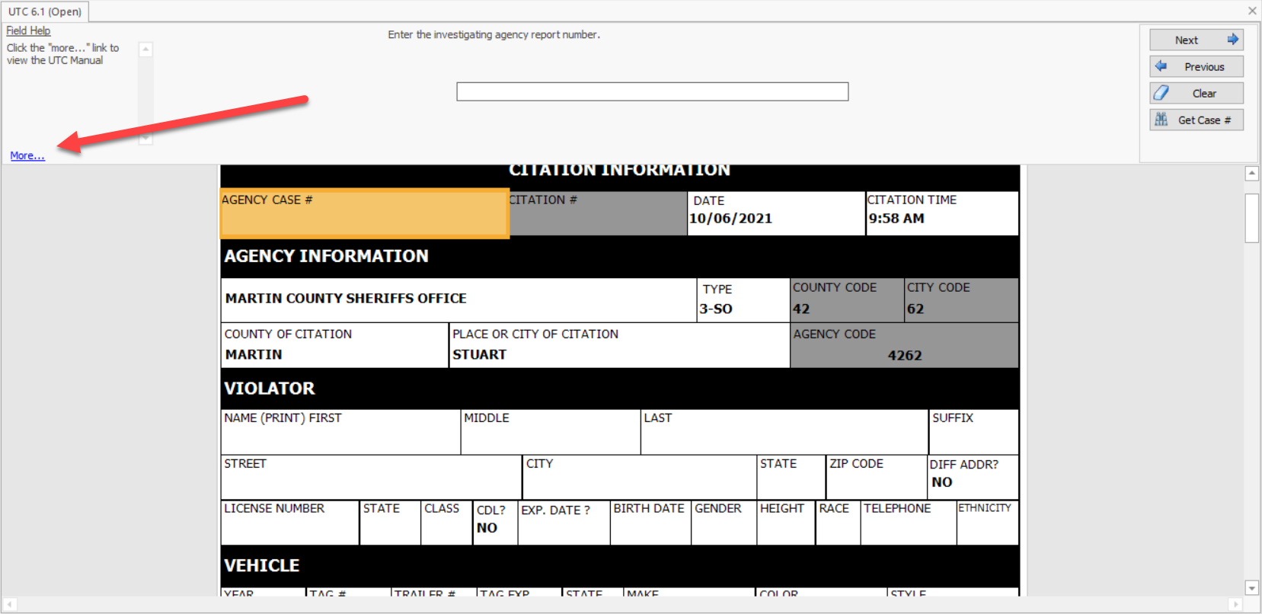
DHSMV’s Online UTC Manual
The “more…” link on the first field (Agency Case Number) will direct users to the online UTC manual which can be found here

Slide 26
The First Time Only
The first time you complete a UTC, you will be required to enter some basic information, such as:
The type of department
The city where the citation was written
The county where the citation as written
Information related to your identification as a reporting officer
The second time you write a UTC and beyond, this information will default based on the initial entry

Slide 27
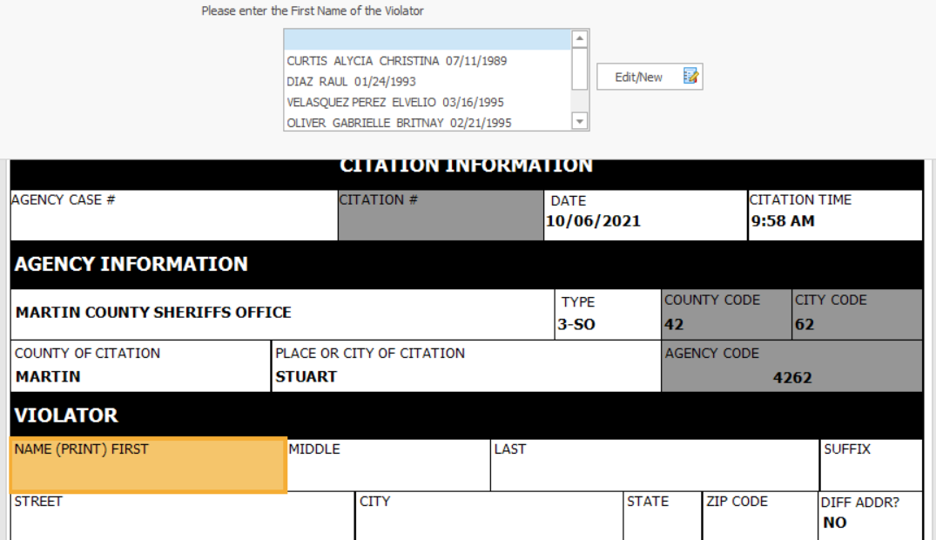
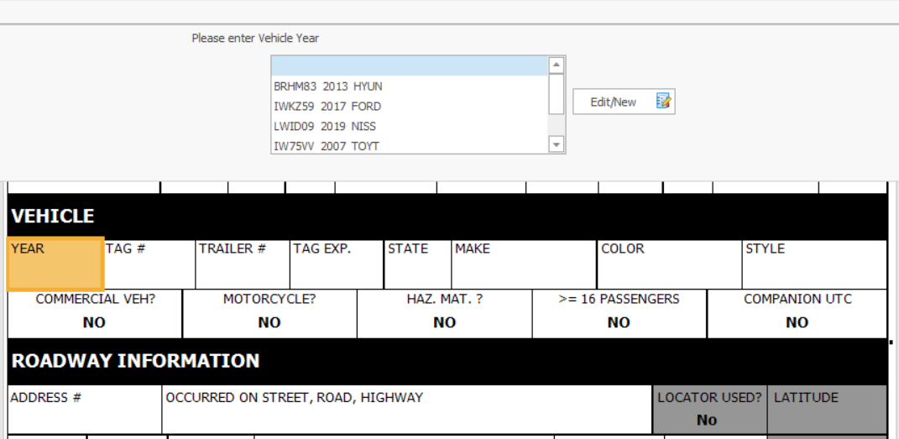
FCIC Importing
You should be running every tag and license BEFORE opening a form in TraCS (officer safety!)
The last 5 DLs and Vehicles ran should automatically show up on a pick list when you tab to the First Name and Vehicle Year fields.
You can start typing your desired selection to highlight who you want

Slide 28
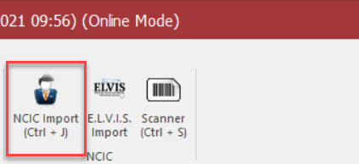
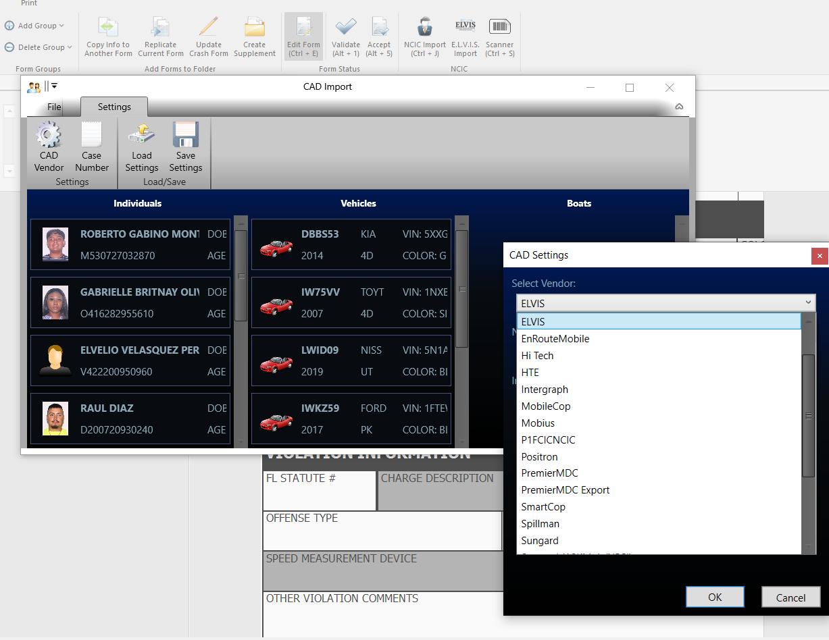
Troubleshooting FCIC Importing
You must run cars and persons before opening the form; otherwise, you must launch the FCIC Import button
If the last 5 queries you ran are not showing up automatically, then press the FCIC import button on the home tab and make sure your vendor is selected from the drop down list
If there is still nobody to select, or if your vendor is not on the list, then you must contact your IT helpdesk and they can contact TraCS for additional support
The shortcut to import manually is Control +J, Alt + A, and Enter
Control + J: Launches editor
Alt + A: Selects All
Enter: Commits the Import button

Slide 29
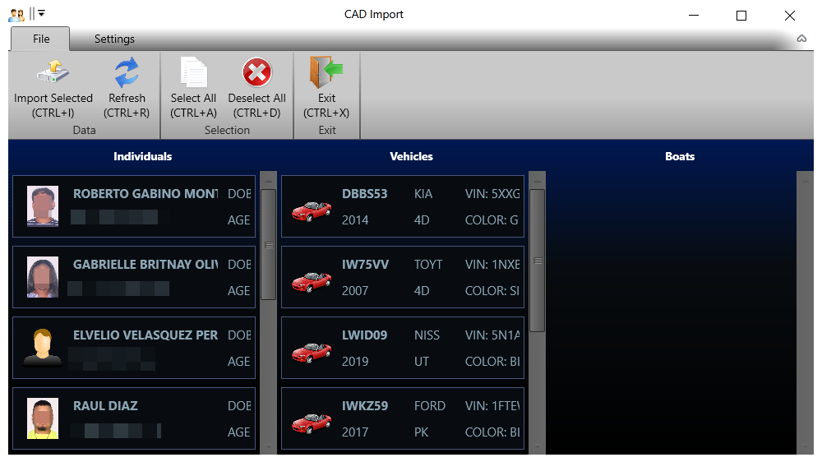
FCIC Importing
This is what it looks like when there are queries to import

Slide 30
FCIC Importing
On the First Name and Vehicle Year fields you can import FCIC data

Slide 31
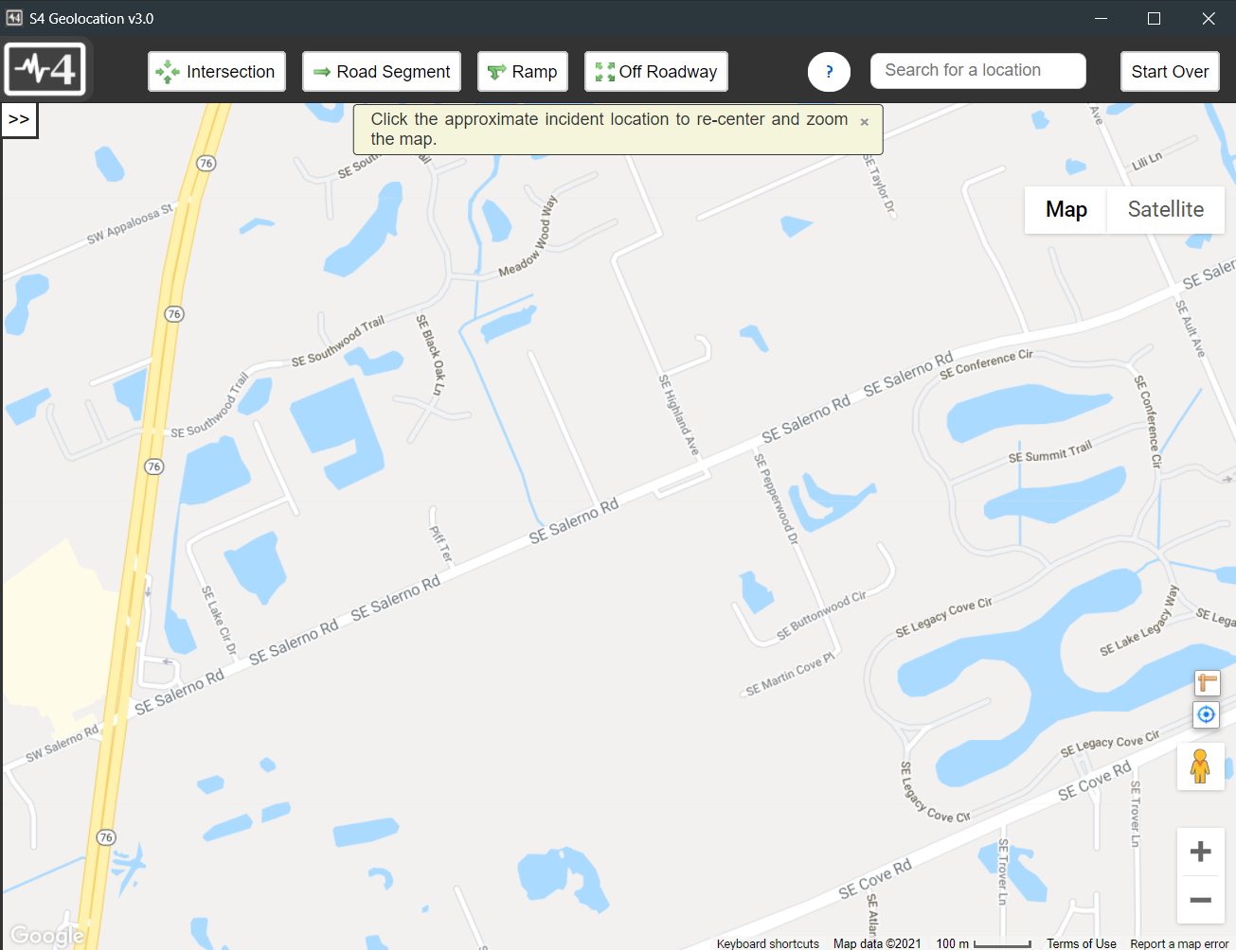
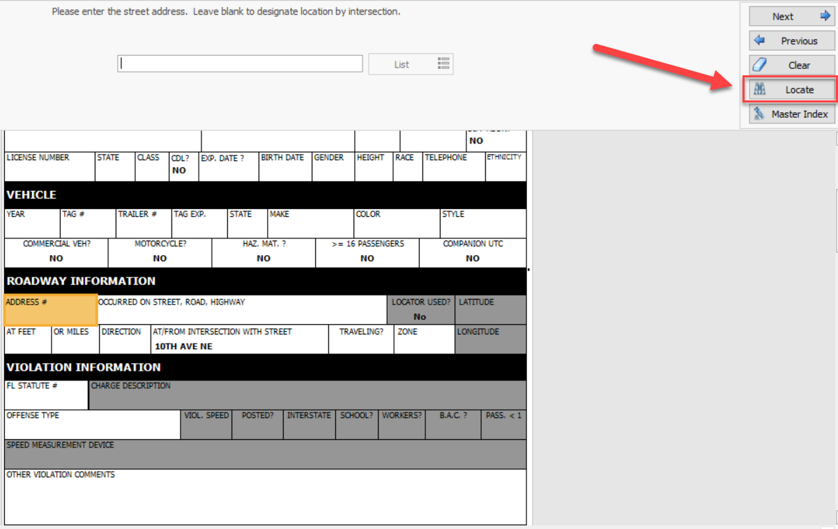
Importing Roadway Information
On any roadway information field, there is a LOCATE button in the databar that will launch a map

Slide 32
Importing Roadway Information
Pan around to find the location
Use the address search to find the location
You can use map or satellite view

Slide 33
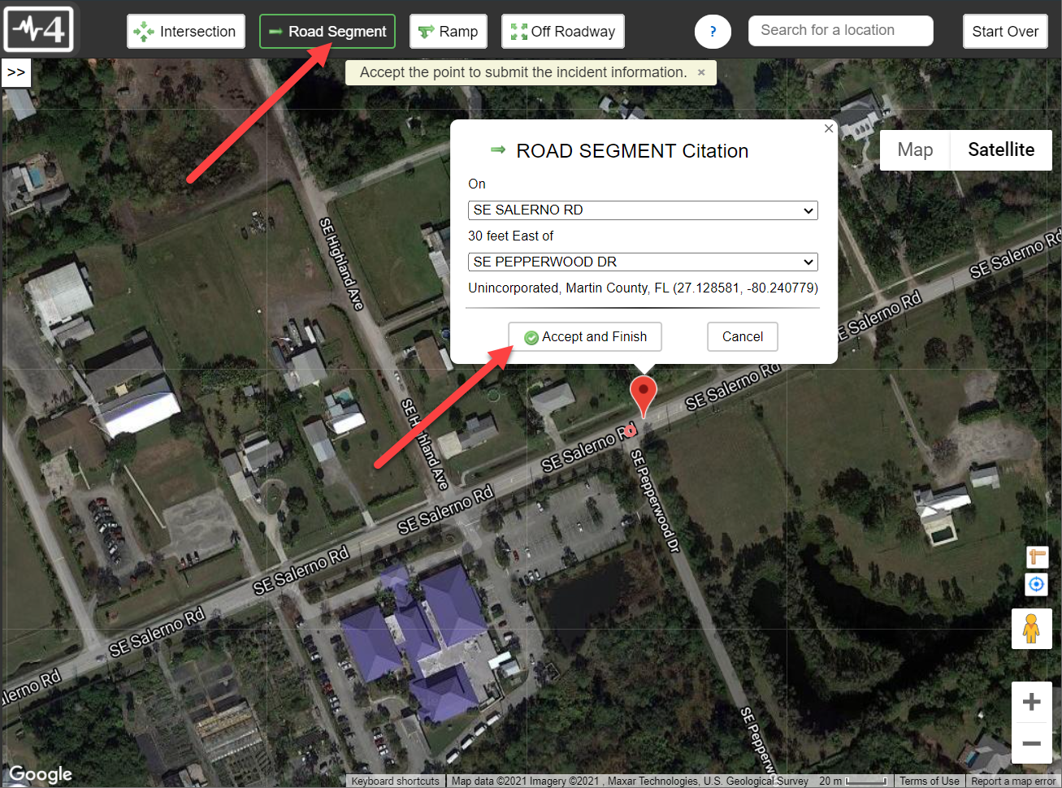
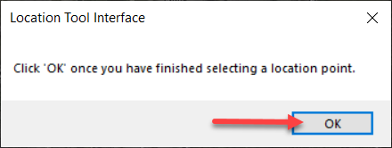
Importing Roadway Information
Select the type of location (intersection, road segment, ramp, or off roadway)
Click on the map to select a location
Click on Accept, Save, and Yes to return to the form

Slide 34
Importing Roadway Information
The information will import into the form; including the lat and long

Slide 35
Manually Entering Roadway Information
If you cannot use the location tool for some reason, the street and intersecting street fields contain a list of streets within your county
You can press Other to free type roadway information; however, you should avoid this when possible

Slide 36
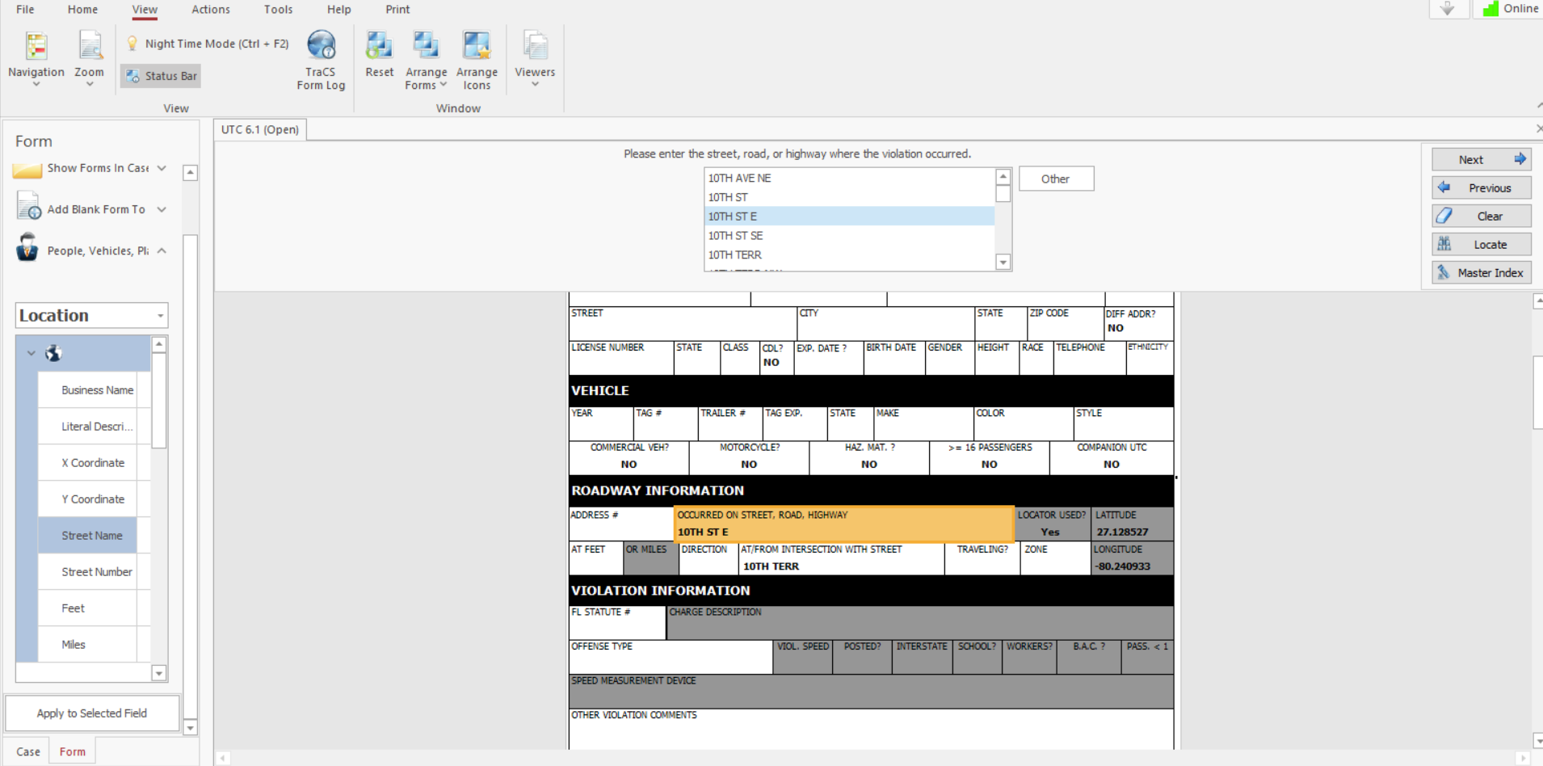
Creating favorite locations
Upon entering a location using the street lists you can use the panel on the left to save entries as a default for later use
Change the drop down to Location and right click and pick Save to Defaults

Slide 37
Using favorite locations
When you get to the Street Address field under the LIST option in the data bar, you will see your list of favorite locations
Pick from the list or press EDIT/NEW while on the blank spot above the list to manually enter a different location

Slide 38
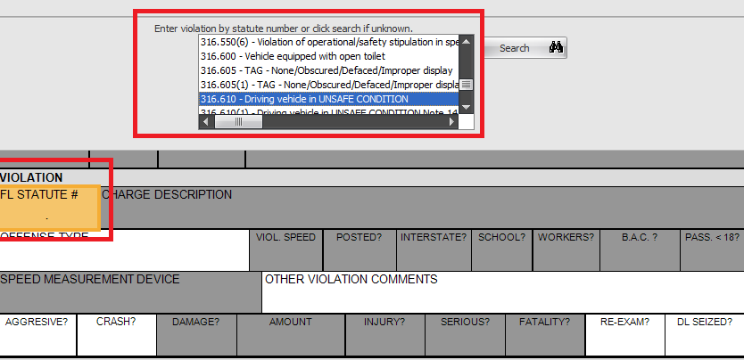
Finding Florida State Statutes
The Appendix C in TraCS is an exact match to DHSMV’s list
When you get to the statute field, a list will appear, and you can start typing the statute number to filter
You will notice that this field always defaults to the previously chosen statute; however, you can always change this value

Slide 39
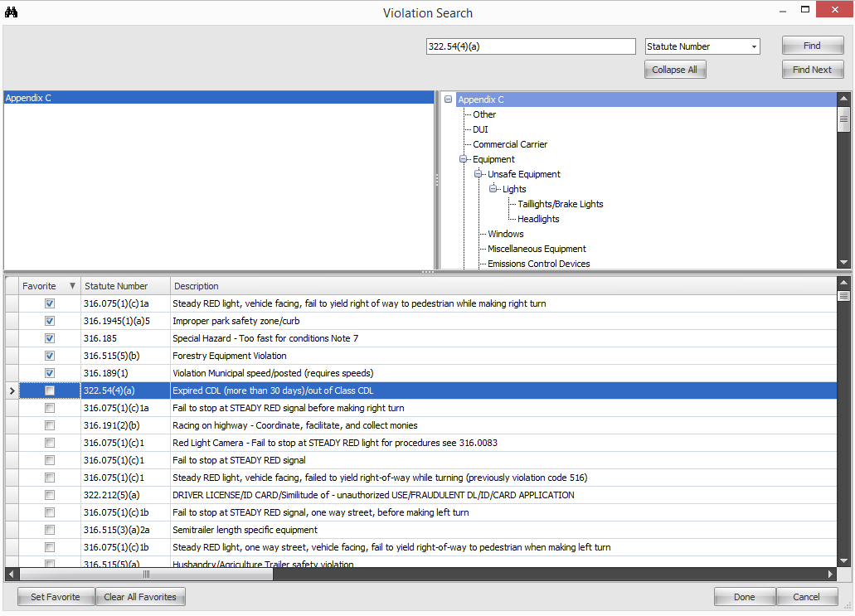
Using the violation search tool
If you do not know the statute, you can press the search button to do a keyword search (description) or a statute search (statute number)
Highlight a statute and press SET FAVORITE to move to the top of the list

Slide 40
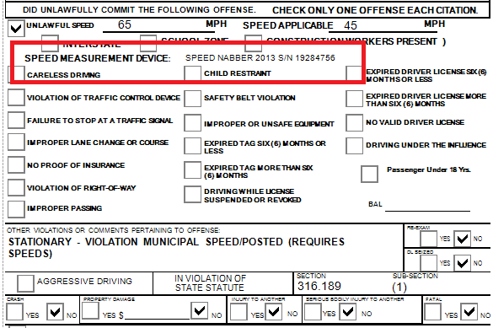
Speed Measurement Device
This field will show up on the printed citation in its own separate field
The Speed Measurement Device will always default to the previously entered value; however, you can always change this value

Slide 41
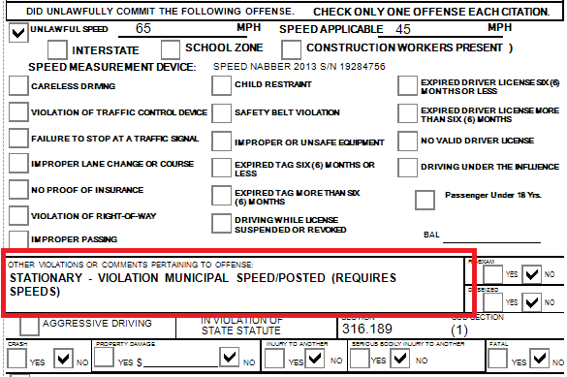
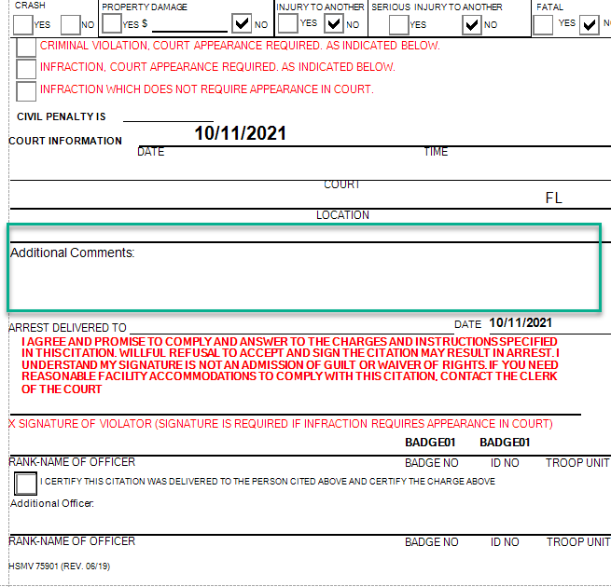
Other Comments
This will be concatenated with the Charge Description on the printout
Other comments will be displayed BEFORE the charge description
Comments over 90 characters will be auto-relocated to Additional Comments near the bottom of the citation

Slide 42
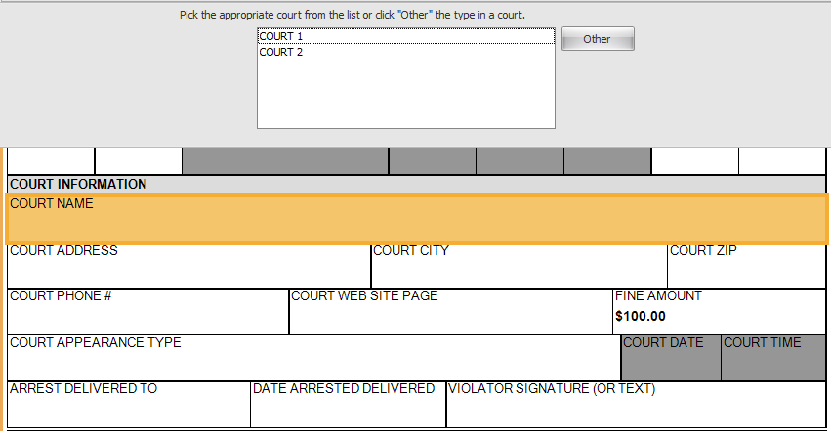
Entering court information
Pick your clerk from the list and the information will auto-populate
The fine amount should auto-populate based on the statute you picked

Slide 43
Subsequent UTCs for same violator
On the home tab, click on the Replicate Current Form button to make an exact copy of the UTC (except the charge)

Slide 44
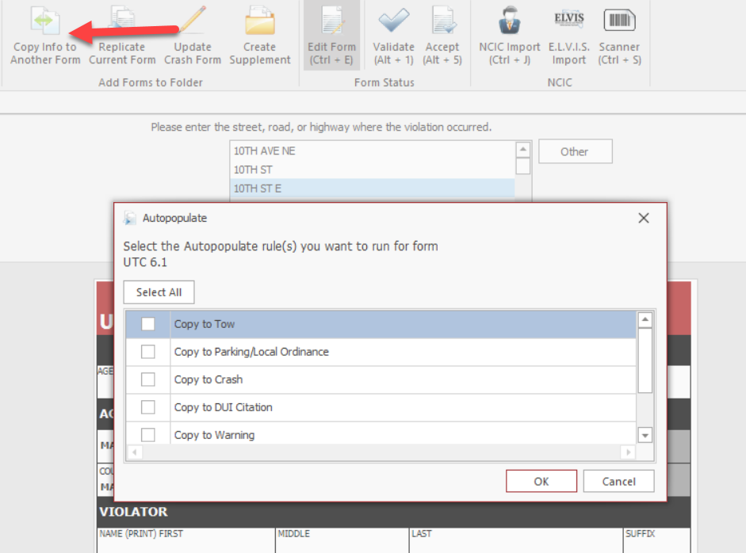
Copy data to a different form
To carry over information to another form, press the Copy to Another Form button and then pick the form

Slide 45
Adding additional witnesses
If more than one officer is assisting with a citation, or more than one witness exists, you can use the Select a Group to Add button to add as many as needed
Note: There is a secondary officer field in the witness section

Slide 46
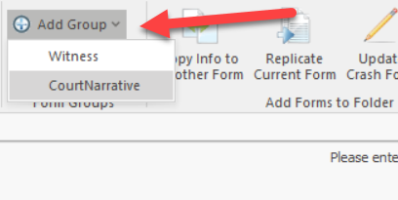
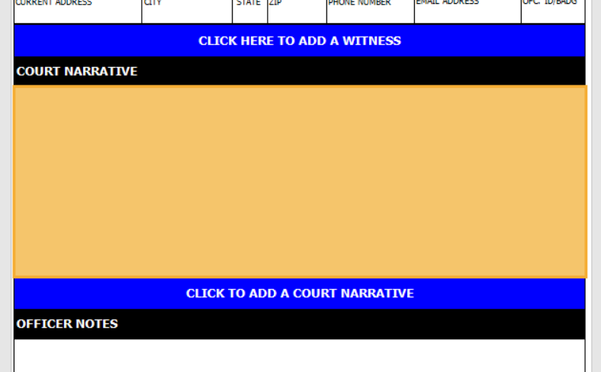
Court Information Sheet
Notes for the judge/clerk can go in the court narrative
Select a Group to Add on the Home tab has a court narrative section

Slide 47
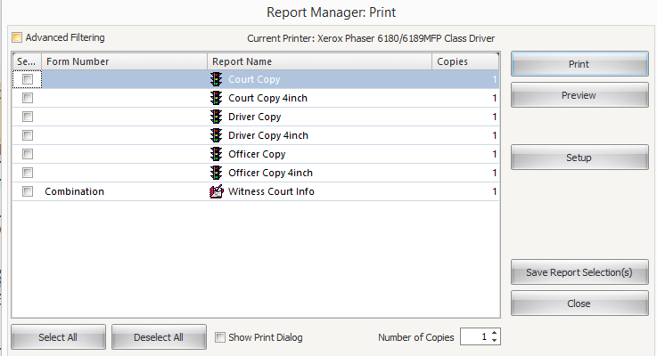
Court Information Sheet
The print menu has a Witness Court Info option

Slide 48
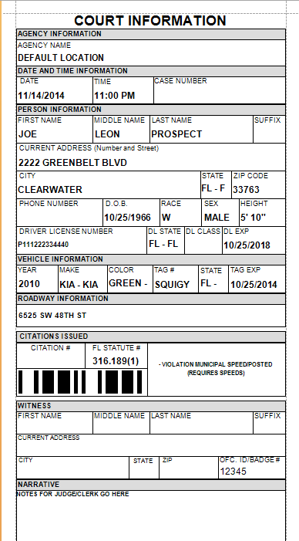
Court Information Sheet
This is an example of how the court info sheet will look
This must be delivered to the clerk if there are individuals or officers that need to be served a subpoena
For non-criminal citations, some clerks may electronically receive the court info sheet. However, check with a TraCS admin to ensure this has been implemented

Slide 49
Electronic Submission to Clerk of Court

Slide 50
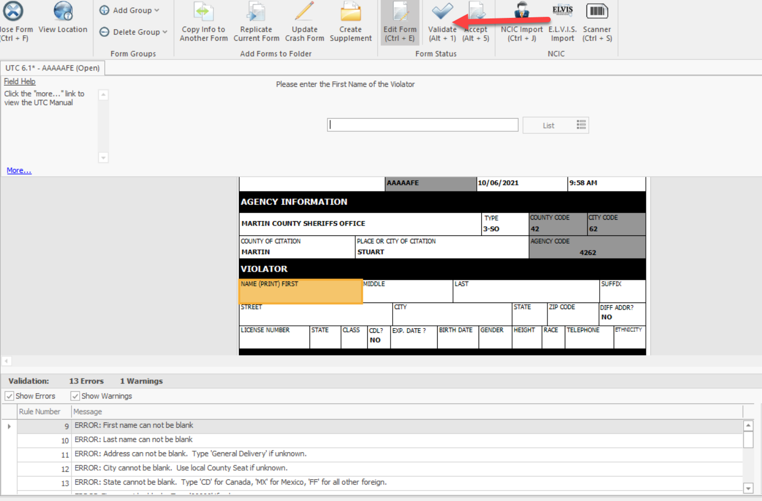
Validation
Once a user has completed filling out a form, the validate button will check the form data against the DHSMV edit rules to help ensure acceptance of the form once it is submitted
Errors and warnings are displayed in the bottom pane
You may double click the item to jump to the field on the form that requires correcting
Warnings DO NOT prevent validation
You can uncheck the Warnings box so you only see Errors

Slide 51
Accept the Citation Form
Officers must Validate the form
If auto-print is turned on, a citation number will automatically generate and be added to the form once it passes validation. The issuer will still have to press Validate once complete
If auto-print is not turned on, the issuer must validate in order for the citation number to be generated and added to the form
Some agencies choose to bypass approval for citations. If this is the case, once validated, the citation will go straight to accepted

Slide 52
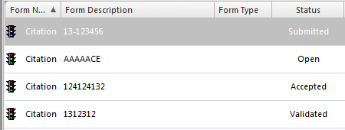
Automated Submission to Clerk of Court
Once a citation is “Accepted”, it will be “Submitted” to your clerk automatically
Below is how all of this looks in the Forms Manager
Any infraction requiring a court appearance will have “mailed” as a status

Slide 53
Edit Forms After Closing
If you shut down a form and reopen it, you must click on the Edit Form button
An officer or supervisor can edit a form by pressing the Edit Form when it is in any of the following statuses
Open
Validated
Accepted
Rejected

Slide 54
Printing

Slide 55
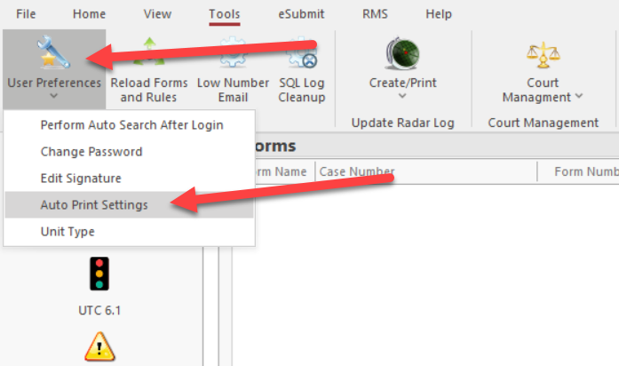
Auto-Print Features
If you want to turn this feature on or off, you can go to the Tools tab
Select User Preferences
Select Auto-Print Settings

Slide 56
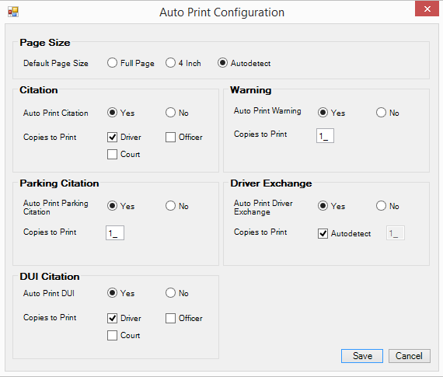
Auto-Print Features
There are many options available for default numbers of copies, which reports to print, and default page size for printers (i.e., full page vs. 4-inch)

Slide 57
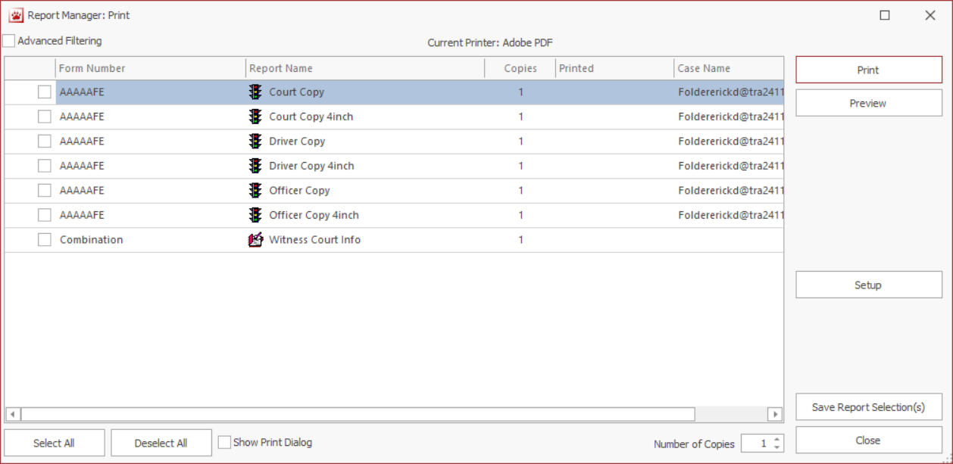
Print a UTC
The print button (control + P) will give you different report options to print
Check the report you want to print

Slide 58
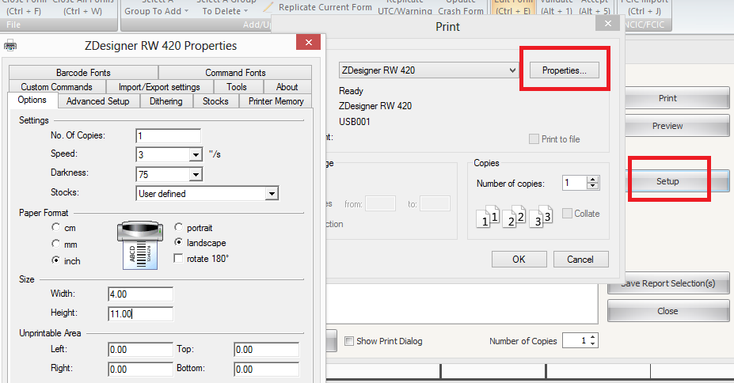
Printer settings
Press setup to pick a printer
Press properties to modify the settings through TraCS if needed

Slide 59
Printers
For assistance with getting a printer set up click here

Slide 60
Voiding Citations

Slide 61
Voiding Citations
Once you open a ticket and begin typing a citizen’s information, it is recommended you either ISSUE the citation or VOID the citation. Do NOT type over the citizen’s data to issue to a different person.
Per the DHSMV, if an officer needs to void a citation, all copies must be in the officer’s possession and marked VOID with a brief explanation and the officer’s initials. Only the arresting officer may void the citation. Forward a copy to DHSMV (Mail Stop 93) for accountability. A citation CANNOT be voided once it is issued to an alleged violator. Remember, it is unlawful and official misconduct for an officer to dispose of a citation other than as required by 316.650 Florida Statutes.

Slide 62
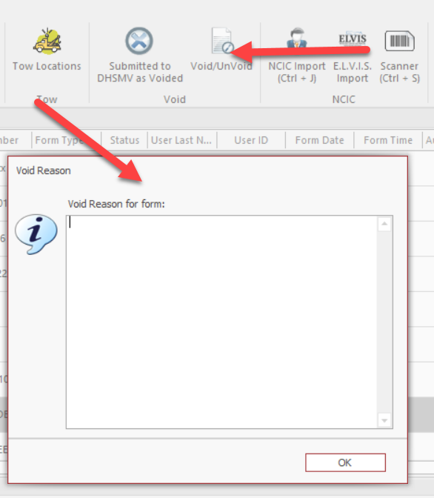
Voiding Citations
Officers can VOID a citation and the form will move to a VOIDED status
The VOID button is under the ACTIONS tab
Officers should type in a memo when prompted

Slide 63
Voiding Citations - Supervisors
Supervisors can ACCEPT a voided citation and the form will move to a ACCEPTED VOIDED status
They can press ACCEPT in the forms manager and when the form is open in the viewer

Slide 64
Voiding Citations - Records
Records can print the voided citation and mail it to DHSMV and then push the SUBMITTED TO DHSMV AS VOIDED button to move the form to a SUBMITTED AS VOIDED status
The Court Copy will have the void reason (memo typed in by officer), who voided it, who accepted the void, and when these actions occurred.

Slide 65
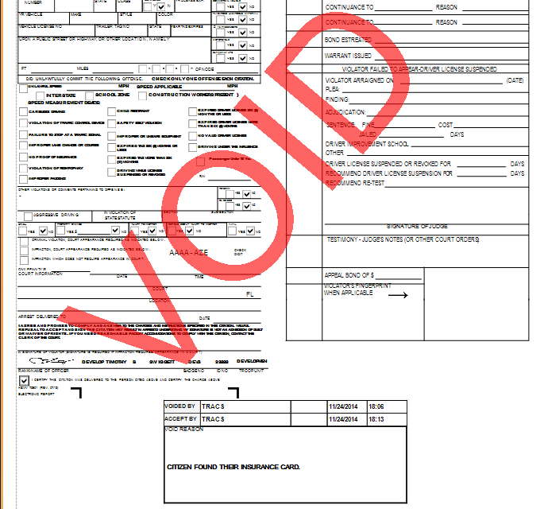
Voiding Citations - Records
Here is what the report looks like

Slide 66
Un-Voiding Citations
If an officer accidently presses VOID, Supervisors can press UNVOID

Slide 67
Searching for Forms in the Forms Manager

Slide 68
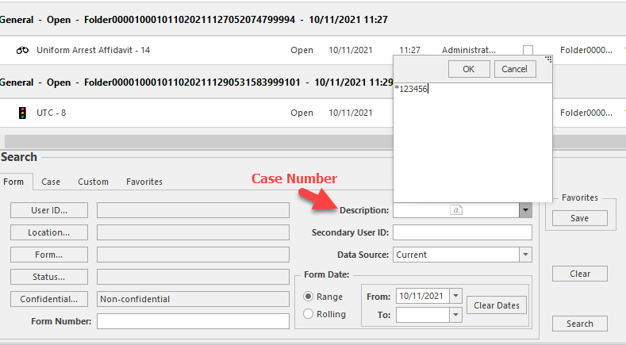
Searching for Forms
The Citation number can be found on the General Search tab and the field is called Form Number
Under the Form tab you can search by person name, agency case number, and more
Use the % or the * symbol to search for partial case number or a key word in a narrative (example: 12-1234 could be searched by %1234 or by *1234)

Slide 69
Additional Tips

Slide 70
What Does Each Status?
Open – The user is still working on the form
Validated – The user is done working on the form and the form is ready to be “accepted”
Accepted – The form has been approved and is ready to go to the State
Rejected – The form was rejected and needs to be evaluated for errors
The user should receive an explanation email with the errors from the rejector
Submitted – The form has been submitted electronically to the clerk’s office
Submitted reports are “locked” to prevent further editing.

Slide 71
Moving Forms Through the Process
Under no exceptions, the following buttons must be pushed:
Officers MUST press the validate button when they are done
Supervisors MUST press the Accept button when they are done
The server MUST be set up properly to automatically submit accepted forms to the state
If a citation is in accepted status for more than 24 hours, there is an issue with the server and IT MUST tell TraCS they require assistance

